Slide 1
Spacing
Spacing rules compare horizontal gaps between overlapping-y shapes
learn_drc — 05 spacing checker
Notes:
Spacing rules compare horizontal gaps between overlapping-y shapes.

Slide 2
The idea
GOLDEN: space=1 A–B, rule S.M1
learn_drc — 05 spacing checker
Notes:
GOLDEN: space=1 A–B, rule S.M1.

Slide 3
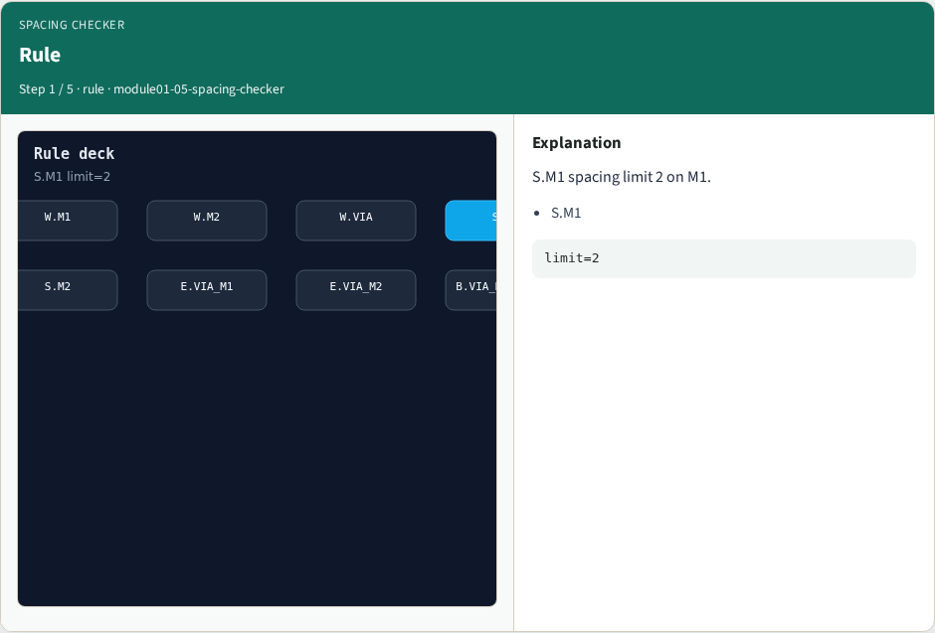
Rule
Rule
learn_drc — 05 spacing checker
Notes:
S.M1 spacing limit 2 on M1.

Slide 4
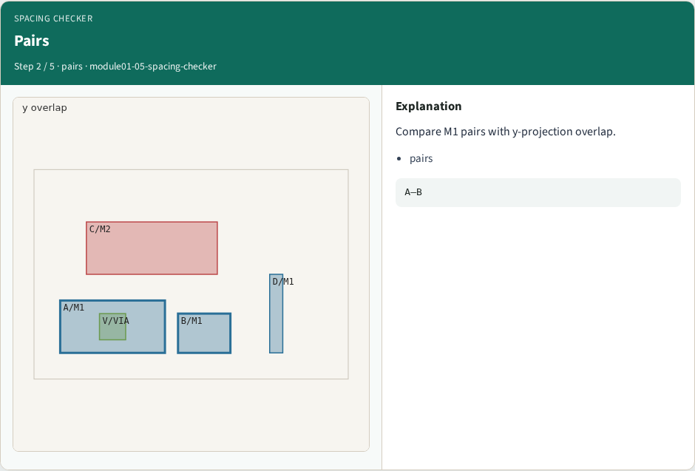
Pairs
Pairs
learn_drc — 05 spacing checker
Notes:
Compare M1 pairs with y-projection overlap.

Slide 5
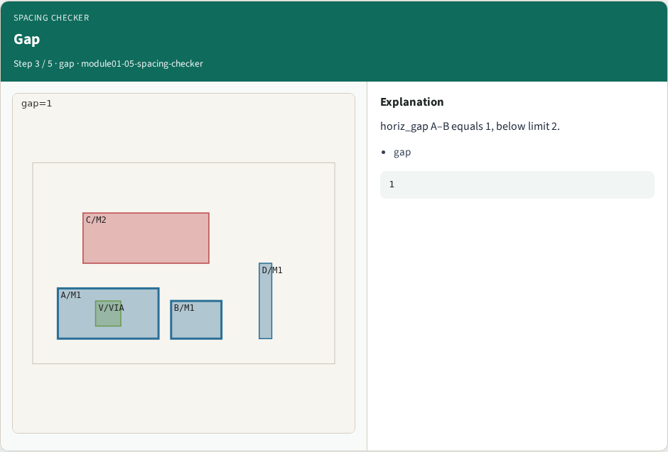
Gap
Gap
learn_drc — 05 spacing checker
Notes:
horiz_gap A–B equals 1, below limit 2.

Slide 6

Hit
Hit
learn_drc — 05 spacing checker
Notes:
Shapes A and B violate S.M1.

Slide 7

Golden
Golden
learn_drc — 05 spacing checker
Notes:
GOLDEN: space=1 A–B, rule S.M1.

Slide 8
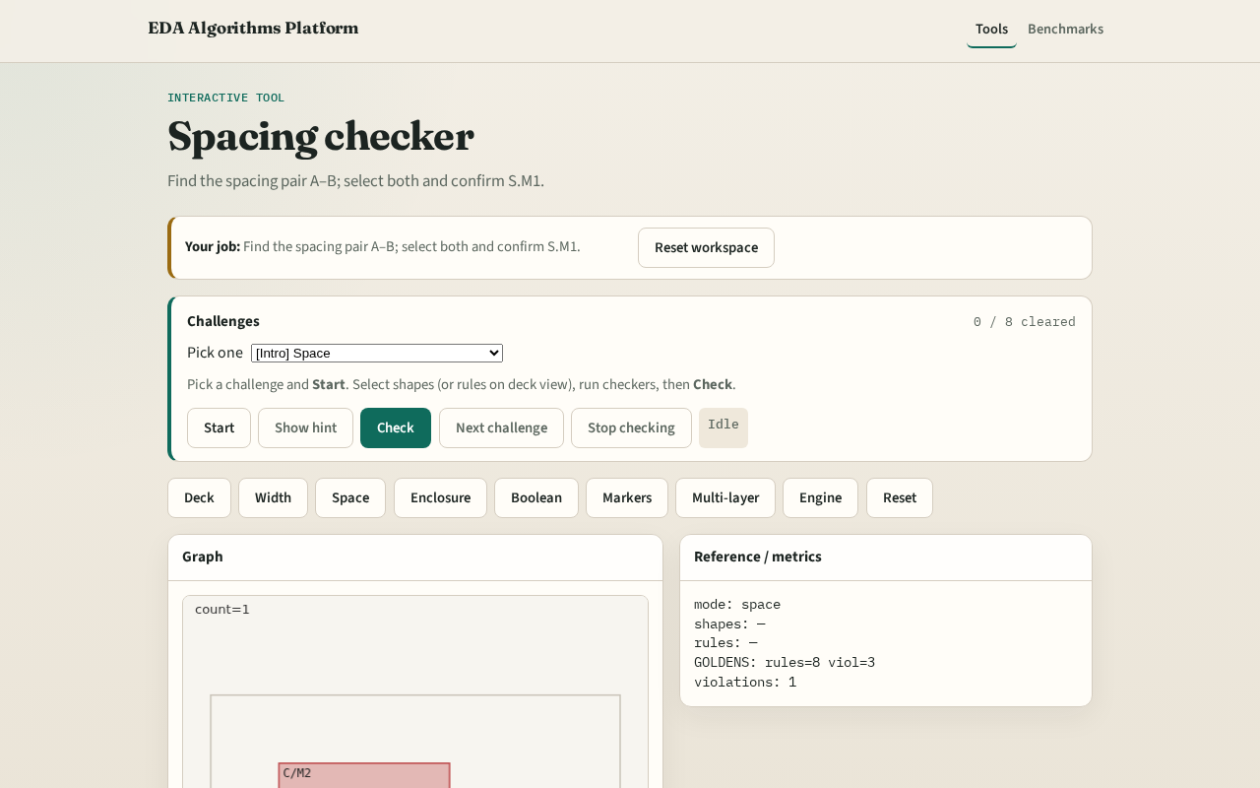
Browser lab track
Browser lab starter
learn_drc — 05 spacing checker
Notes:
Open **spacing-checker**. Select A and B; run spacing check.

Slide 9
Implement track
Call check_spacing(); assert count==1 and set(shapes)=={'A','B'}
learn_drc — 05 spacing checker
Notes:
Call check_spacing(); assert count==1 and set(shapes)=={'A','B'}.

Slide 10
Pitfalls
Measuring vertical gap when shapes are side-by-side
Ignoring y overlap requirement
learn_drc — 05 spacing checker
Notes:
Measuring vertical gap when shapes are side-by-side. Ignoring y overlap requirement.

Slide 11
Your turn
Next: enclosure checker
learn_drc — 05 spacing checker
Notes:
Next: enclosure checker.

