Slide 1
Enclosure
Enclosure rules require VIA (inner) to sit inside metal (outer) by a margin
learn_drc — 01 enclosure checker
Notes:
Enclosure rules require VIA (inner) to sit inside metal (outer) by a margin.

Slide 2
The idea
GOLDEN: enc=1 V vs M2, E.VIA_M2
learn_drc — 01 enclosure checker
Notes:
GOLDEN: enc=1 V vs M2, E.VIA_M2.

Slide 3
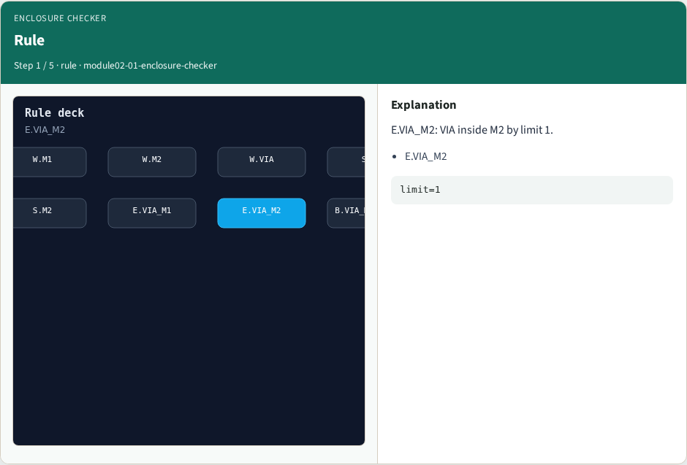
Rule
Rule
learn_drc — 01 enclosure checker
Notes:
E.VIA_M2: VIA inside M2 by limit 1.

Slide 4
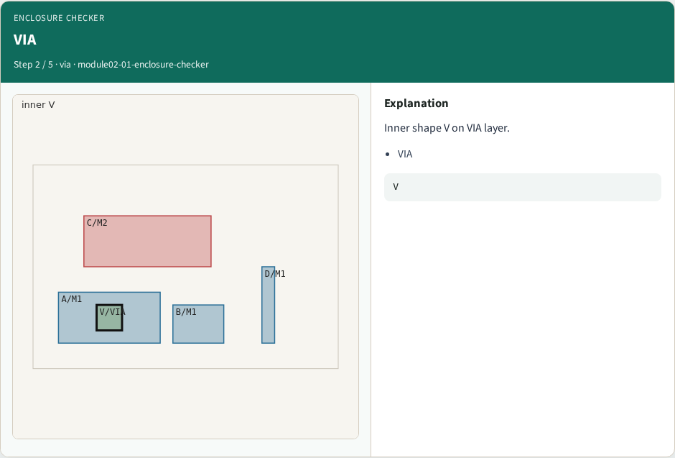
VIA
VIA
learn_drc — 01 enclosure checker
Notes:
Inner shape V on VIA layer.

Slide 5
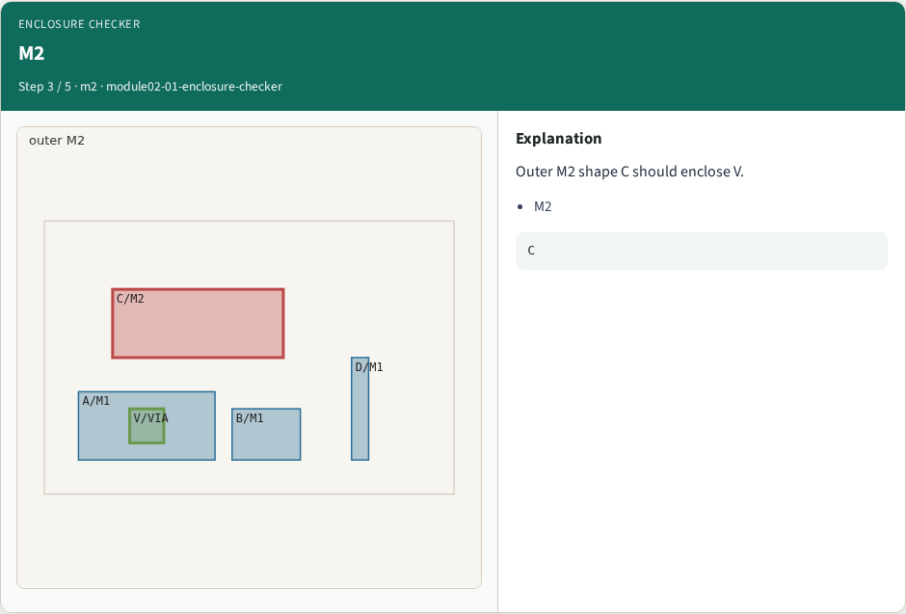
M2
M2
learn_drc — 01 enclosure checker
Notes:
Outer M2 shape C should enclose V.

Slide 6

Margin
Margin
learn_drc — 01 enclosure checker
Notes:
V is not enclosed by M2 — violation.

Slide 7

Golden
Golden
learn_drc — 01 enclosure checker
Notes:
GOLDEN: enc=1 V vs M2, E.VIA_M2.

Slide 8
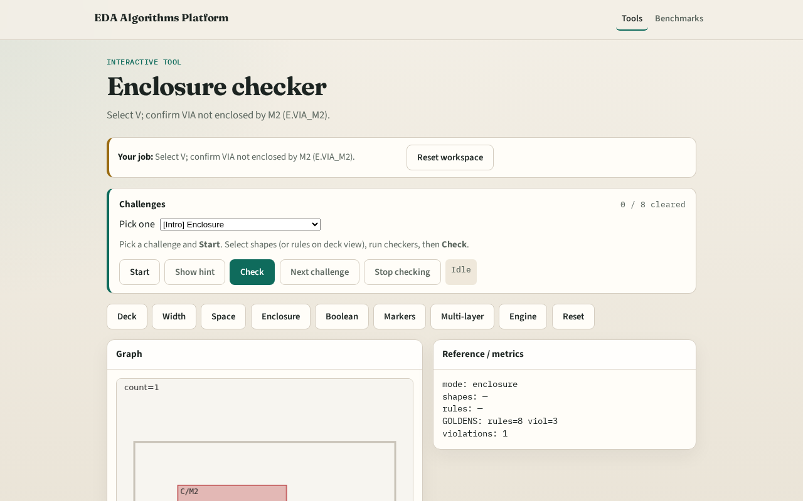
Browser lab track
Browser lab starter
learn_drc — 01 enclosure checker
Notes:
Open **enclosure-checker**. Select V; run enclosure check.

Slide 9
Implement track
Call check_enclosure(); assert count==1 and inner=='V'
learn_drc — 01 enclosure checker
Notes:
Call check_enclosure(); assert count==1 and inner=='V'.

Slide 10
Pitfalls
Checking M1 enclosure when M2 is the failing outer
Using overlap instead of contains
learn_drc — 01 enclosure checker
Notes:
Checking M1 enclosure when M2 is the failing outer. Using overlap instead of contains.

Slide 11
Your turn
Next: collect violation markers
learn_drc — 01 enclosure checker
Notes:
Next: collect violation markers.

