Slide 1
Violations
Signoff DRC emits markers , one record per geometry violation with rule_id
learn_drc — 03 violation markers
Notes:
Signoff DRC emits markers — one record per geometry violation with rule_id.

Slide 2
The idea
GOLDEN: violation_count=3 with rule_id
learn_drc — 03 violation markers
Notes:
GOLDEN: violation_count=3 with rule_id.

Slide 3
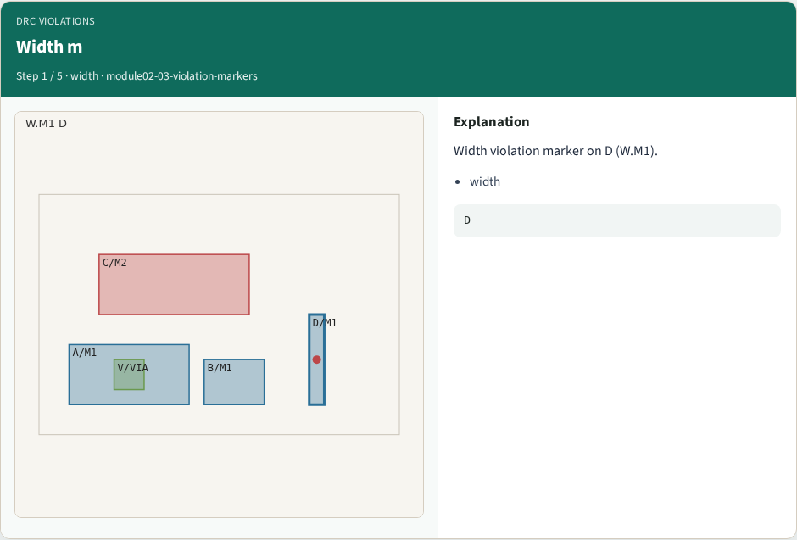
Width m
Width m
learn_drc — 03 violation markers
Notes:
Width violation marker on D (W.M1).

Slide 4
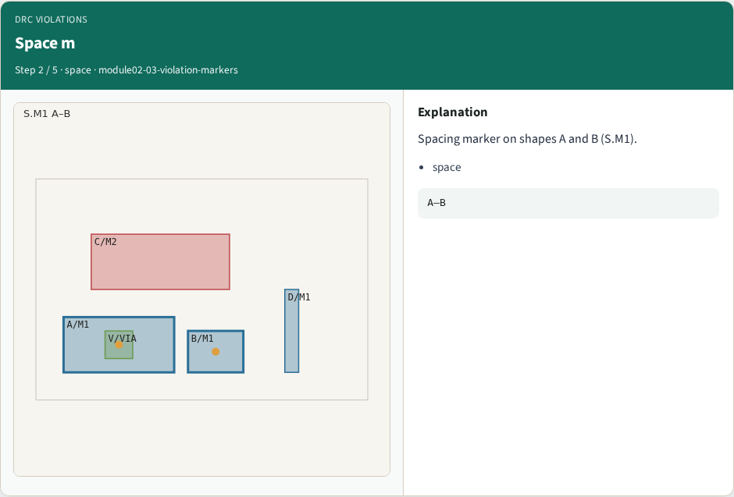
Space m
Space m
learn_drc — 03 violation markers
Notes:
Spacing marker on shapes A and B (S.M1).

Slide 5
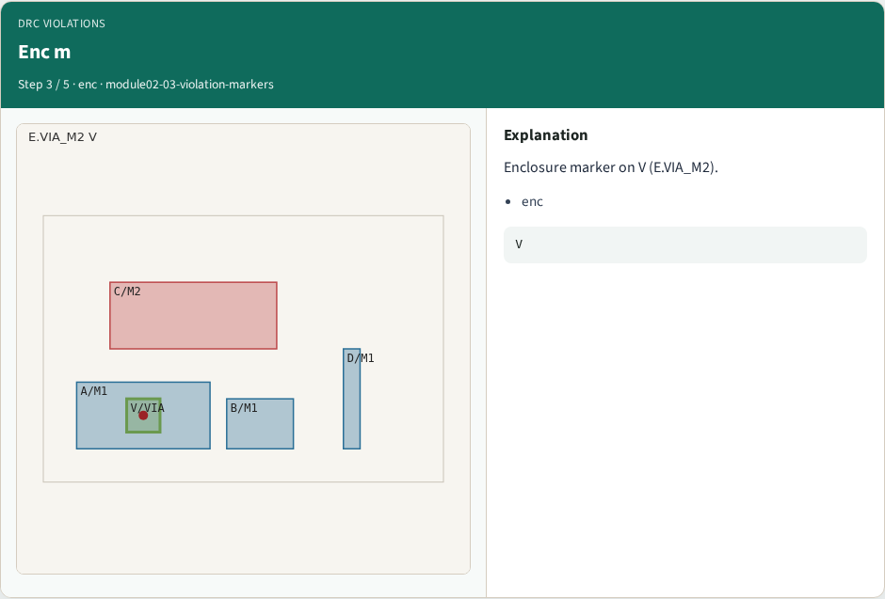
Enc m
Enc m
learn_drc — 03 violation markers
Notes:
Enclosure marker on V (E.VIA_M2).

Slide 6

Rule id
Rule id
learn_drc — 03 violation markers
Notes:
Each violation carries a rule_id field.

Slide 7

Golden
Golden
learn_drc — 03 violation markers
Notes:
GOLDEN: violation_count=3 with rule_id.

Slide 8
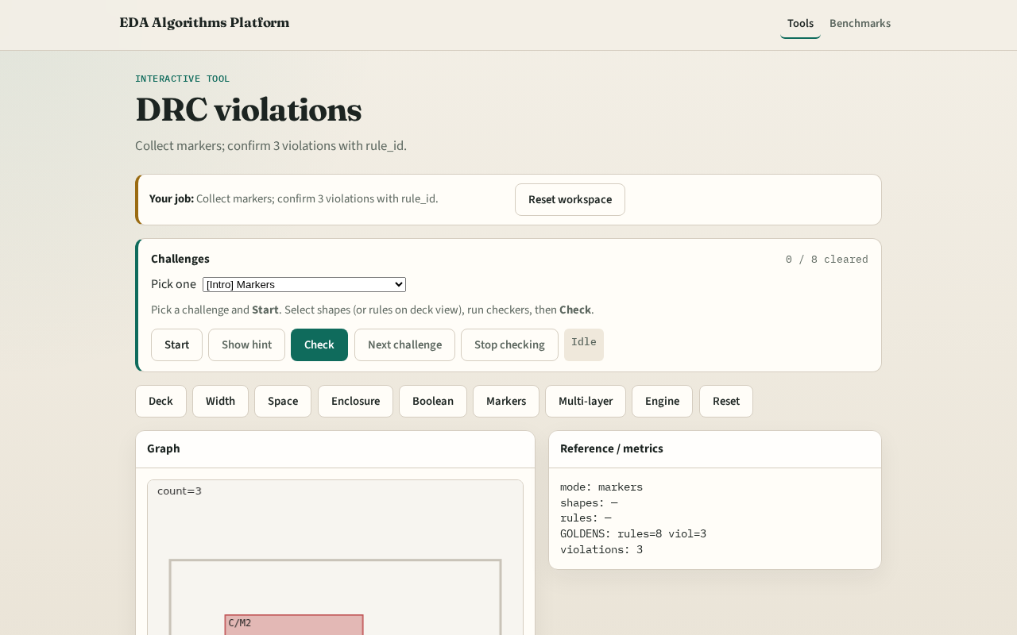
Browser lab track
Browser lab starter
learn_drc — 03 violation markers
Notes:
Open **violation-markers**. Run collect; confirm 3 violations.

Slide 9
Implement track
Call collect_violations(); assert count==3 and all have rule_id
learn_drc — 03 violation markers
Notes:
Call collect_violations(); assert count==3 and all have rule_id.

Slide 10
Pitfalls
Double-counting boolean hits as geometry violations
Missing rule_id field
learn_drc — 03 violation markers
Notes:
Double-counting boolean hits as geometry violations. Missing rule_id field.

Slide 11
Your turn
Next: multi-layer deck rules
learn_drc — 03 violation markers
Notes:
Next: multi-layer deck rules.

