Slide 1
Multi-layer
Real decks span layers , enclosure and boolean tie VIA to M1/M2
learn_drc — 01 multi layer deck
Notes:
Real decks span layers — enclosure and boolean tie VIA to M1/M2.

Slide 2
The idea
GOLDEN: 2 enclosure rules; fires E.VIA_M2
learn_drc — 01 multi layer deck
Notes:
GOLDEN: 2 enclosure rules; fires E.VIA_M2.

Slide 3
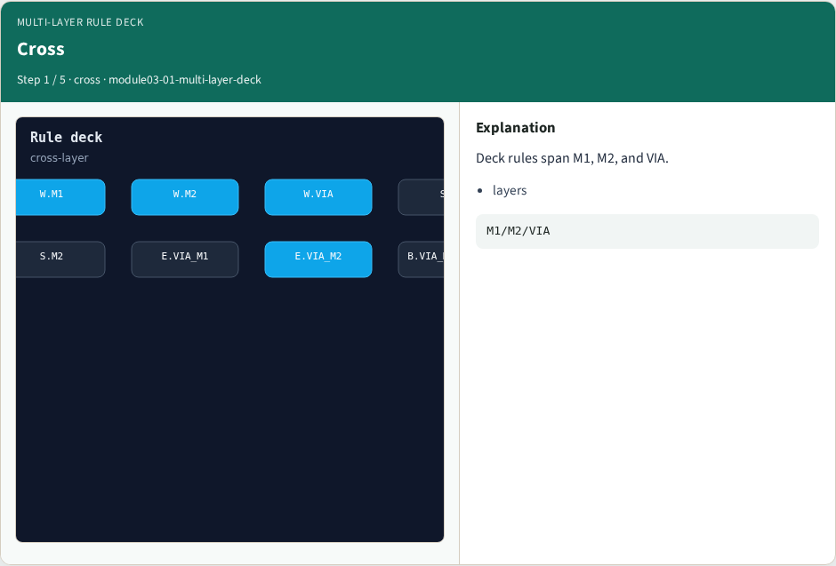
Cross
Cross
learn_drc — 01 multi layer deck
Notes:
Deck rules span M1, M2, and VIA.

Slide 4
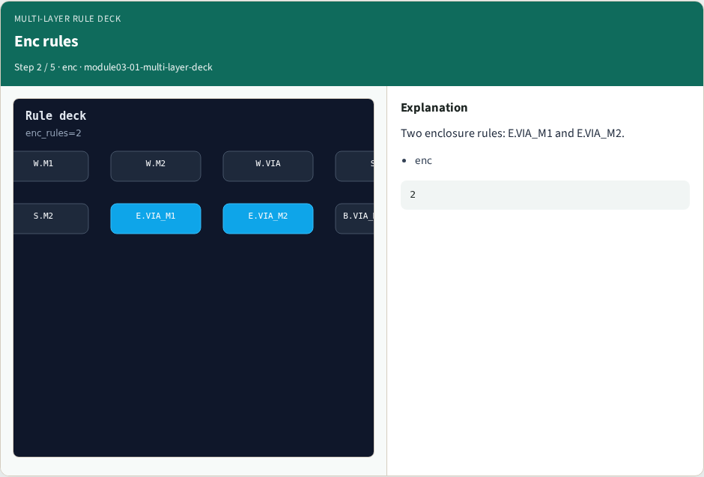
Enc rules
Enc rules
learn_drc — 01 multi layer deck
Notes:
Two enclosure rules: E.VIA_M1 and E.VIA_M2.

Slide 5
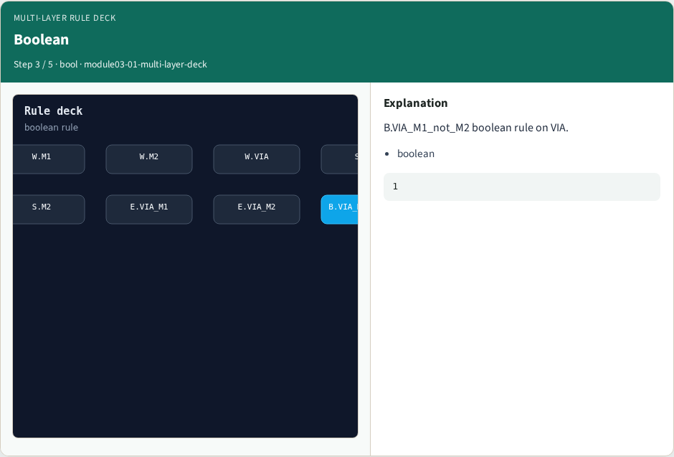
Boolean
Boolean
learn_drc — 01 multi layer deck
Notes:
B.VIA_M1_not_M2 boolean rule on VIA.

Slide 6
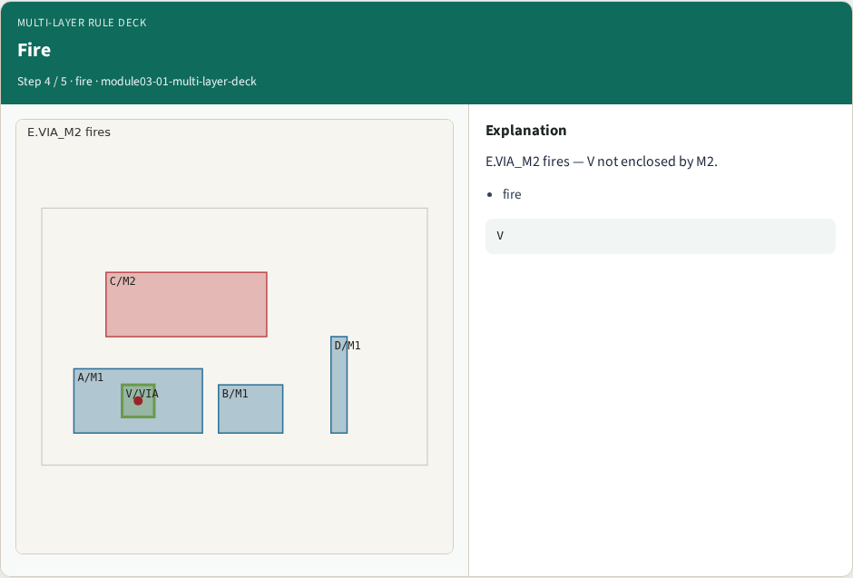
Fire
Fire
learn_drc — 01 multi layer deck
Notes:
E.VIA_M2 fires — V not enclosed by M2.

Slide 7

Golden
Golden
learn_drc — 01 multi layer deck
Notes:
GOLDEN: 2 enclosure rules; fires E.VIA_M2.

Slide 8
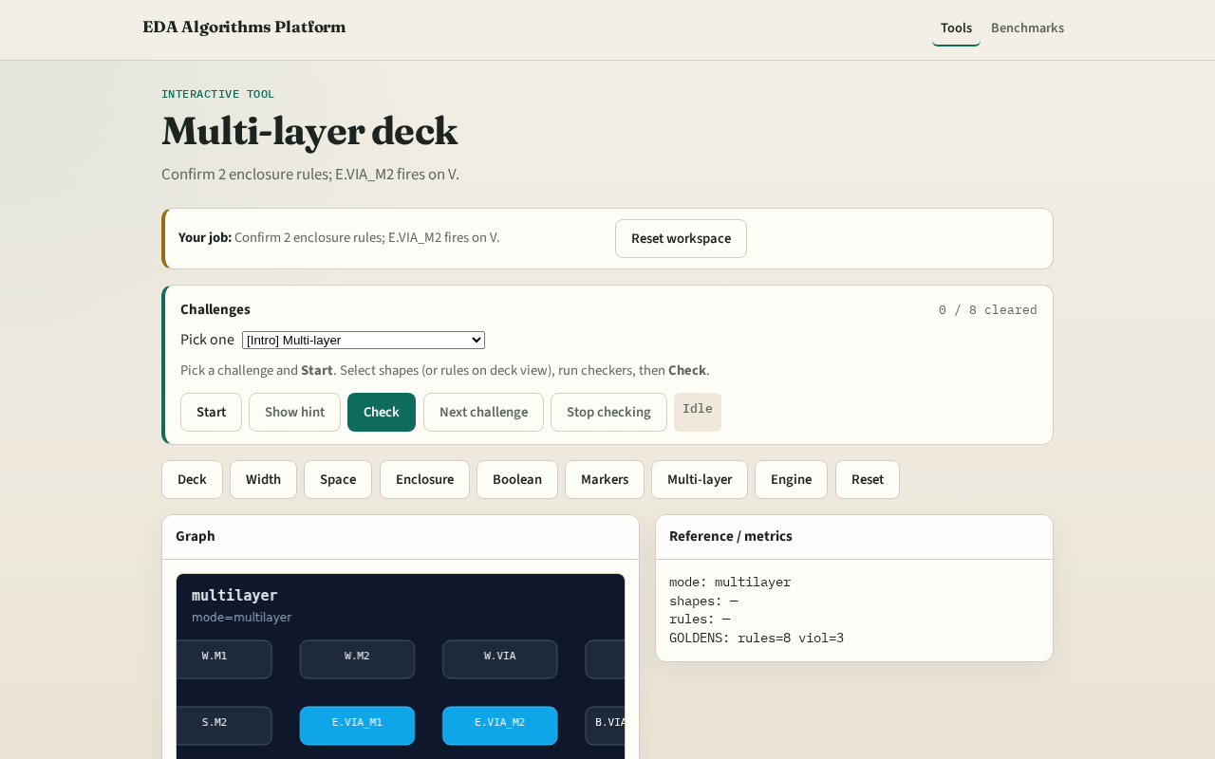
Browser lab track
Browser lab starter
learn_drc — 01 multi layer deck
Notes:
Open **multi-layer-deck**. Run multi-layer view; confirm E.VIA_M2 fires.

Slide 9
Implement track
Call multi_layer_rules(); assert enclosure_count==2 and fires count==1
learn_drc — 01 multi layer deck
Notes:
Call multi_layer_rules(); assert enclosure_count==2 and fires count==1.

Slide 10
Pitfalls
Counting width rules as cross-layer
Ignoring boolean deck entries
learn_drc — 01 multi layer deck
Notes:
Counting width rules as cross-layer. Ignoring boolean deck entries.

Slide 11
Your turn
Next: deck boolean rules
learn_drc — 01 multi layer deck
Notes:
Next: deck boolean rules.

