Slide 1
Boolean
Boolean deck rules express layer interactions , VIA covered by M1 and not M2
learn_drc — 03 deck boolean
Notes:
Boolean deck rules express layer interactions — VIA covered by M1 and not M2.

Slide 2
The idea
GOLDEN: boolean hit=1 on V
learn_drc — 03 deck boolean
Notes:
GOLDEN: boolean hit=1 on V.

Slide 3
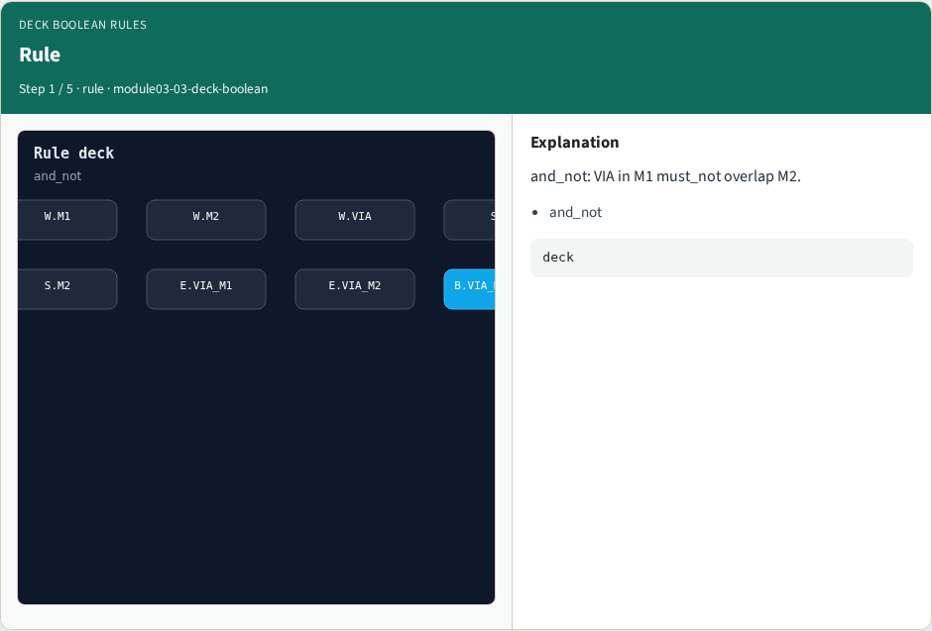
Rule
Rule
learn_drc — 03 deck boolean
Notes:
and_not: VIA in M1 must_not overlap M2.

Slide 4
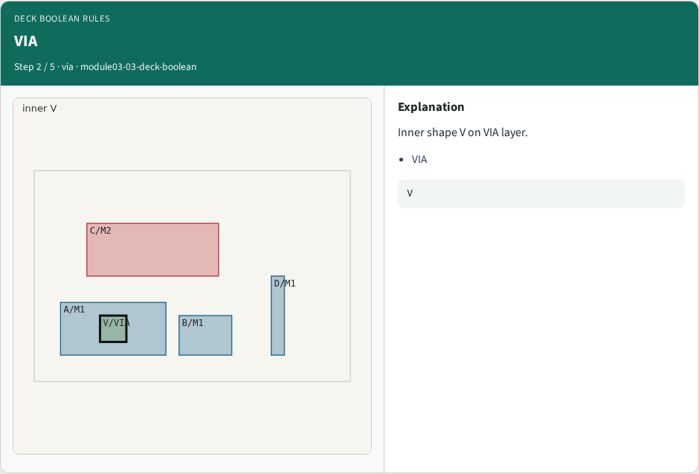
VIA
VIA
learn_drc — 03 deck boolean
Notes:
Inner shape V on VIA layer.

Slide 5
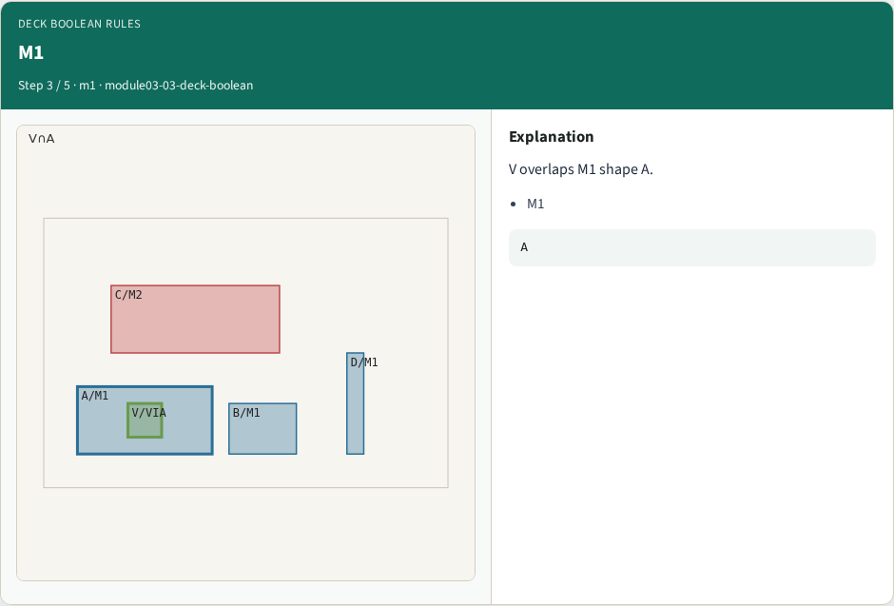
M1
M1
learn_drc — 03 deck boolean
Notes:
V overlaps M1 shape A.

Slide 6
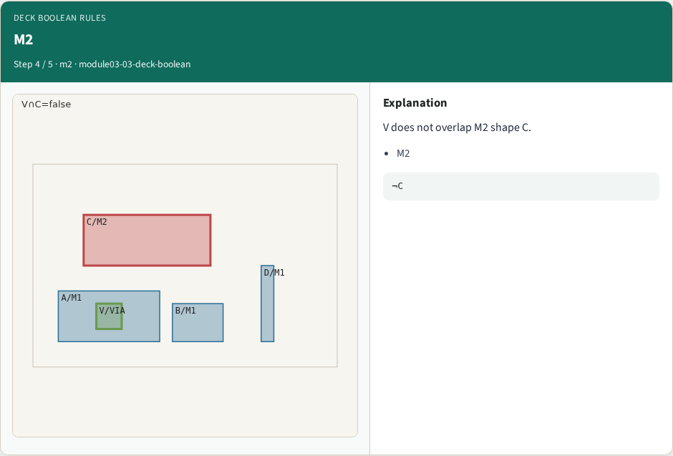
M2
M2
learn_drc — 03 deck boolean
Notes:
V does not overlap M2 shape C.

Slide 7

Golden
Golden
learn_drc — 03 deck boolean
Notes:
GOLDEN: boolean hit=1 on V.

Slide 8
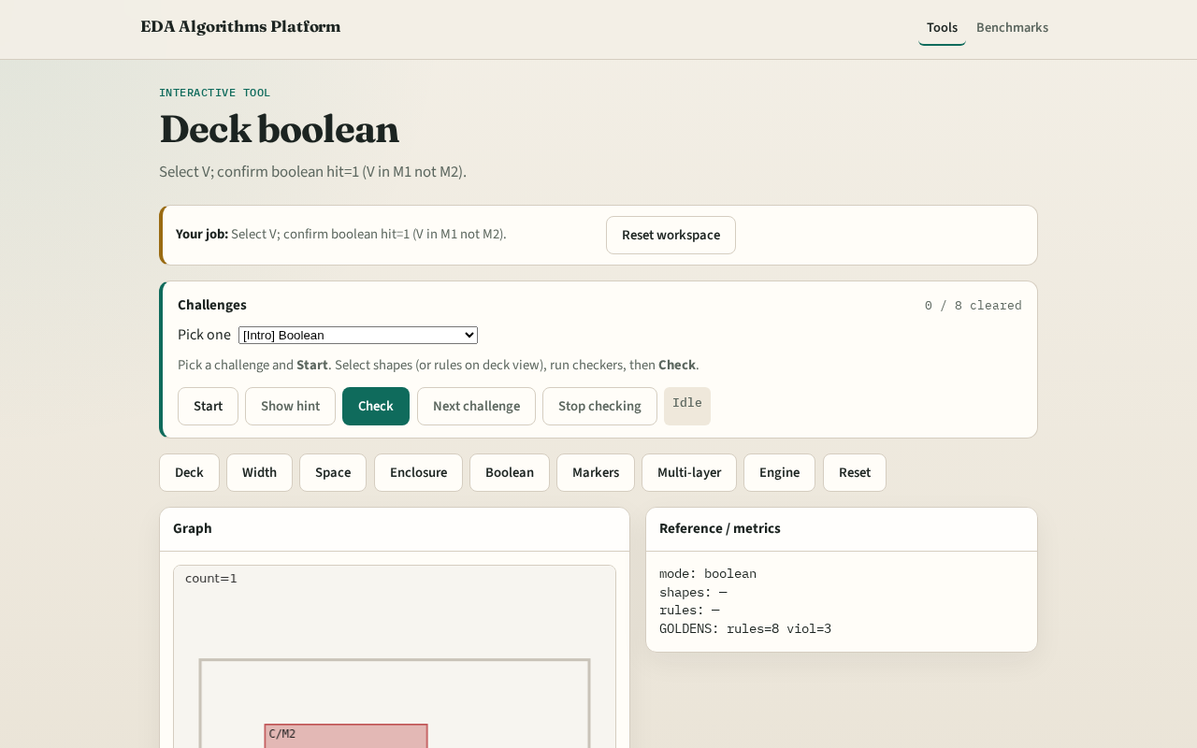
Browser lab track
Browser lab starter
learn_drc — 03 deck boolean
Notes:
Open **deck-boolean**. Select V; run boolean check.

Slide 9
Implement track
Call check_boolean(); assert count==1 and hits[0].shapes==['V']
learn_drc — 03 deck boolean
Notes:
Call check_boolean(); assert count==1 and hits[0].shapes==['V'].

Slide 10
Pitfalls
Treating enclosure failures as boolean hits
Requiring full containment for overlap
learn_drc — 03 deck boolean
Notes:
Treating enclosure failures as boolean hits. Requiring full containment for overlap.

Slide 11
Your turn
Next: DRC engine integration
learn_drc — 03 deck boolean
Notes:
Next: DRC engine integration.

