Slide 1
Engine
A tiny engine chains every checker and reports ok when goldens match
learn_drc — 01 drc engine
Notes:
A tiny engine chains every checker and reports ok when goldens match.

Slide 2
The idea
GOLDEN: ok=True viol=3
learn_drc — 01 drc engine
Notes:
GOLDEN: ok=True viol=3.

Slide 3
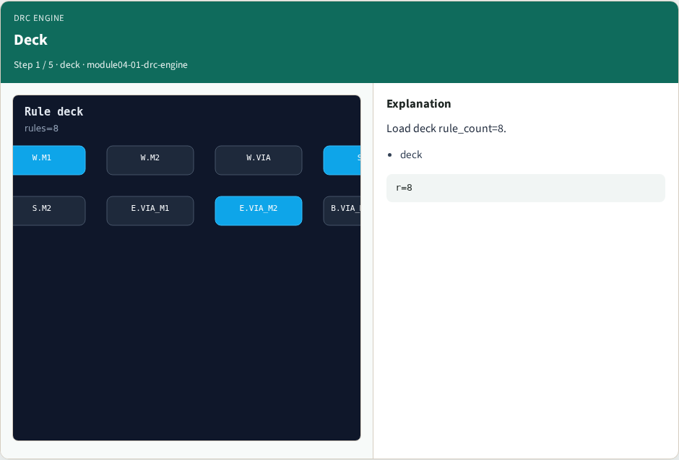
Deck
Deck
learn_drc — 01 drc engine
Notes:
Load deck rule_count=8.

Slide 4

Checks
Checks
learn_drc — 01 drc engine
Notes:
Run width, space, and enclosure checkers.

Slide 5
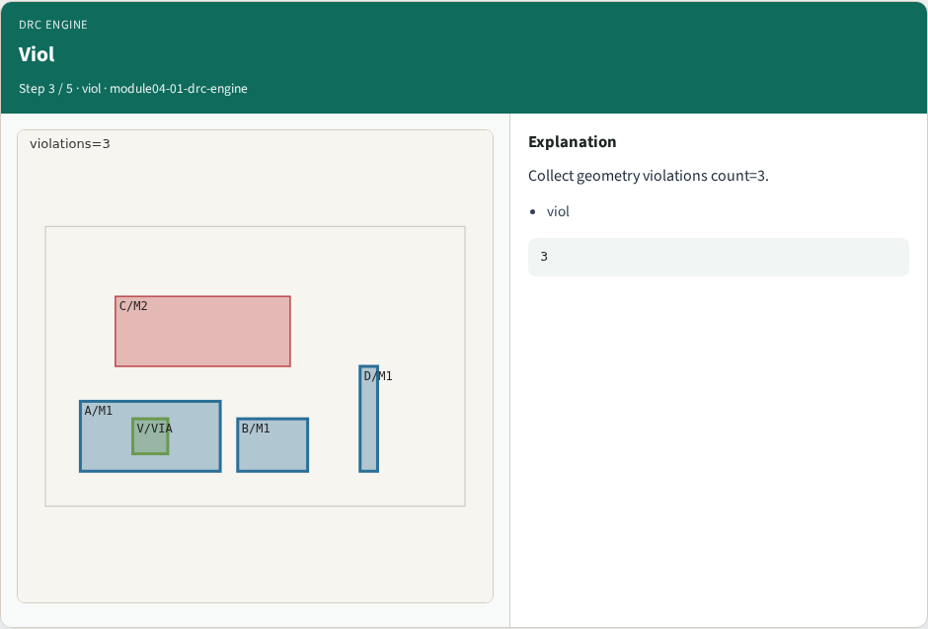
Viol
Viol
learn_drc — 01 drc engine
Notes:
Collect geometry violations count=3.

Slide 6
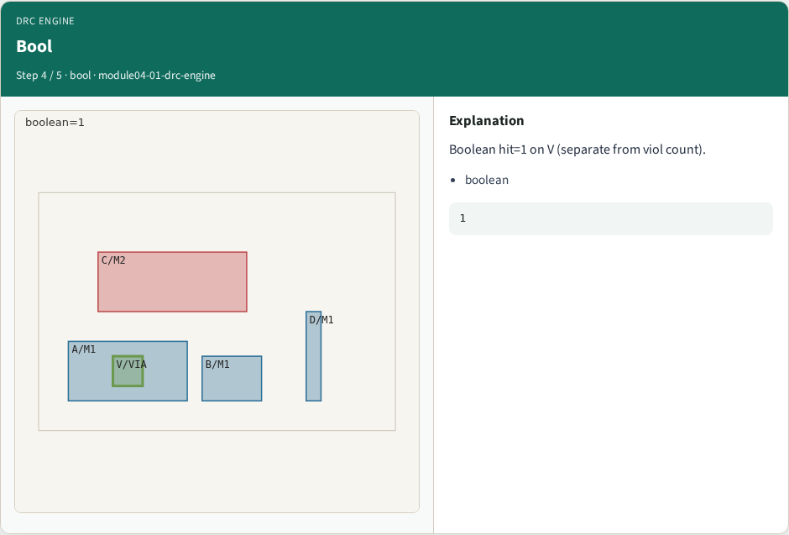
Bool
Bool
learn_drc — 01 drc engine
Notes:
Boolean hit=1 on V (separate from viol count).

Slide 7

OK
OK
learn_drc — 01 drc engine
Notes:
GOLDEN: ok=True viol=3.

Slide 8
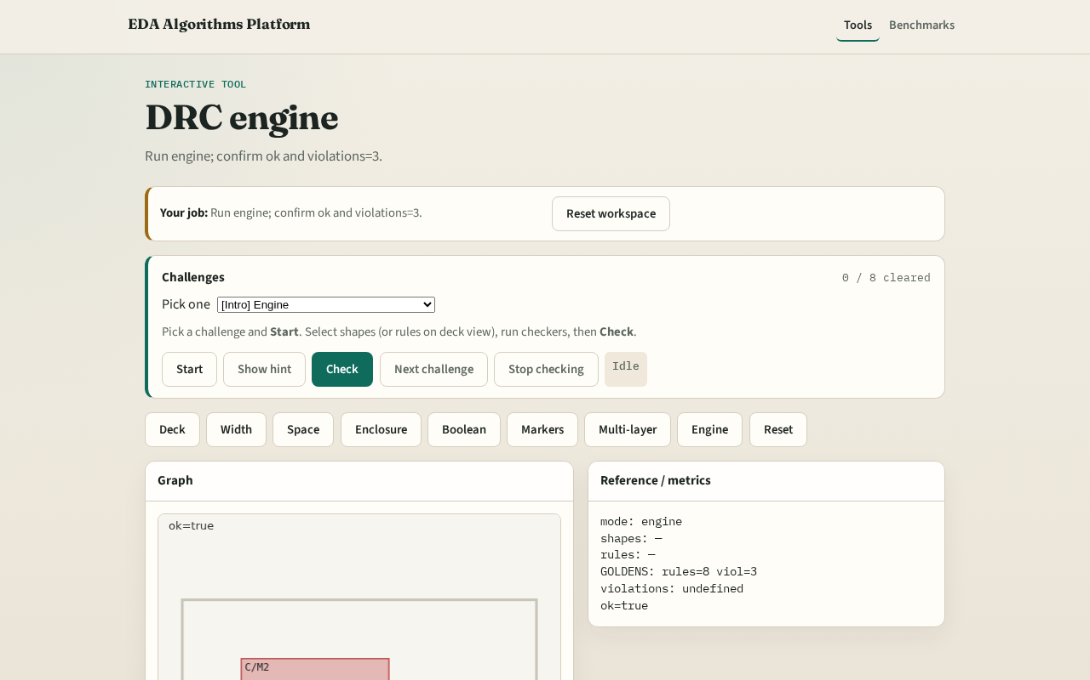
Browser lab track
Browser lab starter
learn_drc — 01 drc engine
Notes:
Open **drc-engine**. Run engine; confirm ok.

Slide 9
Implement track
Call drc_engine(); assert ok and violations.count==3
learn_drc — 01 drc engine
Notes:
Call drc_engine(); assert ok and violations.count==3.

Slide 10
Pitfalls
Reporting partial checks
Changing the toy without updating goldens
learn_drc — 01 drc engine
Notes:
Reporting partial checks. Changing the toy without updating goldens.

Slide 11
Your turn
Next: offline compare, then wrap
learn_drc — 01 drc engine
Notes:
Next: offline compare, then wrap.

