Slide 1
Schematic graph
LVS starts from the schematic , devices, nets, and pin edges before layout extract
learn_lvs — 01 schematic graph
Notes:
LVS starts from the schematic — devices, nets, and pin edges before layout extract.

Slide 2
The idea
GOLDEN: 2 devices, 4 nets, mn1/mp1
learn_lvs — 01 schematic graph
Notes:
GOLDEN: 2 devices, 4 nets, mn1/mp1.

Slide 3
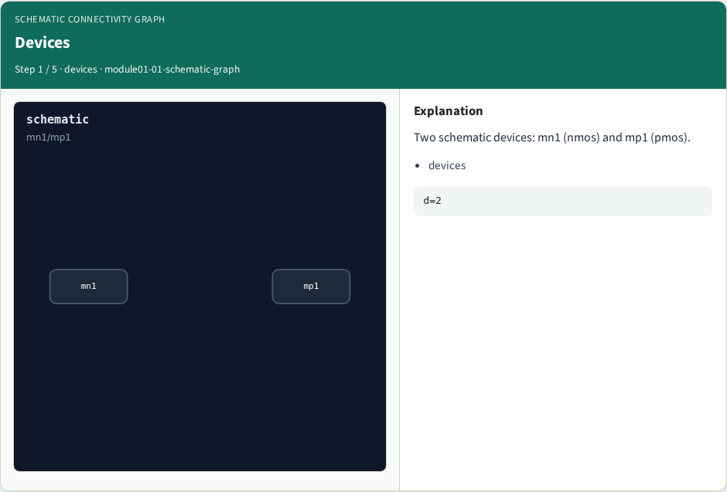
Devices
Devices
learn_lvs — 01 schematic graph
Notes:
Two schematic devices: mn1 (nmos) and mp1 (pmos).

Slide 4
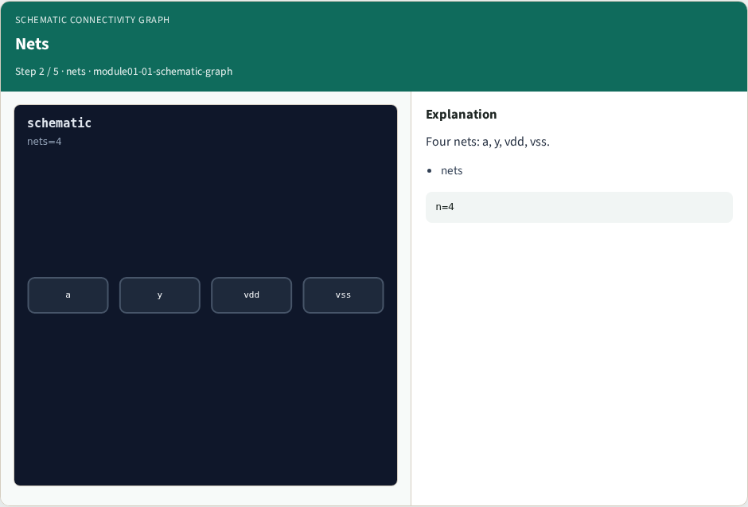
Nets
Nets
learn_lvs — 01 schematic graph
Notes:
Four nets: a, y, vdd, vss.

Slide 5

Pins
Pins
learn_lvs — 01 schematic graph
Notes:
Each device pin attaches to a net (G/D/S).

Slide 6
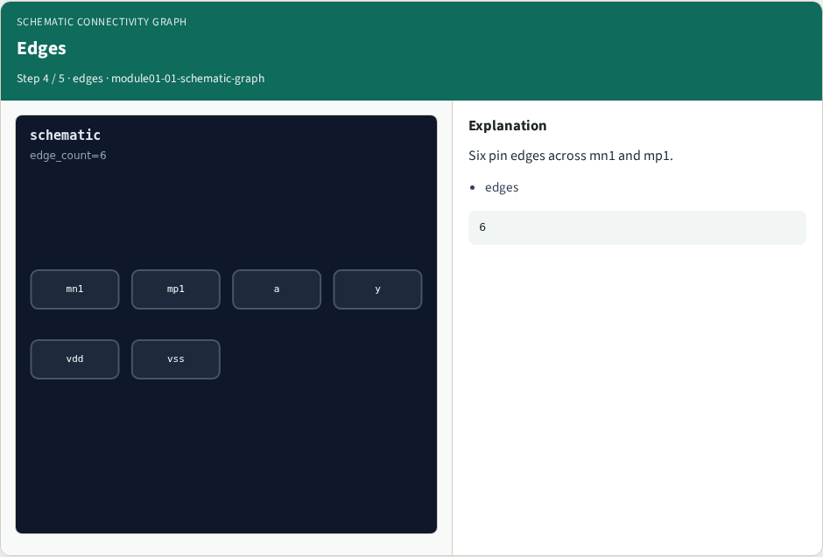
Edges
Edges
learn_lvs — 01 schematic graph
Notes:
Six pin edges across mn1 and mp1.

Slide 7

Golden
Golden
learn_lvs — 01 schematic graph
Notes:
GOLDEN: device_count=2, net_count=4.

Slide 8
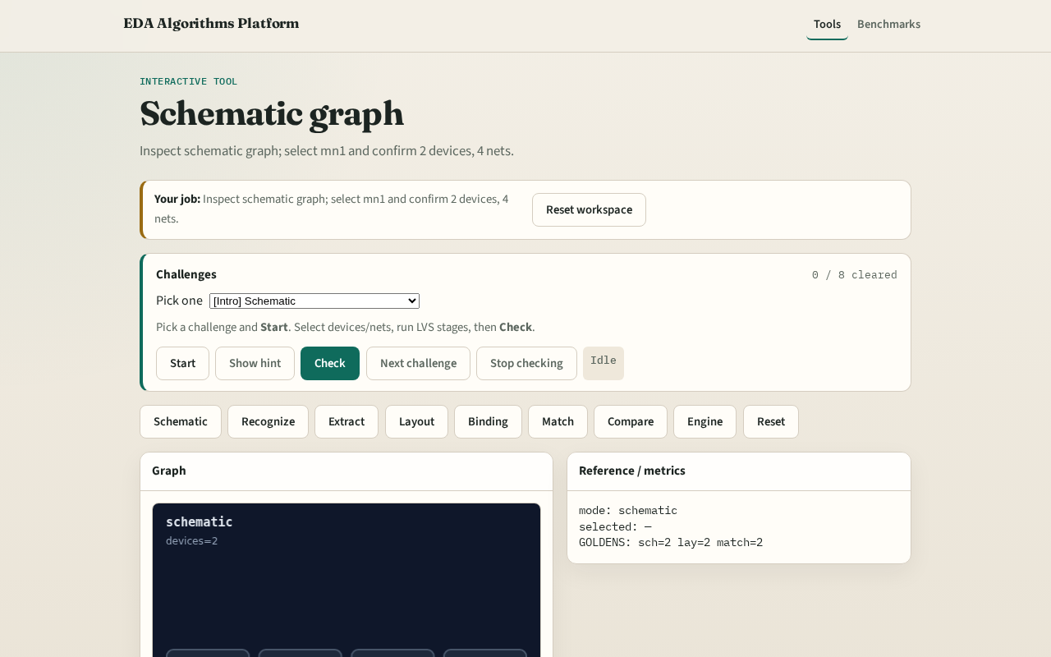
Browser lab track
Browser lab starter
learn_lvs — 01 schematic graph
Notes:
Open **schematic-graph**. Inspect tiny_lvs; confirm mn1/mp1 and 4 nets.

Slide 9
Implement track
Call schematic_graph(); assert device_count==2 and net_count==4
learn_lvs — 01 schematic graph
Notes:
Call schematic_graph(); assert device_count==2 and net_count==4.

Slide 10
Pitfalls
Counting layout shapes as schematic devices
Missing supply nets
learn_lvs — 01 schematic graph
Notes:
Counting layout shapes as schematic devices. Missing supply nets.

Slide 11
Your turn
Next: device recognition
learn_lvs — 01 schematic graph
Notes:
Next: device recognition.

