Slide 1
Device recog
Device recognition maps layout shapes to MOS instances , nmos vs pmos
learn_lvs — 03 device recog
Notes:
Device recognition maps layout shapes to MOS instances — nmos vs pmos.

Slide 2
The idea
GOLDEN: nmos=1 pmos=1 (X0/X1)
learn_lvs — 03 device recog
Notes:
GOLDEN: nmos=1 pmos=1 (X0/X1).

Slide 3
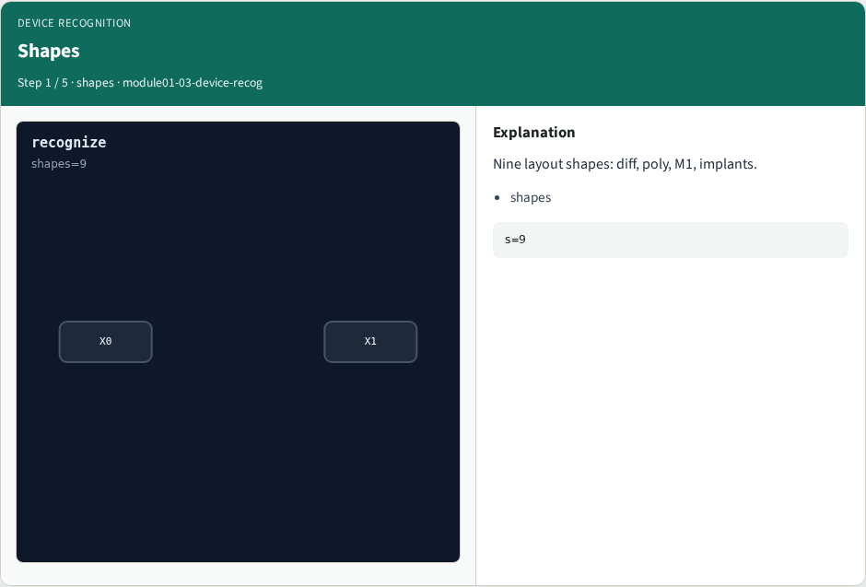
Shapes
Shapes
learn_lvs — 03 device recog
Notes:
Nine layout shapes: diff, poly, M1, implants.

Slide 4
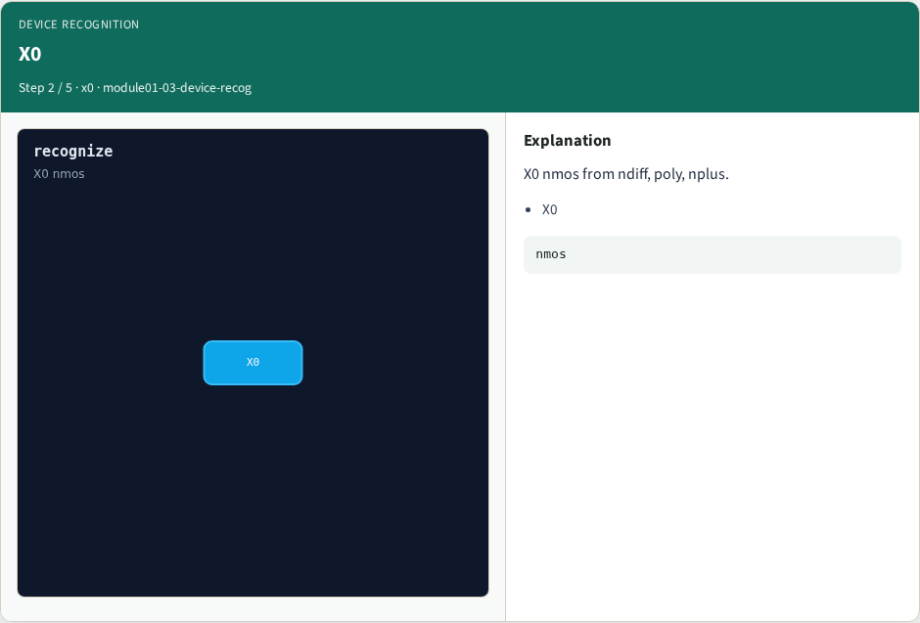
X0
X0
learn_lvs — 03 device recog
Notes:
X0 nmos from ndiff, poly, nplus.

Slide 5

X1
X1
learn_lvs — 03 device recog
Notes:
X1 pmos from pdiff, poly, pplus.

Slide 6

Types
Types
learn_lvs — 03 device recog
Notes:
Classify each layout device by type.

Slide 7

Golden
Golden
learn_lvs — 03 device recog
Notes:
GOLDEN: nmos=1, pmos=1.

Slide 8
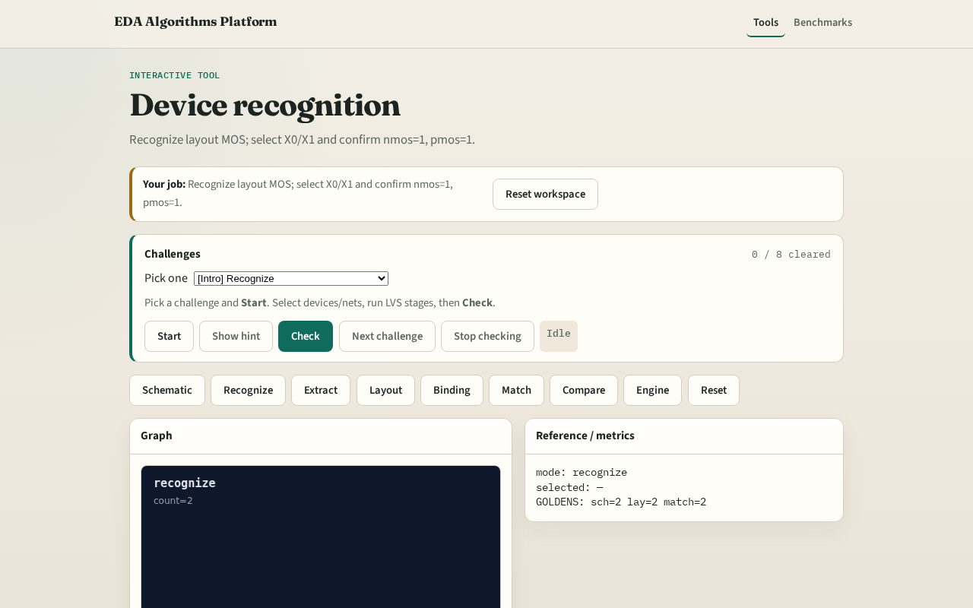
Browser lab track
Browser lab starter
learn_lvs — 03 device recog
Notes:
Open **device-recog**. Select X0 and X1; confirm nmos/pmos counts.

Slide 9
Implement track
Call recognize_devices(); assert nmos==1 and pmos==1
learn_lvs — 03 device recog
Notes:
Call recognize_devices(); assert nmos==1 and pmos==1.

Slide 10
Pitfalls
Counting shapes instead of devices
Swapping nmos/pmos polarity
learn_lvs — 03 device recog
Notes:
Counting shapes instead of devices. Swapping nmos/pmos polarity.

Slide 11
Your turn
Next: net extraction
learn_lvs — 03 device recog
Notes:
Next: net extraction.

