Slide 1
Net extract
Net extraction groups layout shapes into electrically connected nets
learn_lvs — 05 net extract
Notes:
Net extraction groups layout shapes into electrically connected nets.

Slide 2
The idea
GOLDEN: 4 layout nets net_a/y/vss/vdd
learn_lvs — 05 net extract
Notes:
GOLDEN: 4 layout nets net_a/y/vss/vdd.

Slide 3

Shapes
Shapes
learn_lvs — 05 net extract
Notes:
M1 and diffusion shapes carry connectivity.

Slide 4
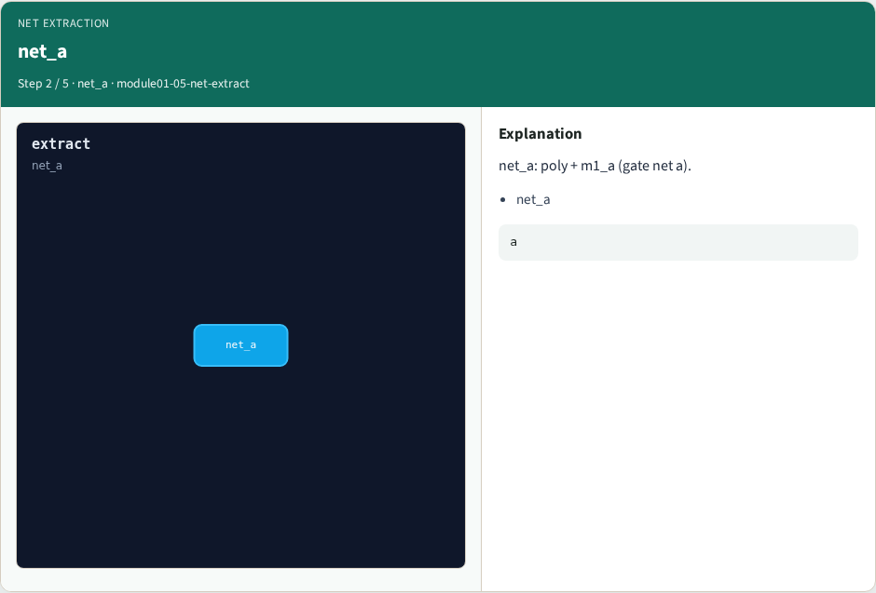
net_a
net_a
learn_lvs — 05 net extract
Notes:
net_a: poly + m1_a (gate net a).

Slide 5

net_y
net_y
learn_lvs — 05 net extract
Notes:
net_y: m1_y (output y).

Slide 6

Supplies
Supplies
learn_lvs — 05 net extract
Notes:
net_vss and net_vdd tie diff + M1.

Slide 7

Golden
Golden
learn_lvs — 05 net extract
Notes:
GOLDEN: count=4 nets.

Slide 8
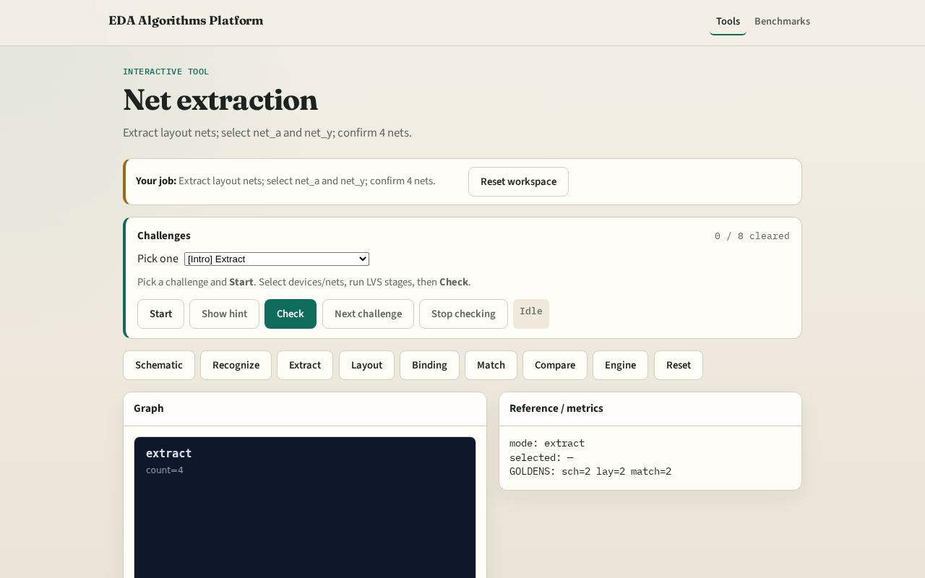
Browser lab track
Browser lab starter
learn_lvs — 05 net extract
Notes:
Open **net-extract**. Select net_a and net_y; confirm 4 layout nets.

Slide 9
Implement track
Call extract_nets(); assert count==4 and ids include net_a, net_y
learn_lvs — 05 net extract
Notes:
Call extract_nets(); assert count==4 and ids include net_a, net_y.

Slide 10
Pitfalls
Splitting a net at a via
Missing port annotation on supplies
learn_lvs — 05 net extract
Notes:
Splitting a net at a via. Missing port annotation on supplies.

Slide 11
Your turn
Next: layout device–net graph
learn_lvs — 05 net extract
Notes:
Next: layout device–net graph.

