Slide 1
Layout graph
Layout graph mirrors schematic , devices X0/X1 with pin-to-net edges
learn_lvs — 01 layout graph
Notes:
Layout graph mirrors schematic — devices X0/X1 with pin-to-net edges.

Slide 2
The idea
GOLDEN: 2 devices, 4 nets, 6 edges
learn_lvs — 01 layout graph
Notes:
GOLDEN: 2 devices, 4 nets, 6 edges.

Slide 3
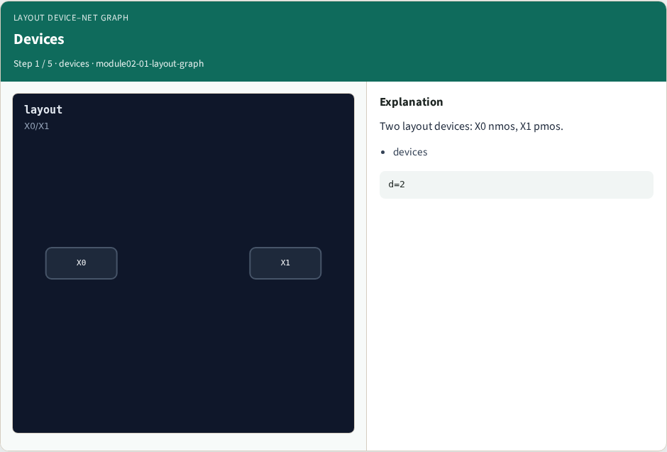
Devices
Devices
learn_lvs — 01 layout graph
Notes:
Two layout devices: X0 nmos, X1 pmos.

Slide 4
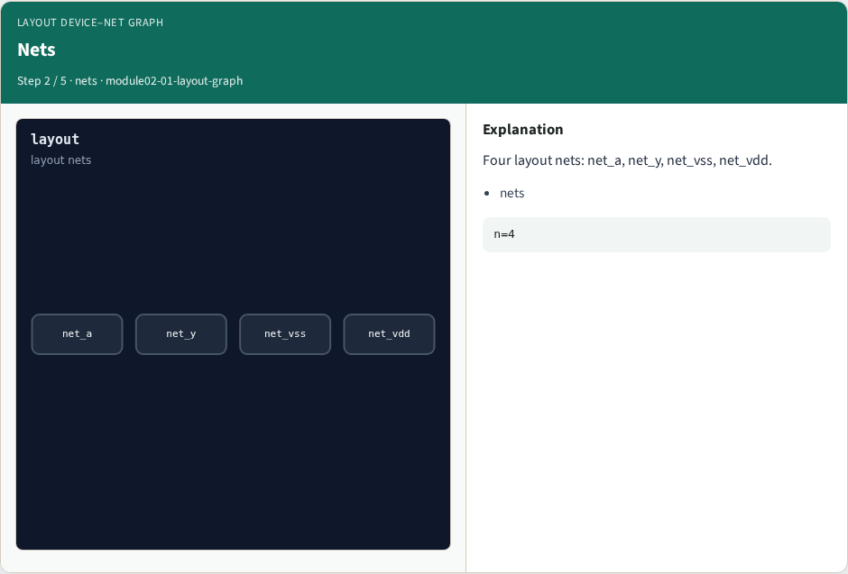
Nets
Nets
learn_lvs — 01 layout graph
Notes:
Four layout nets: net_a, net_y, net_vss, net_vdd.

Slide 5

Pins
Pins
learn_lvs — 01 layout graph
Notes:
Each device has G/D/S pins on layout nets.

Slide 6
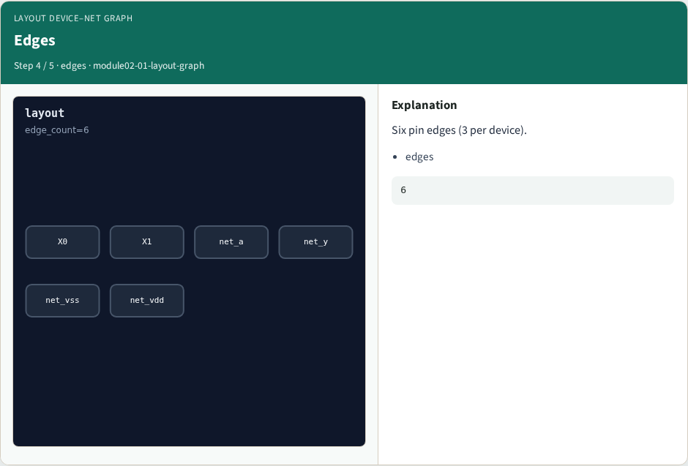
Edges
Edges
learn_lvs — 01 layout graph
Notes:
Six pin edges (3 per device).

Slide 7
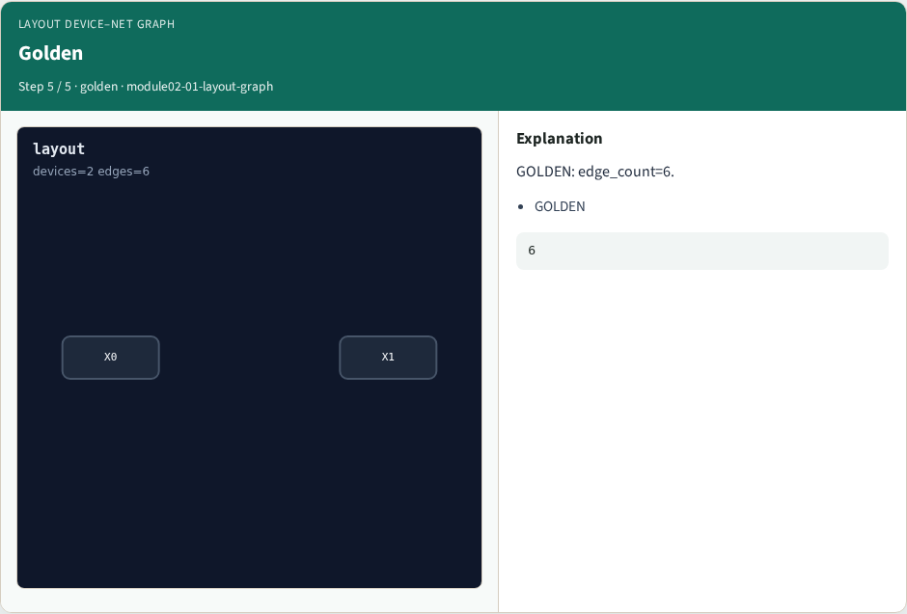
Golden
Golden
learn_lvs — 01 layout graph
Notes:
GOLDEN: edge_count=6.

Slide 8
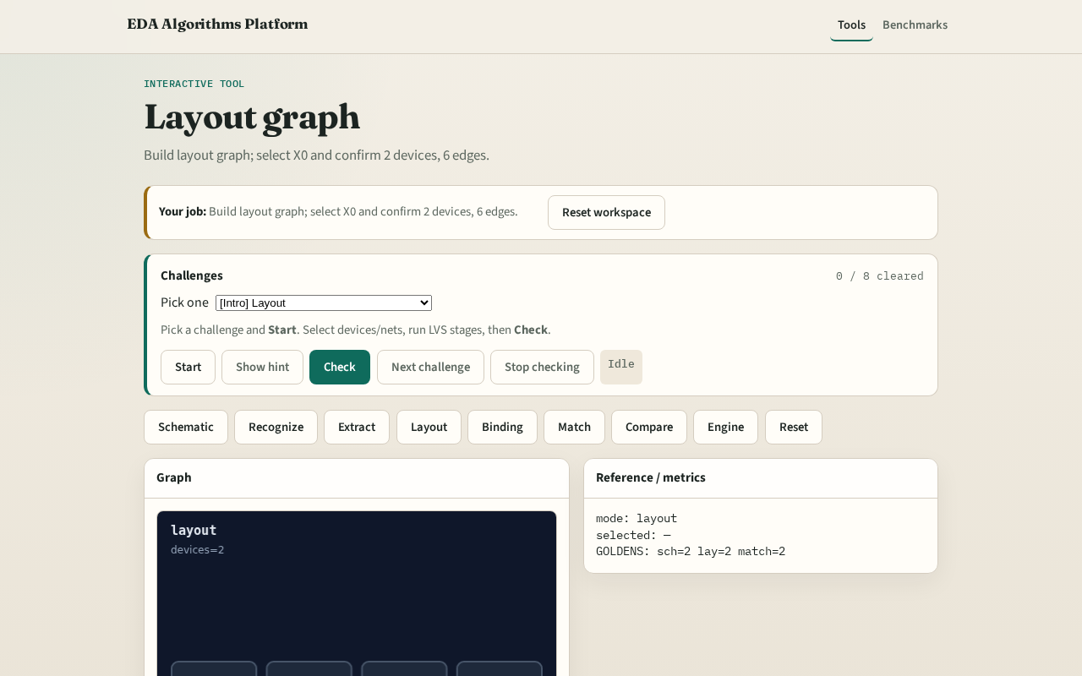
Browser lab track
Browser lab starter
learn_lvs — 01 layout graph
Notes:
Open **layout-graph**. Confirm X0/X1 and 6 pin edges.

Slide 9
Implement track
Call layout_graph(); assert device_count==2 and edge_count==6
learn_lvs — 01 layout graph
Notes:
Call layout_graph(); assert device_count==2 and edge_count==6.

Slide 10
Pitfalls
Using schematic net names on layout graph
Missing a pin edge
learn_lvs — 01 layout graph
Notes:
Using schematic net names on layout graph. Missing a pin edge.

Slide 11
Your turn
Next: pin / name binding
learn_lvs — 01 layout graph
Notes:
Next: pin / name binding.

