Slide 1
Pin binding
Binding table maps layout X0→mn1 and layout nets to schematic ports
learn_lvs — 03 pin binding
Notes:
Binding table maps layout X0→mn1 and layout nets to schematic ports.

Slide 2
The idea
GOLDEN: X0→mn1, X1→mp1; 4 net binds
learn_lvs — 03 pin binding
Notes:
GOLDEN: X0→mn1, X1→mp1; 4 net binds.

Slide 3

Dev bind
Dev bind
learn_lvs — 03 pin binding
Notes:
Device binding: X0→mn1, X1→mp1.

Slide 4

Net bind
Net bind
learn_lvs — 03 pin binding
Notes:
Net binding: net_a→a, net_y→y.

Slide 5

Supplies
Supplies
learn_lvs — 03 pin binding
Notes:
net_vss→vss, net_vdd→vdd.

Slide 6

Pairs
Pairs
learn_lvs — 03 pin binding
Notes:
Four net pairs and two device pairs.

Slide 7

Golden
Golden
learn_lvs — 03 pin binding
Notes:
GOLDEN: device_count=2, net_count=4.

Slide 8
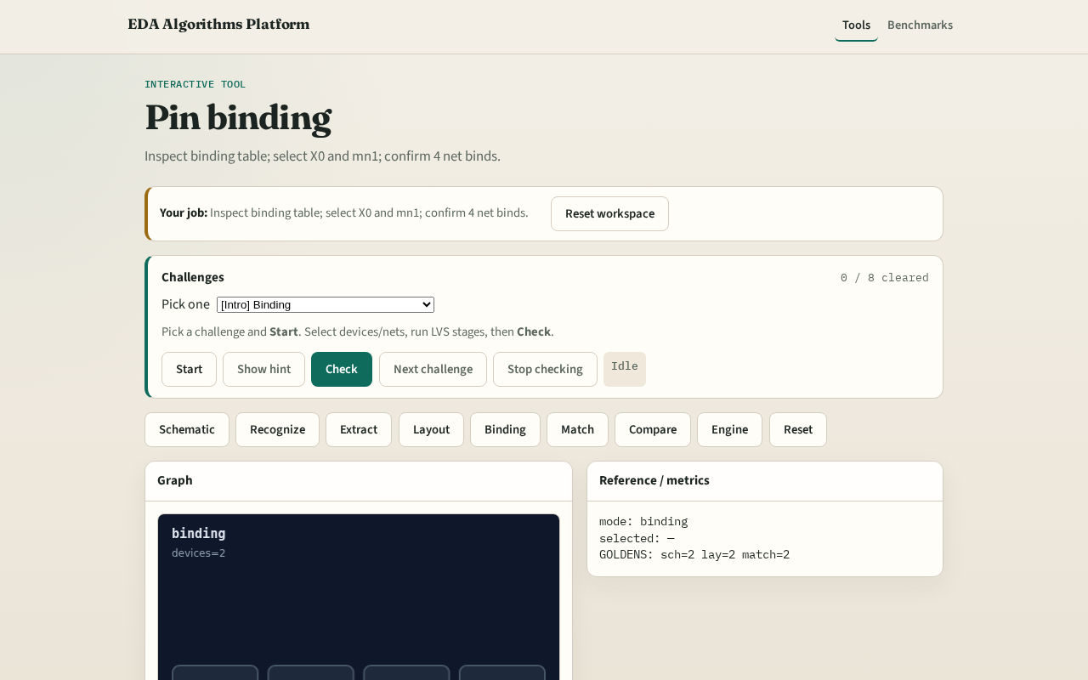
Browser lab track
Browser lab starter
learn_lvs — 03 pin binding
Notes:
Open **pin-binding**. Select X0 and mn1; confirm binding table.

Slide 9
Implement track
Call pin_binding(); assert devices['X0']=='mn1' and len(nets)==4
learn_lvs — 03 pin binding
Notes:
Call pin_binding(); assert devices['X0']=='mn1' and len(nets)==4.

Slide 10
Pitfalls
Binding by position instead of connectivity
Missing a supply bind
learn_lvs — 03 pin binding
Notes:
Binding by position instead of connectivity. Missing a supply bind.

Slide 11
Your turn
Next: device matching
learn_lvs — 03 pin binding
Notes:
Next: device matching.

