Slide 1
Device match
Device match checks binding plus type agreement (nmos↔nmos)
learn_lvs — 01 device match
Notes:
Device match checks binding plus type agreement (nmos↔nmos).

Slide 2
The idea
GOLDEN: matched_devices=2
learn_lvs — 01 device match
Notes:
GOLDEN: matched_devices=2.

Slide 3

Bind
Bind
learn_lvs — 01 device match
Notes:
Use device binding X0→mn1, X1→mp1.

Slide 4
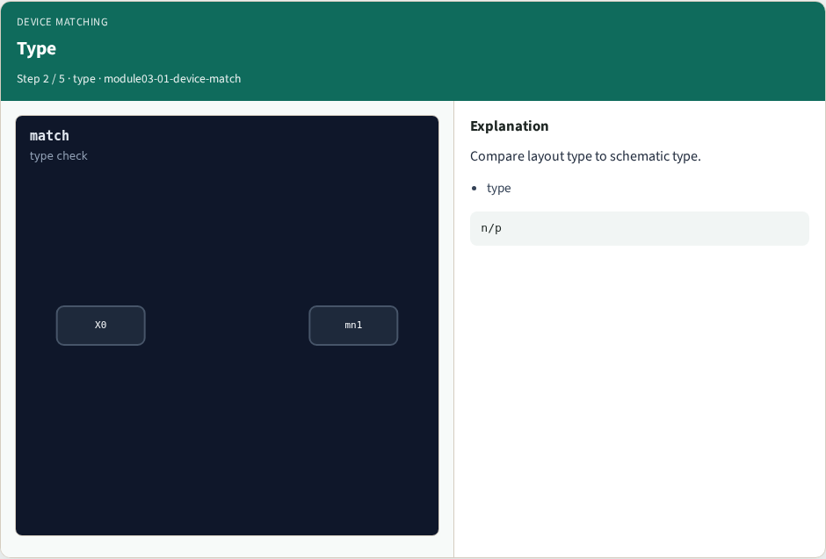
Type
Type
learn_lvs — 01 device match
Notes:
Compare layout type to schematic type.

Slide 5
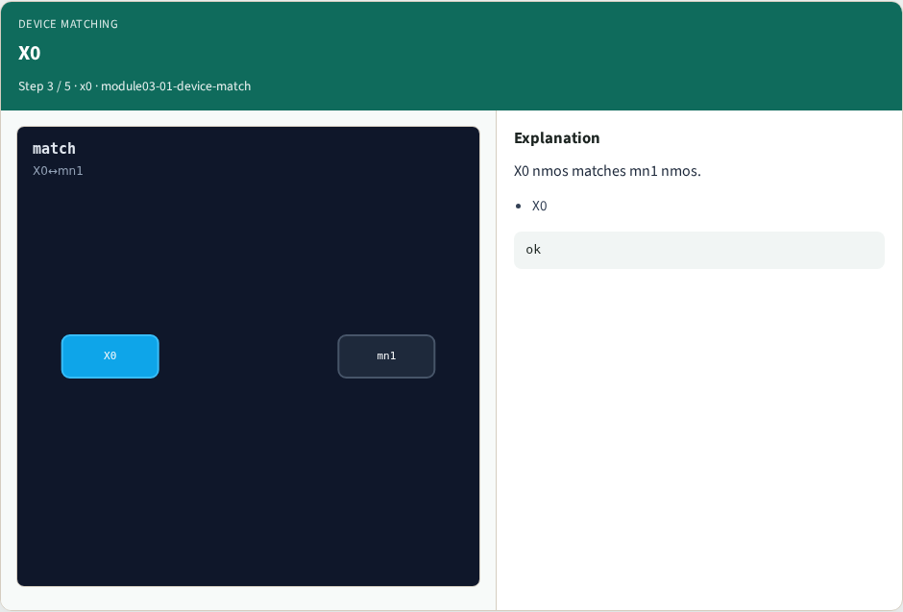
X0
X0
learn_lvs — 01 device match
Notes:
X0 nmos matches mn1 nmos.

Slide 6

X1
X1
learn_lvs — 01 device match
Notes:
X1 pmos matches mp1 pmos.

Slide 7

Golden
Golden
learn_lvs — 01 device match
Notes:
GOLDEN: matched_devices=2.

Slide 8
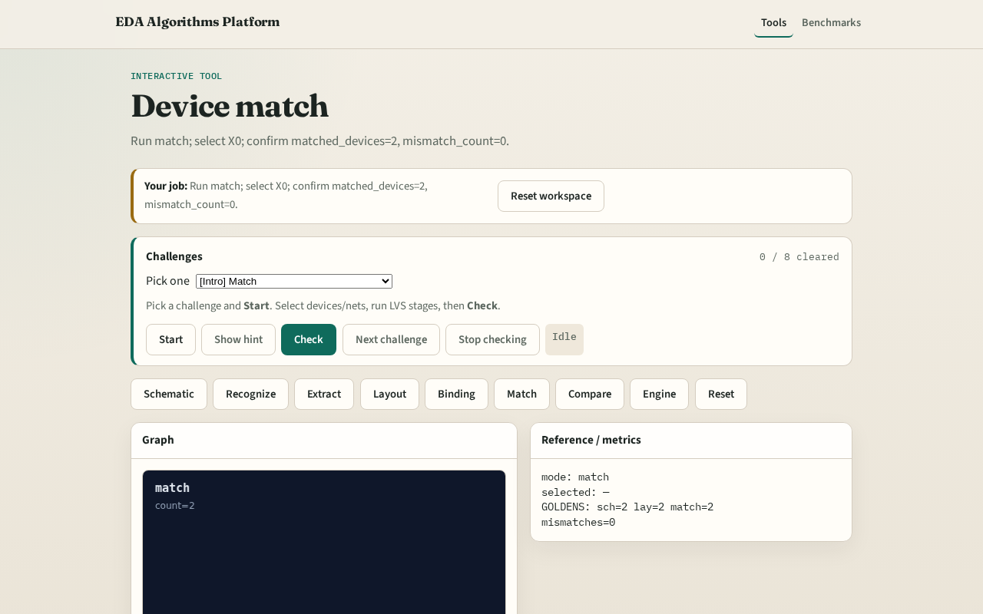
Browser lab track
Browser lab starter
learn_lvs — 01 device match
Notes:
Open **device-match**. Run match; confirm 2 matched devices.

Slide 9
Implement track
Call match_devices(); assert count==2 and mismatch_count==0
learn_lvs — 01 device match
Notes:
Call match_devices(); assert count==2 and mismatch_count==0.

Slide 10
Pitfalls
Matching by name only without type check
Skipping unbound devices
learn_lvs — 01 device match
Notes:
Matching by name only without type check. Skipping unbound devices.

Slide 11
Your turn
Next: LVS graph compare
learn_lvs — 01 device match
Notes:
Next: LVS graph compare.

