Slide 1
LVS compare
LVS compare checks every pin net after rename , mismatch_count must be zero
learn_lvs — 03 lvs compare
Notes:
LVS compare checks every pin net after rename — mismatch_count must be zero.

Slide 2
The idea
GOLDEN: mismatch_count=0, matched_nets=4
learn_lvs — 03 lvs compare
Notes:
GOLDEN: mismatch_count=0, matched_nets=4.

Slide 3

Rename
Rename
learn_lvs — 03 lvs compare
Notes:
Map layout nets to schematic via binding.

Slide 4

Pins
Pins
learn_lvs — 03 lvs compare
Notes:
Walk each device pin on both sides.

Slide 5
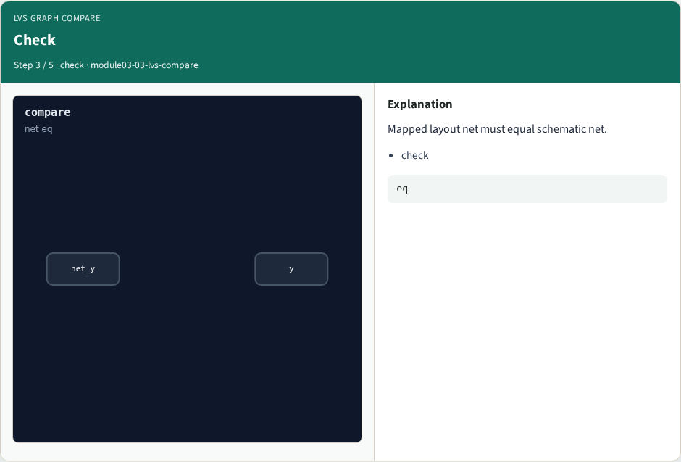
Check
Check
learn_lvs — 03 lvs compare
Notes:
Mapped layout net must equal schematic net.

Slide 6

Nets
Nets
learn_lvs — 03 lvs compare
Notes:
All four bound nets match.

Slide 7

Golden
Golden
learn_lvs — 03 lvs compare
Notes:
GOLDEN: mismatch_count=0, matched_nets=4.

Slide 8
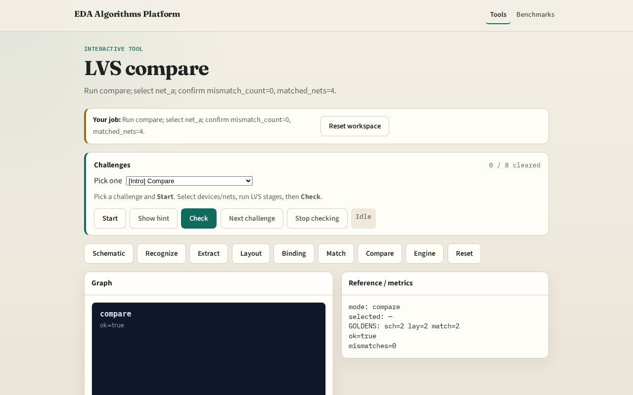
Browser lab track
Browser lab starter
learn_lvs — 03 lvs compare
Notes:
Open **lvs-compare**. Run compare; confirm ok and 4 matched nets.

Slide 9
Implement track
Call lvs_compare(); assert ok and matched_net_count==4
learn_lvs — 03 lvs compare
Notes:
Call lvs_compare(); assert ok and matched_net_count==4.

Slide 10
Pitfalls
Comparing unbound nets
Ignoring pin direction mismatches as net errors
learn_lvs — 03 lvs compare
Notes:
Comparing unbound nets. Ignoring pin direction mismatches as net errors.

Slide 11
Your turn
Next: LVS engine integration
learn_lvs — 03 lvs compare
Notes:
Next: LVS engine integration.

