Slide 1
Engine
A tiny engine chains every LVS stage and reports ok when goldens match
learn_lvs — 01 lvs engine
Notes:
A tiny engine chains every LVS stage and reports ok when goldens match.

Slide 2
The idea
GOLDEN: ok=True
learn_lvs — 01 lvs engine
Notes:
GOLDEN: ok=True.

Slide 3
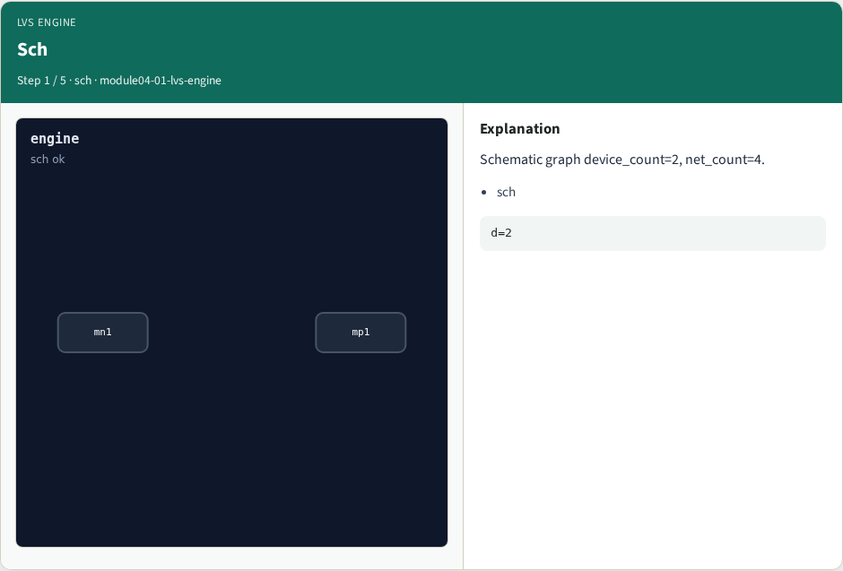
Sch
Sch
learn_lvs — 01 lvs engine
Notes:
Schematic graph device_count=2, net_count=4.

Slide 4

Recog
Recog
learn_lvs — 01 lvs engine
Notes:
Recognize nmos=1, pmos=1.

Slide 5

Extract
Extract
learn_lvs — 01 lvs engine
Notes:
Extract 4 layout nets.

Slide 6
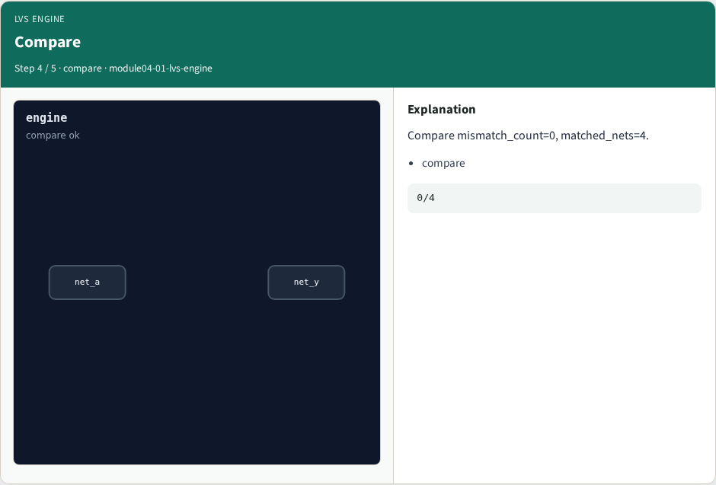
Compare
Compare
learn_lvs — 01 lvs engine
Notes:
Compare mismatch_count=0, matched_nets=4.

Slide 7

OK
OK
learn_lvs — 01 lvs engine
Notes:
GOLDEN: ok=True.

Slide 8
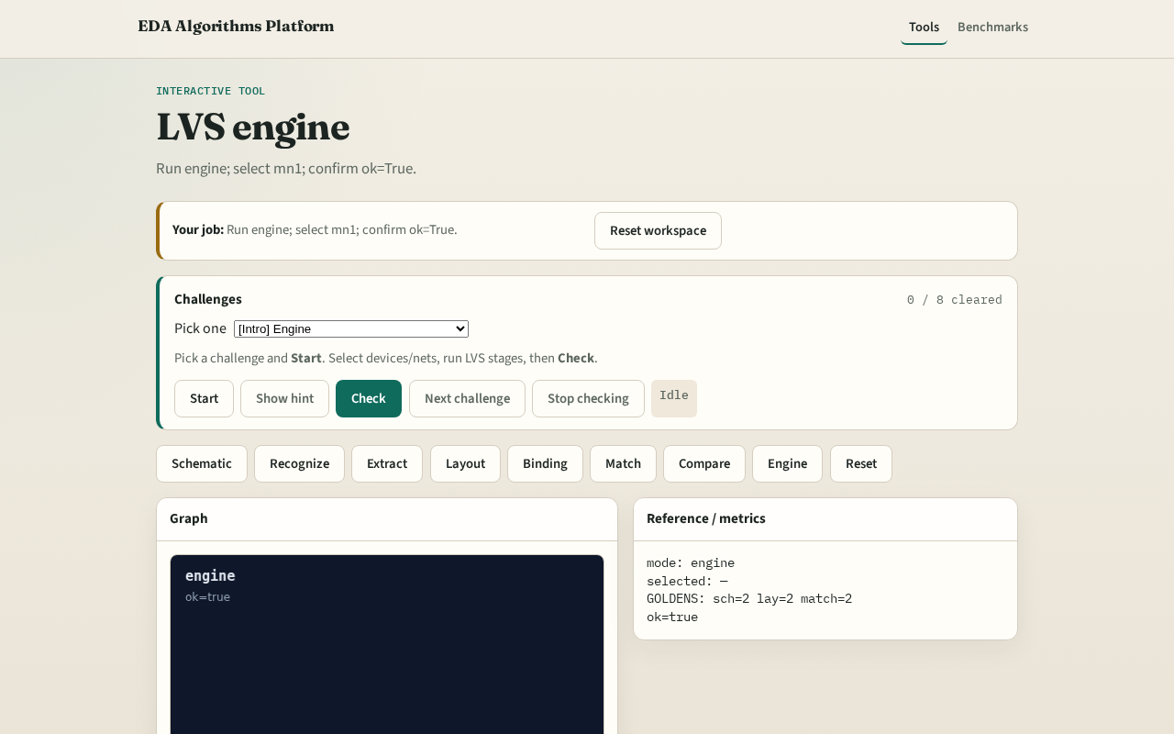
Browser lab track
Browser lab starter
learn_lvs — 01 lvs engine
Notes:
Open **lvs-engine**. Run engine; confirm ok.

Slide 9
Implement track
Call lvs_engine(); assert ok is True
learn_lvs — 01 lvs engine
Notes:
Call lvs_engine(); assert ok is True.

Slide 10
Pitfalls
Reporting partial stages
Changing toy without updating goldens
learn_lvs — 01 lvs engine
Notes:
Reporting partial stages. Changing toy without updating goldens.

Slide 11
Your turn
Next: offline compare, then wrap
learn_lvs — 01 lvs engine
Notes:
Next: offline compare, then wrap.

