Slide 1
Why Paint
Place rectangles on named Magic layers (paint)
learn_magic — 01 paint layers
Notes:
Place rectangles on named Magic layers (paint).

Slide 2
The idea
GOLDEN: 6 rects; metal1 paint=2
learn_magic — 01 paint layers
Notes:
GOLDEN: 6 rects; metal1 paint=2.

Slide 3
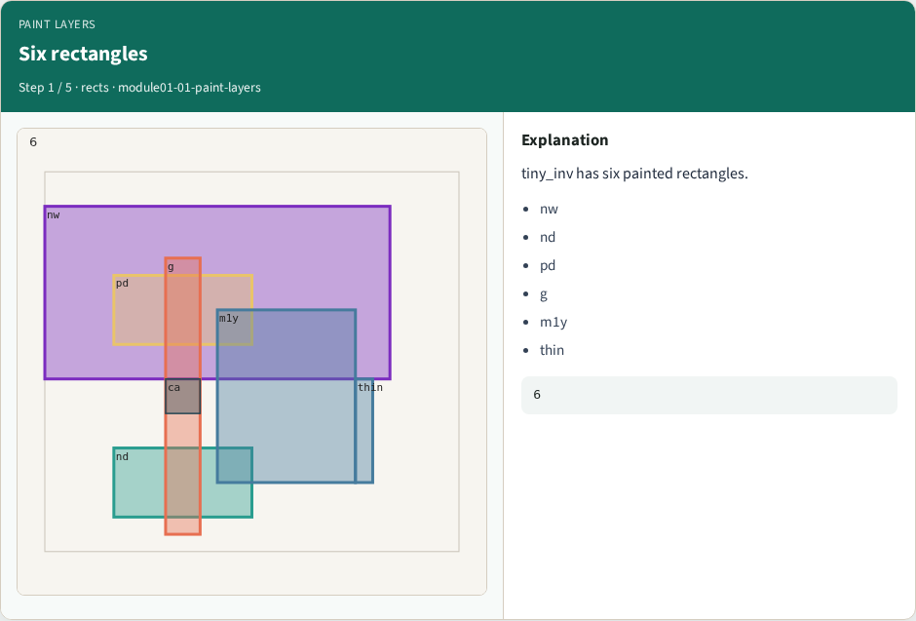
Six rectangles
Six rectangles
learn_magic — 01 paint layers
Notes:
tiny_inv has six painted rectangles.

Slide 4

Layer names
Layer names
learn_magic — 01 paint layers
Notes:
Layers: ndiff, pdiff, poly, metal1, nwell, pwell.

Slide 5

metal1 paint
metal1 paint
learn_magic — 01 paint layers
Notes:
Two metal1 rectangles: m1y and thin.

Slide 6

Paint command
Paint command
learn_magic — 01 paint layers
Notes:
Magic paint places rects on the active layer.

Slide 7

Golden
Golden
learn_magic — 01 paint layers
Notes:
GOLDEN: rect_count=6; paint_metal1=2.

Slide 8
Browser lab track
Open paint-layers
Run the stage buttons and Check the goldens
learn_magic — 01 paint layers
Notes:
Open **paint-layers**. Run the stage buttons and Check the goldens.

Slide 9
Implement track
From common/, run solvers.py and confirm MAGIC_PARTA_OK
learn_magic — 01 paint layers
Notes:
From common/, run solvers.py and confirm MAGIC_PARTA_OK.

Slide 10
Pitfalls
Mixing KLayout viewer shortcuts with Magic paint commands
Forgetting min_width when reading DRC errors
learn_magic — 01 paint layers
Notes:
Mixing KLayout viewer shortcuts with Magic paint commands. Forgetting min_width when reading DRC errors.

Slide 11
Try these
From the common folder, run the Magic map self-test
learn_magic — 01 paint layers
Notes:
From the common folder, run the Magic map self-test.

Slide 12
Try these — try these
cd courses/learn_magic/common
python3 solvers.py
learn_magic — 01 paint layers

Slide 13
Pseudocode
Here is the check in plain steps
learn_magic — 01 paint layers
Notes:
Here is the check in plain steps.

Slide 14
Pseudocode — try these
6 rects; metal1 paint=2.
ok if goldens match
learn_magic — 01 paint layers

Slide 15
Next
Complete the quiz for this part
Continue the Magic Part A map, then the real CLI track
learn_magic — 01 paint layers
Notes:
Continue the Magic Part A map, then the real CLI track.

