Slide 1
Why GDS
Map Magic layers to GDS layer numbers
learn_magic — 01 gds write map
Notes:
Map Magic layers to GDS layer numbers.

Slide 2
The idea
GOLDEN: gds_layer_count=6; metal1→49
learn_magic — 01 gds write map
Notes:
GOLDEN: gds_layer_count=6; metal1→49.

Slide 3
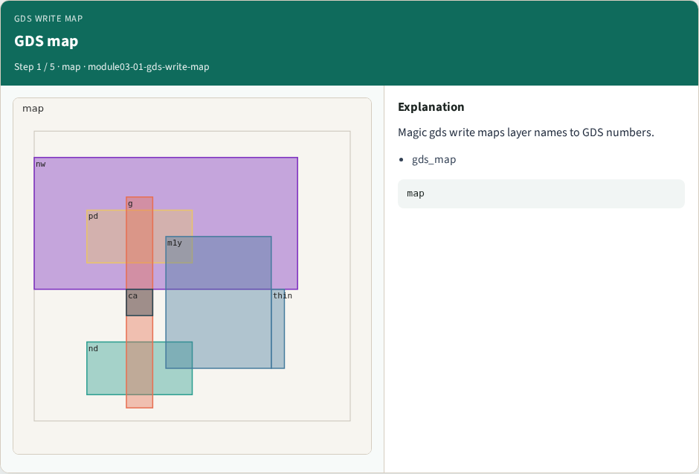
GDS map
GDS map
learn_magic — 01 gds write map
Notes:
Magic gds write maps layer names to GDS numbers.

Slide 4

metal1→49
metal1→49
learn_magic — 01 gds write map
Notes:
metal1 streams as GDS layer 49.

Slide 5

Six entries
Six entries
learn_magic — 01 gds write map
Notes:
Six layer/contact mappings in gds_map.

Slide 6

Streamout
Streamout
learn_magic — 01 gds write map
Notes:
Part A uses a fixed map — real Magic writes .gds.

Slide 7

Golden
Golden
learn_magic — 01 gds write map
Notes:
GOLDEN: gds_layer_count=6.

Slide 8
Browser lab track
Open gds-write-map
Run the stage buttons and Check the goldens
learn_magic — 01 gds write map
Notes:
Open **gds-write-map**. Run the stage buttons and Check the goldens.

Slide 9
Implement track
From common/, run solvers.py and confirm MAGIC_PARTA_OK
learn_magic — 01 gds write map
Notes:
From common/, run solvers.py and confirm MAGIC_PARTA_OK.

Slide 10
Pitfalls
Mixing KLayout viewer shortcuts with Magic paint commands
Forgetting min_width when reading DRC errors
learn_magic — 01 gds write map
Notes:
Mixing KLayout viewer shortcuts with Magic paint commands. Forgetting min_width when reading DRC errors.

Slide 11
Try these
From the common folder, run the Magic map self-test
learn_magic — 01 gds write map
Notes:
From the common folder, run the Magic map self-test.

Slide 12
Try these — try these
cd courses/learn_magic/common
python3 solvers.py
learn_magic — 01 gds write map

Slide 13
Pseudocode
Here is the check in plain steps
learn_magic — 01 gds write map
Notes:
Here is the check in plain steps.

Slide 14
Pseudocode — try these
gds_layer_count=6; metal1→49.
ok if goldens match
learn_magic — 01 gds write map

Slide 15
Next
Complete the quiz for this part
Continue the Magic Part A map, then the real CLI track
learn_magic — 01 gds write map
Notes:
Continue the Magic Part A map, then the real CLI track.

