Slide 1
Why Magic
Run the full Part A engine; ok when every golden matches
learn_magic — 03 magic engine
Notes:
Run the full Part A engine; ok when every golden matches.

Slide 2
The idea
GOLDEN: magic_engine ok=True
learn_magic — 03 magic engine
Notes:
GOLDEN: magic_engine ok=True.

Slide 3

Paint ok
Paint ok
learn_magic — 03 magic engine
Notes:
Paint layers stage passes.

Slide 4

Select ok
Select ok
learn_magic — 03 magic engine
Notes:
Select box stage passes.

Slide 5

Contact ok
Contact ok
learn_magic — 03 magic engine
Notes:
Contact stage passes.

Slide 6
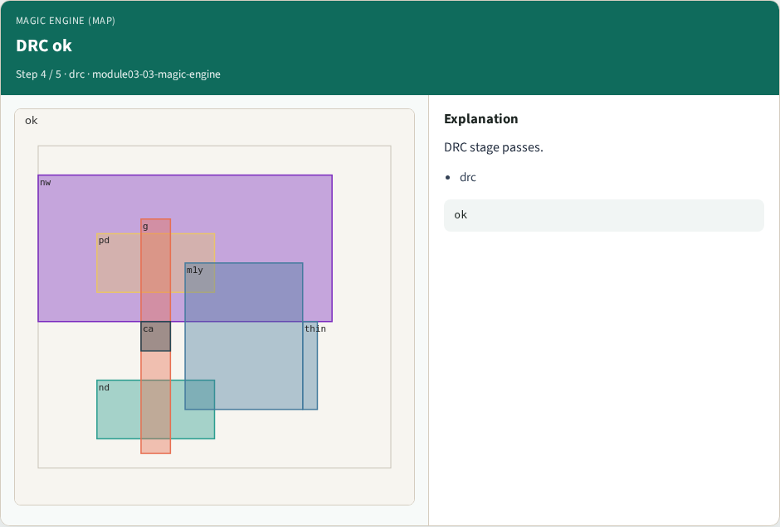
DRC ok
DRC ok
learn_magic — 03 magic engine
Notes:
DRC stage passes.

Slide 7

Engine golden
Engine golden
learn_magic — 03 magic engine
Notes:
GOLDEN: magic_engine ok=True.

Slide 8
Browser lab track
Open magic-engine
Run the stage buttons and Check the goldens
learn_magic — 03 magic engine
Notes:
Open **magic-engine**. Run the stage buttons and Check the goldens.

Slide 9
Implement track
From common/, run solvers.py and confirm MAGIC_PARTA_OK
learn_magic — 03 magic engine
Notes:
From common/, run solvers.py and confirm MAGIC_PARTA_OK.

Slide 10
Pitfalls
Mixing KLayout viewer shortcuts with Magic paint commands
Forgetting min_width when reading DRC errors
learn_magic — 03 magic engine
Notes:
Mixing KLayout viewer shortcuts with Magic paint commands. Forgetting min_width when reading DRC errors.

Slide 11
Try these
From the common folder, run the Magic map self-test
learn_magic — 03 magic engine
Notes:
From the common folder, run the Magic map self-test.

Slide 12
Try these — try these
cd courses/learn_magic/common
python3 solvers.py
learn_magic — 03 magic engine

Slide 13
Pseudocode
Here is the check in plain steps
learn_magic — 03 magic engine
Notes:
Here is the check in plain steps.

Slide 14
Pseudocode — try these
magic_engine ok=True.
ok if goldens match
learn_magic — 03 magic engine

Slide 15
Next
Complete the quiz for this part
Continue the Magic Part A map, then the real CLI track
learn_magic — 03 magic engine
Notes:
Continue the Magic Part A map, then the real CLI track.

