Slide 1
Why real Magic
Invoke magic -dnull -noconsole script.tcl; recipe starts tech_load→load_cell
learn_magic — 01 magic cli
Notes:
Invoke magic -dnull -noconsole script.tcl; recipe starts tech_load→load_cell.

Slide 2
The idea
GOLDEN: First two cmds: tech_load, load_cell
learn_magic — 01 magic cli
Notes:
GOLDEN: First two cmds: tech_load, load_cell.

Slide 3
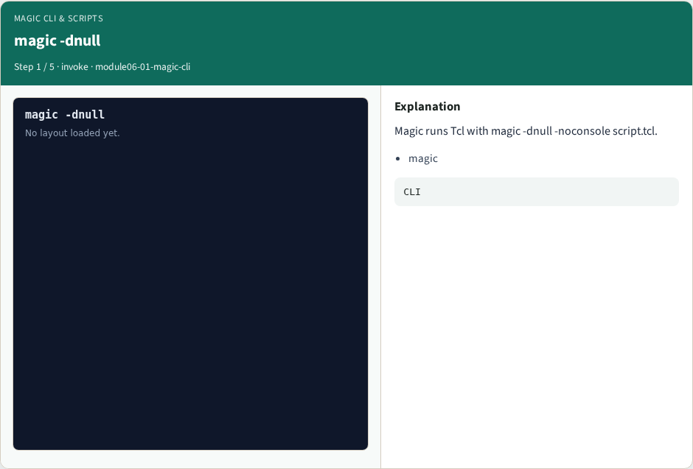
magic -dnull
magic -dnull
learn_magic — 01 magic cli
Notes:
Magic runs Tcl with magic -dnull -noconsole script.tcl.

Slide 4

tech load
tech load
learn_magic — 01 magic cli
Notes:
First load the technology file.

Slide 5

load cell
load cell
learn_magic — 01 magic cli
Notes:
Then load the tiny_inv layout.

Slide 6

paint verify
paint verify
learn_magic — 01 magic cli
Notes:
Verify rect and contact counts.

Slide 7

Golden
Golden
learn_magic — 01 magic cli
Notes:
GOLDEN: recipe prefix tech_load→load_cell.

Slide 8
Browser lab track
Open magic-cli
Build the Magic recipe or open evidence stages, then Check
learn_magic — 01 magic cli
Notes:
Open **magic-cli**. Build the Magic recipe or open evidence stages, then Check.

Slide 9
Implement track
From common/, run real_solvers.py and confirm REAL_MAGIC_OK
learn_magic — 01 magic cli
Notes:
From common/, run real_solvers.py and confirm REAL_MAGIC_OK.

Slide 10
Pitfalls
Editing goldens by hand without re-running scripts
Confusing Part A map JSON with checked-in logs
learn_magic — 01 magic cli
Notes:
Editing goldens by hand without re-running scripts. Confusing Part A map JSON with checked-in logs.

Slide 11
Try these
From the common folder, run the real Magic self-test
learn_magic — 01 magic cli
Notes:
From the common folder, run the real Magic self-test.

Slide 12
Try these — try these
cd courses/learn_magic/common
python3 real_solvers.py
learn_magic — 01 magic cli

Slide 13
Pseudocode
Here is the check in plain steps
learn_magic — 01 magic cli
Notes:
Here is the check in plain steps.

Slide 14
Pseudocode — try these
First two cmds: tech_load, load_cell.
ok if goldens match
learn_magic — 01 magic cli

Slide 15
Next
Complete the quiz for this part
Continue the Part B evidence track, then algorithms and internals
learn_magic — 01 magic cli
Notes:
Continue the Part B evidence track, then algorithms and internals.

