Slide 1
Why real Magic
Name the six teaching layers in scmos.tech
learn_magic — 03 magic tech vocab
Notes:
Name the six teaching layers in scmos.tech.

Slide 2
The idea
GOLDEN: Layers ndiff,pdiff,poly,metal1,nwell,contact; count=6
learn_magic — 03 magic tech vocab
Notes:
GOLDEN: Layers ndiff,pdiff,poly,metal1,nwell,contact; count=6.

Slide 3
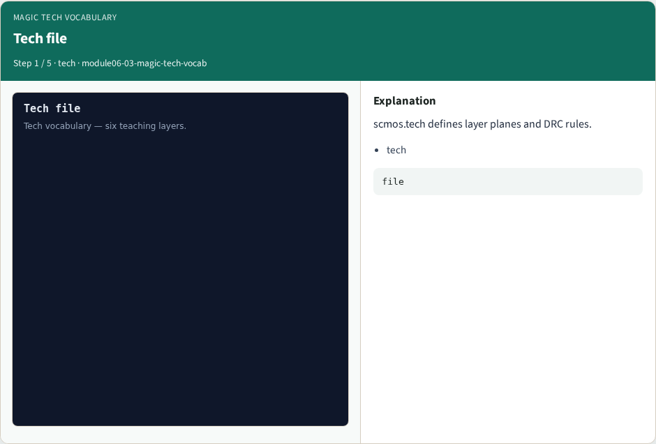
Tech file
Tech file
learn_magic — 03 magic tech vocab
Notes:
scmos.tech defines layer planes and DRC rules.

Slide 4

ndiff
ndiff
learn_magic — 03 magic tech vocab
Notes:
ndiff is active diffusion (n-type).

Slide 5

poly
poly
learn_magic — 03 magic tech vocab
Notes:
poly is the gate layer.

Slide 6

metal1
metal1
learn_magic — 03 magic tech vocab
Notes:
metal1 routes signals; min_width=2 in lab.

Slide 7
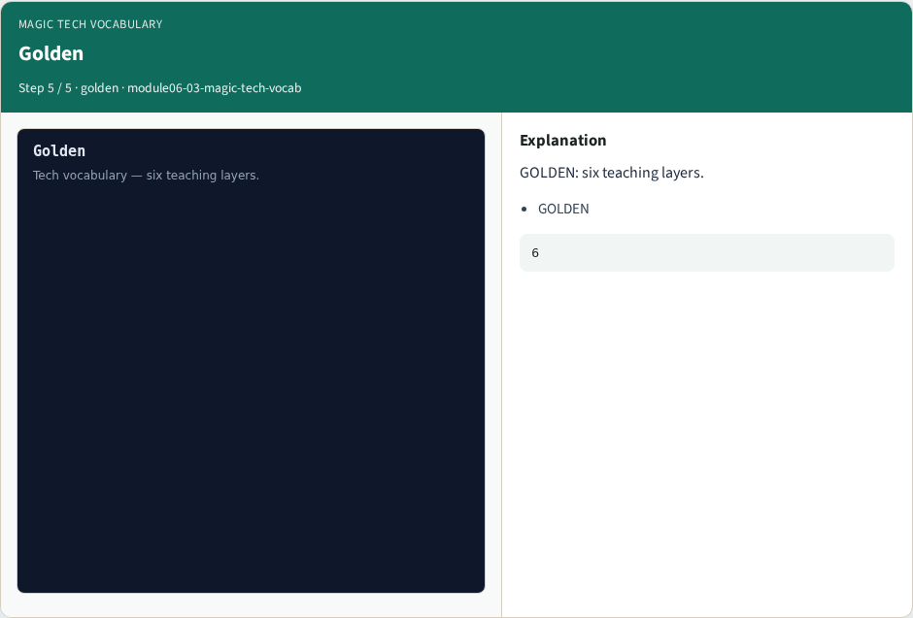
Golden
Golden
learn_magic — 03 magic tech vocab
Notes:
GOLDEN: six teaching layers.

Slide 8
Browser lab track
Open magic-tech-vocab
Build the Magic recipe or open evidence stages, then Check
learn_magic — 03 magic tech vocab
Notes:
Open **magic-tech-vocab**. Build the Magic recipe or open evidence stages, then Check.

Slide 9
Implement track
From common/, run real_solvers.py and confirm REAL_MAGIC_OK
learn_magic — 03 magic tech vocab
Notes:
From common/, run real_solvers.py and confirm REAL_MAGIC_OK.

Slide 10
Pitfalls
Editing goldens by hand without re-running scripts
Confusing Part A map JSON with checked-in logs
learn_magic — 03 magic tech vocab
Notes:
Editing goldens by hand without re-running scripts. Confusing Part A map JSON with checked-in logs.

Slide 11
Try these
From the common folder, run the real Magic self-test
learn_magic — 03 magic tech vocab
Notes:
From the common folder, run the real Magic self-test.

Slide 12
Try these — try these
cd courses/learn_magic/common
python3 real_solvers.py
learn_magic — 03 magic tech vocab

Slide 13
Pseudocode
Here is the check in plain steps
learn_magic — 03 magic tech vocab
Notes:
Here is the check in plain steps.

Slide 14
Pseudocode — try these
Layers ndiff,pdiff,poly,metal1,nwell,contact; count=6.
ok if goldens match
learn_magic — 03 magic tech vocab

Slide 15
Next
Complete the quiz for this part
Continue the Part B evidence track, then algorithms and internals
learn_magic — 03 magic tech vocab
Notes:
Continue the Part B evidence track, then algorithms and internals.

