Slide 1
Why real Magic
Run drc check; find width violation on thin metal1
learn_magic — 03 real drc
Notes:
Run drc check; find width violation on thin metal1.

Slide 2
The idea
GOLDEN: drc_error_count=1; thin on metal1
learn_magic — 03 real drc
Notes:
GOLDEN: drc_error_count=1; thin on metal1.

Slide 3

drc check
drc check
learn_magic — 03 real drc
Notes:
drc check scans planes against tech rules.

Slide 4
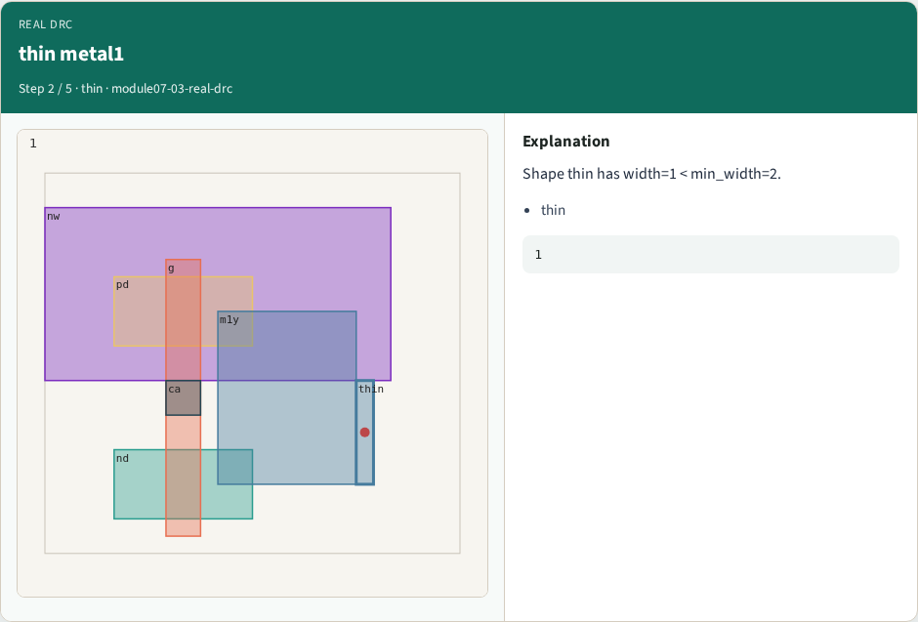
thin metal1
thin metal1
learn_magic — 03 real drc
Notes:
Shape thin has width=1 < min_width=2.

Slide 5

metal1
metal1
learn_magic — 03 real drc
Notes:
Violation is on metal1.

Slide 6

One error
One error
learn_magic — 03 real drc
Notes:
Teaching log reports DRC_ERRORS=1.

Slide 7

Golden
Golden
learn_magic — 03 real drc
Notes:
GOLDEN: drc_error_count=1 on thin.

Slide 8
Browser lab track
Open real-drc
Build the Magic recipe or open evidence stages, then Check
learn_magic — 03 real drc
Notes:
Open **real-drc**. Build the Magic recipe or open evidence stages, then Check.

Slide 9
Implement track
From common/, run real_solvers.py and confirm REAL_MAGIC_OK
learn_magic — 03 real drc
Notes:
From common/, run real_solvers.py and confirm REAL_MAGIC_OK.

Slide 10
Pitfalls
Editing goldens by hand without re-running scripts
Confusing Part A map JSON with checked-in logs
learn_magic — 03 real drc
Notes:
Editing goldens by hand without re-running scripts. Confusing Part A map JSON with checked-in logs.

Slide 11
Try these
From the common folder, run the real Magic self-test
learn_magic — 03 real drc
Notes:
From the common folder, run the real Magic self-test.

Slide 12
Try these — try these
cd courses/learn_magic/common
python3 real_solvers.py
learn_magic — 03 real drc

Slide 13
Pseudocode
Here is the check in plain steps
learn_magic — 03 real drc
Notes:
Here is the check in plain steps.

Slide 14
Pseudocode — try these
drc_error_count=1; thin on metal1.
ok if goldens match
learn_magic — 03 real drc

Slide 15
Next
Complete the quiz for this part
Continue the Part B evidence track, then algorithms and internals
learn_magic — 03 real drc
Notes:
Continue the Part B evidence track, then algorithms and internals.

