Slide 1
Why algorithms
Flood-fill metal1 nets; contact bridges poly and metal1
learn_magic — 01 paint connectivity
Notes:
Flood-fill metal1 nets; contact bridges poly and metal1.

Slide 2
The idea
GOLDEN: metal1_net_shapes=2; contact_count=1
learn_magic — 01 paint connectivity
Notes:
GOLDEN: metal1_net_shapes=2; contact_count=1.

Slide 3
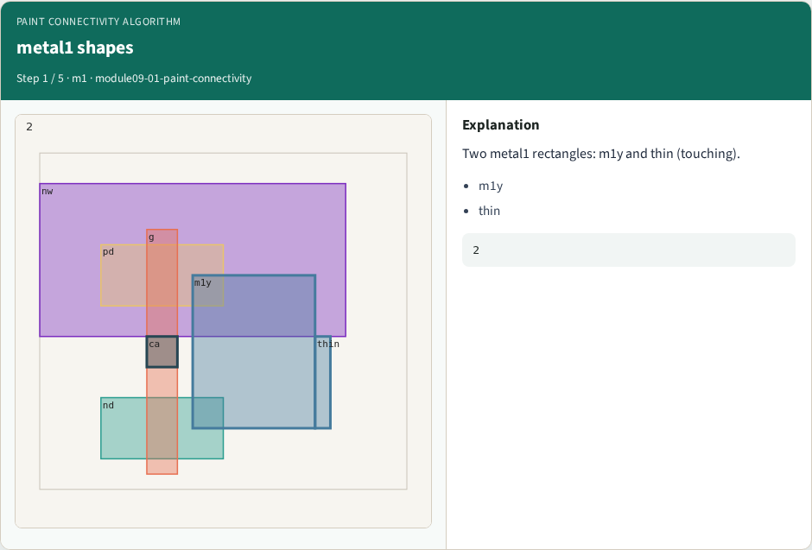
metal1 shapes
metal1 shapes
learn_magic — 01 paint connectivity
Notes:
Two metal1 rectangles: m1y and thin (touching).

Slide 4
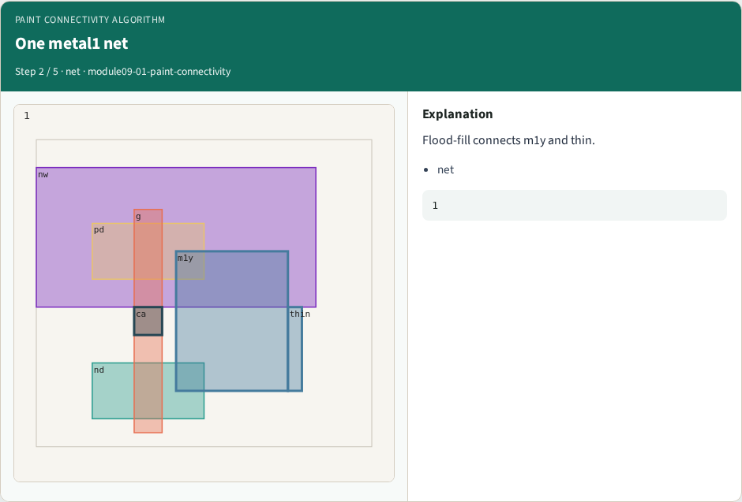
One metal1 net
One metal1 net
learn_magic — 01 paint connectivity
Notes:
Flood-fill connects m1y and thin.

Slide 5
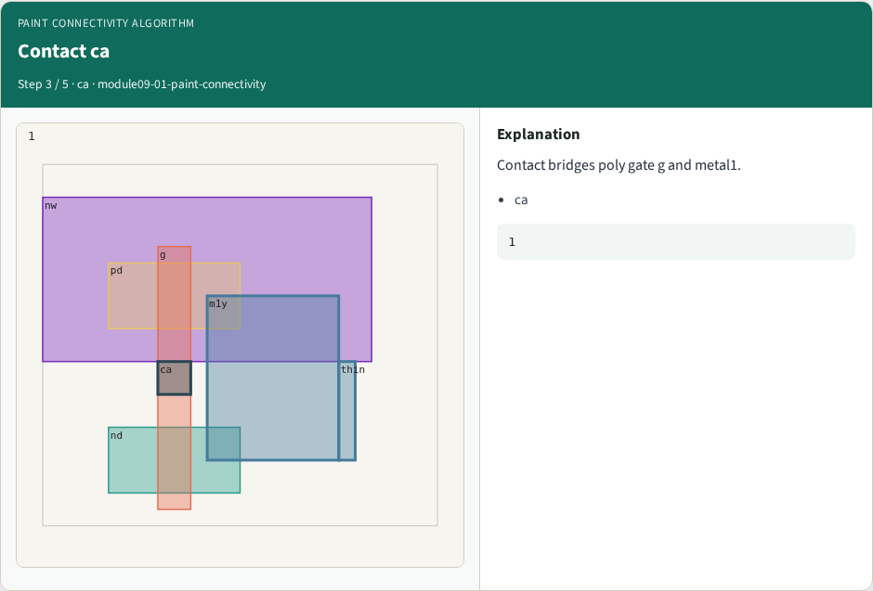
Contact ca
Contact ca
learn_magic — 01 paint connectivity
Notes:
Contact bridges poly gate g and metal1.

Slide 6
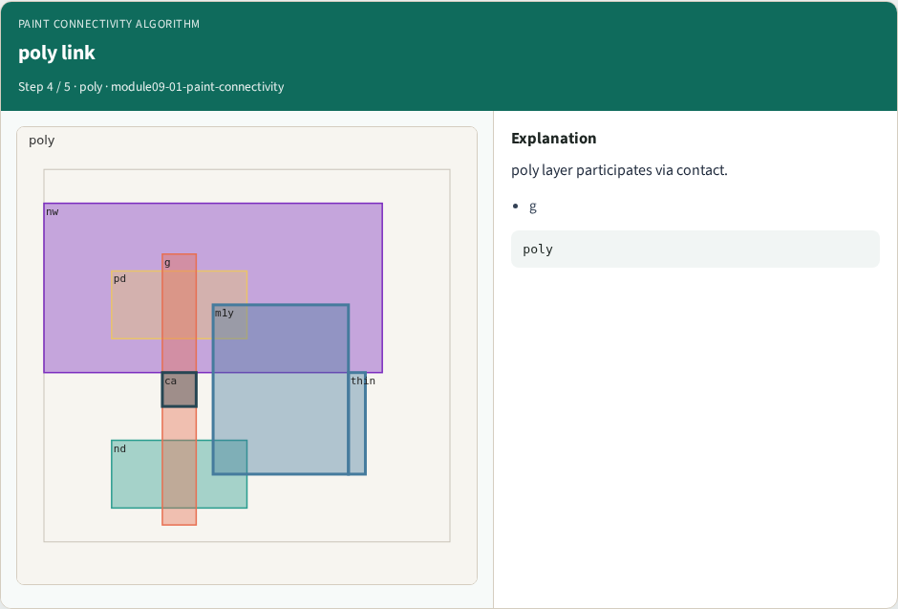
poly link
poly link
learn_magic — 01 paint connectivity
Notes:
poly layer participates via contact.

Slide 7

Golden
Golden
learn_magic — 01 paint connectivity
Notes:
GOLDEN: metal1_net_shapes=2 contact=1.

Slide 8
Browser lab track
Open paint-connectivity
Run connectivity / DRC / extract / bind, then Check
learn_magic — 01 paint connectivity
Notes:
Open **paint-connectivity**. Run connectivity / DRC / extract / bind, then Check.

Slide 9
Implement track
From common/, run algo_solvers.py and partc_bind.py
learn_magic — 01 paint connectivity
Notes:
From common/, run algo_solvers.py and partc_bind.py.

Slide 10
Pitfalls
Changing tiny_algo_magic without updating Part B goldens
Ignoring the bind side
learn_magic — 01 paint connectivity
Notes:
Changing tiny_algo_magic without updating Part B goldens. Ignoring the bind side.

Slide 11
Try these
From the common folder, run the Part C self-tests
learn_magic — 01 paint connectivity
Notes:
From the common folder, run the Part C self-tests.

Slide 12
Try these — try these
cd courses/learn_magic/common
python3 algo_solvers.py
python3 partc_bind.py
learn_magic — 01 paint connectivity

Slide 13
Pseudocode
Here is the check in plain steps
learn_magic — 01 paint connectivity
Notes:
Here is the check in plain steps.

Slide 14
Pseudocode — try these
metal1_net_shapes=2; contact_count=1.
ok if goldens match and bind
learn_magic — 01 paint connectivity

Slide 15
Next
Complete the quiz for this part
Continue Part C, then internals literacy
learn_magic — 01 paint connectivity
Notes:
Continue Part C, then internals literacy.

