Slide 1
Why algorithms
Region scan for width violations on painted rects
learn_magic — 03 drc region algo
Notes:
Region scan for width violations on painted rects.

Slide 2
The idea
GOLDEN: drc_error_count=1 on thin metal1
learn_magic — 03 drc region algo
Notes:
GOLDEN: drc_error_count=1 on thin metal1.

Slide 3

Region scan
Region scan
learn_magic — 03 drc region algo
Notes:
Walk each painted rect; check min_width.

Slide 4
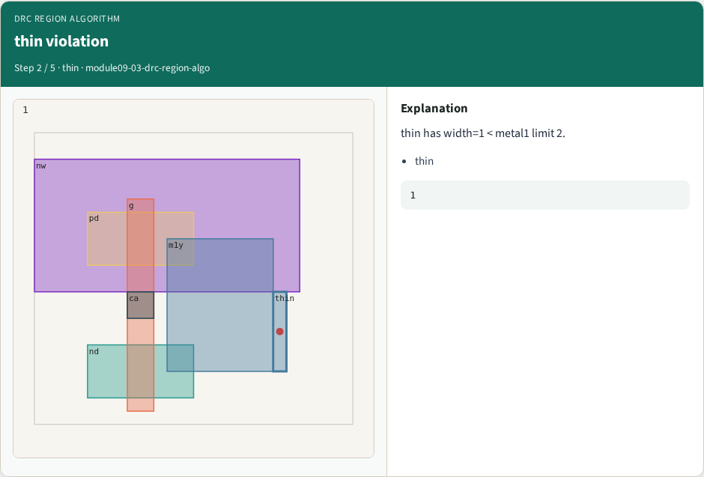
thin violation
thin violation
learn_magic — 03 drc region algo
Notes:
thin has width=1 < metal1 limit 2.

Slide 5

Other shapes
Other shapes
learn_magic — 03 drc region algo
Notes:
Other rects meet width rules.

Slide 6

One error
One error
learn_magic — 03 drc region algo
Notes:
Teaching golden drc_error_count=1.

Slide 7

Golden
Golden
learn_magic — 03 drc region algo
Notes:
GOLDEN: error on thin metal1.

Slide 8
Browser lab track
Open drc-region-algo
Run connectivity / DRC / extract / bind, then Check
learn_magic — 03 drc region algo
Notes:
Open **drc-region-algo**. Run connectivity / DRC / extract / bind, then Check.

Slide 9
Implement track
From common/, run algo_solvers.py and partc_bind.py
learn_magic — 03 drc region algo
Notes:
From common/, run algo_solvers.py and partc_bind.py.

Slide 10
Pitfalls
Changing tiny_algo_magic without updating Part B goldens
Ignoring the bind side
learn_magic — 03 drc region algo
Notes:
Changing tiny_algo_magic without updating Part B goldens. Ignoring the bind side.

Slide 11
Try these
From the common folder, run the Part C self-tests
learn_magic — 03 drc region algo
Notes:
From the common folder, run the Part C self-tests.

Slide 12
Try these — try these
cd courses/learn_magic/common
python3 algo_solvers.py
python3 partc_bind.py
learn_magic — 03 drc region algo

Slide 13
Pseudocode
Here is the check in plain steps
learn_magic — 03 drc region algo
Notes:
Here is the check in plain steps.

Slide 14
Pseudocode — try these
drc_error_count=1 on thin metal1.
ok if goldens match and bind
learn_magic — 03 drc region algo

Slide 15
Next
Complete the quiz for this part
Continue Part C, then internals literacy
learn_magic — 03 drc region algo
Notes:
Continue Part C, then internals literacy.

