Slide 1
Why Magic internals
Map Tile / Plane / CellDef to the Magic C tree
learn_magic — 01 tile plane model
Notes:
Map Tile / Plane / CellDef to the Magic C tree.

Slide 2
The idea
GOLDEN: Name the three pillars and how Plane holds DRC rules
learn_magic — 01 tile plane model
Notes:
GOLDEN: Name the three pillars and how Plane holds DRC rules.

Slide 3
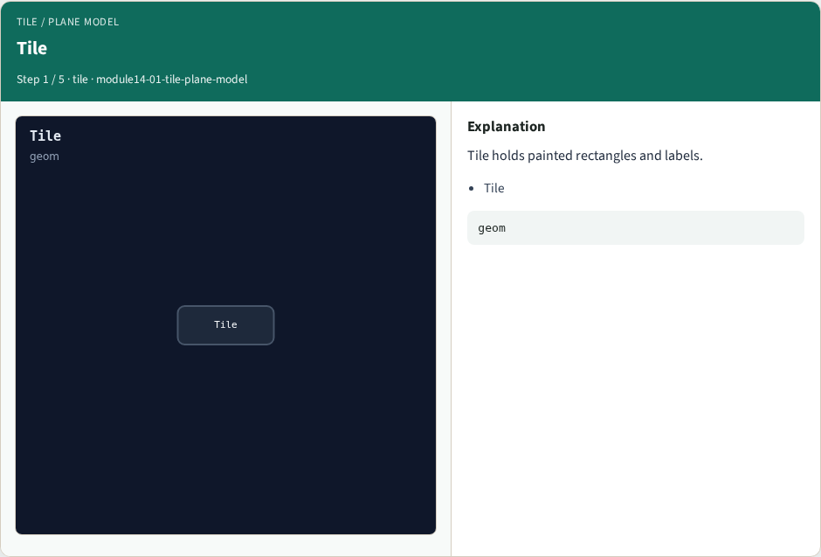
Tile
Tile
learn_magic — 01 tile plane model
Notes:
Tile holds painted rectangles and labels.

Slide 4

Plane
Plane
learn_magic — 01 tile plane model
Notes:
Plane holds layer definitions and DRC rules.

Slide 5

CellDef
CellDef
learn_magic — 01 tile plane model
Notes:
CellDef holds ports and hierarchy metadata.

Slide 6

Nesting
Nesting
learn_magic — 01 tile plane model
Notes:
Tiles live on Planes; CellDef wraps the cell view.

Slide 7

Golden
Golden
learn_magic — 01 tile plane model
Notes:
GOLDEN: Tile, Plane, CellDef — three pillars.

Slide 8
Browser lab track
Open tile-plane-model
Click through stages and check goldens
learn_magic — 01 tile plane model
Notes:
Open **tile-plane-model**. Click through stages and check goldens.

Slide 9
Implement track
Call tile_plane_model() in internals_solvers; assert golden match
learn_magic — 01 tile plane model
Notes:
Call tile_plane_model() in internals_solvers; assert golden match.

Slide 10
Pitfalls
Treating browser JSON as the C API
Confusing Tile with OpenSTA Graph
learn_magic — 01 tile plane model
Notes:
Treating browser JSON as the C API. Confusing Tile with OpenSTA Graph.

Slide 11
Try these
From the common folder, run the internals self-test
learn_magic — 01 tile plane model
Notes:
From the common folder, run the internals self-test.

Slide 12
Try these — try these
cd courses/learn_magic/common
python3 internals_solvers.py
learn_magic — 01 tile plane model

Slide 13
Pseudocode
Here is the checklist in plain steps
learn_magic — 01 tile plane model
Notes:
Here is the checklist in plain steps.

Slide 14
Pseudocode — try these
Name the three pillars and how Plane holds DRC rules.
learn_magic — 01 tile plane model

Slide 15
Next
Complete the quiz for this part
Wrap the Magic path , map, CLI evidence, algorithms, and C tree literacy
learn_magic — 01 tile plane model
Notes:
Wrap the Magic path — map, CLI evidence, algorithms, and C tree literacy.

