Slide 1
Why Magic internals
Read the DRC scan → marker shape bound to Part B goldens
learn_magic — 03 read drc cifwrite
Notes:
Read the DRC scan → marker shape bound to Part B goldens.

Slide 2
The idea
GOLDEN: load_rules → scan_region → emit_marker (drc=1); cifwrite stages
learn_magic — 03 read drc cifwrite
Notes:
GOLDEN: load_rules → scan_region → emit_marker (drc=1); cifwrite stages.

Slide 3

load_rules
load_rules
learn_magic — 03 read drc cifwrite
Notes:
Load tech min_width for metal1 from Plane.

Slide 4

scan_region
scan_region
learn_magic — 03 read drc cifwrite
Notes:
Walk tiles on the active plane.

Slide 5

emit_marker
emit_marker
learn_magic — 03 read drc cifwrite
Notes:
Flag thin rect (width=1 < limit=2).

Slide 6
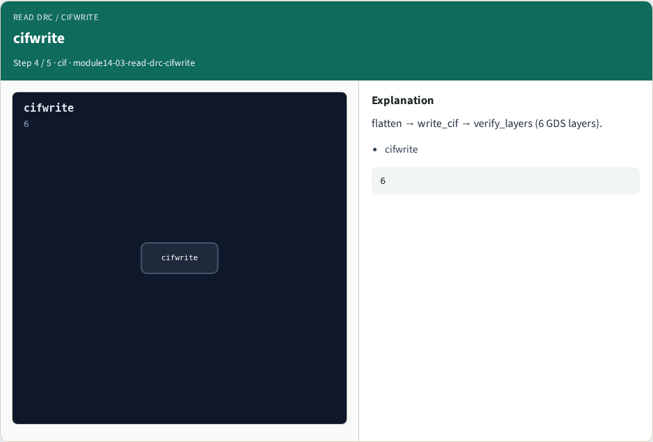
cifwrite
cifwrite
learn_magic — 03 read drc cifwrite
Notes:
flatten → write_cif → verify_layers (6 GDS layers).

Slide 7

Golden
Golden
learn_magic — 03 read drc cifwrite
Notes:
GOLDEN: DRC→Part B drc=1; GDS layers=6.

Slide 8
Browser lab track
Open read-drc-cifwrite
Click through stages and check goldens
learn_magic — 03 read drc cifwrite
Notes:
Open **read-drc-cifwrite**. Click through stages and check goldens.

Slide 9
Implement track
Call read_drc_cifwrite() in internals_solvers; assert golden match
learn_magic — 03 read drc cifwrite
Notes:
Call read_drc_cifwrite() in internals_solvers; assert golden match.

Slide 10
Pitfalls
Treating browser JSON as the C API
Confusing Tile with OpenSTA Graph
learn_magic — 03 read drc cifwrite
Notes:
Treating browser JSON as the C API. Confusing Tile with OpenSTA Graph.

Slide 11
Try these
From the common folder, run the internals self-test
learn_magic — 03 read drc cifwrite
Notes:
From the common folder, run the internals self-test.

Slide 12
Try these — try these
cd courses/learn_magic/common
python3 internals_solvers.py
learn_magic — 03 read drc cifwrite

Slide 13
Pseudocode
Here is the checklist in plain steps
learn_magic — 03 read drc cifwrite
Notes:
Here is the checklist in plain steps.

Slide 14
Pseudocode — try these
load_rules → scan_region → emit_marker (drc=1); cifwrite stages.
learn_magic — 03 read drc cifwrite

Slide 15
Next
Complete the quiz for this part
Wrap the Magic path , map, CLI evidence, algorithms, and C tree literacy
learn_magic — 03 read drc cifwrite
Notes:
Wrap the Magic path — map, CLI evidence, algorithms, and C tree literacy.

