Slide 1
Why Magic internals
Know where a new Tcl command lives and the minimal stub to build
learn_magic — 03 contribute magic
Notes:
Know where a new Tcl command lives and the minimal stub to build.

Slide 2
The idea
GOLDEN: commands/cmd_drc.c + Tcl register + Makefile + magic -help drc
learn_magic — 03 contribute magic
Notes:
GOLDEN: commands/cmd_drc.c + Tcl register + Makefile + magic -help drc.

Slide 3

Tree layout
Tree layout
learn_magic — 03 contribute magic
Notes:
tiles/planes/cells hold layout; commands/ holds Tcl.

Slide 4

Stub file
Stub file
learn_magic — 03 contribute magic
Notes:
Minimal .c: Tcl command drc registration.

Slide 5

Makefile hook
Makefile hook
learn_magic — 03 contribute magic
Notes:
Add object to Makefile and rebuild Magic.

Slide 6

Smoke
Smoke
learn_magic — 03 contribute magic
Notes:
magic -help drc proves the command exists.

Slide 7
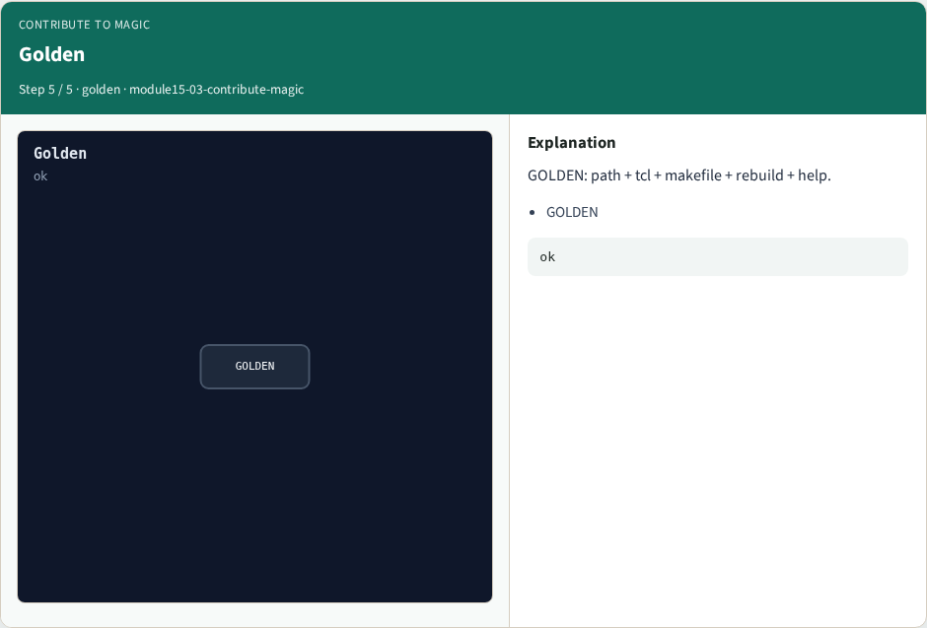
Golden
Golden
learn_magic — 03 contribute magic
Notes:
GOLDEN: path + tcl + makefile + rebuild + help.

Slide 8
Browser lab track
Open contribute-magic
Click through stages and check goldens
learn_magic — 03 contribute magic
Notes:
Open **contribute-magic**. Click through stages and check goldens.

Slide 9
Implement track
Call contribute_magic() in internals_solvers; assert golden match
learn_magic — 03 contribute magic
Notes:
Call contribute_magic() in internals_solvers; assert golden match.

Slide 10
Pitfalls
Treating browser JSON as the C API
Confusing Tile with OpenSTA Graph
learn_magic — 03 contribute magic
Notes:
Treating browser JSON as the C API. Confusing Tile with OpenSTA Graph.

Slide 11
Try these
From the common folder, run the internals self-test
learn_magic — 03 contribute magic
Notes:
From the common folder, run the internals self-test.

Slide 12
Try these — try these
cd courses/learn_magic/common
python3 internals_solvers.py
learn_magic — 03 contribute magic

Slide 13
Pseudocode
Here is the checklist in plain steps
learn_magic — 03 contribute magic
Notes:
Here is the checklist in plain steps.

Slide 14
Pseudocode — try these
commands/cmd_drc.c + Tcl register + Makefile + magic -help drc.
learn_magic — 03 contribute magic

Slide 15
Next
Complete the quiz for this part
Wrap the Magic path , map, CLI evidence, algorithms, and C tree literacy
learn_magic — 03 contribute magic
Notes:
Wrap the Magic path — map, CLI evidence, algorithms, and C tree literacy.

