Slide 1
Why Read
Read schematic and layout SPICE-like netlists
learn_netgen — 01 read netlists map
Notes:
Read schematic and layout SPICE-like netlists.

Slide 2
The idea
GOLDEN: sch/lay devices=2
learn_netgen — 01 read netlists map
Notes:
GOLDEN: sch/lay devices=2.

Slide 3
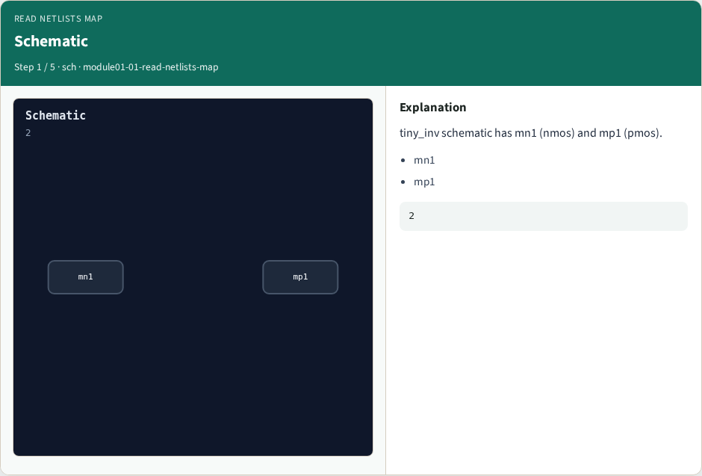
Schematic
Schematic
learn_netgen — 01 read netlists map
Notes:
tiny_inv schematic has mn1 (nmos) and mp1 (pmos).

Slide 4
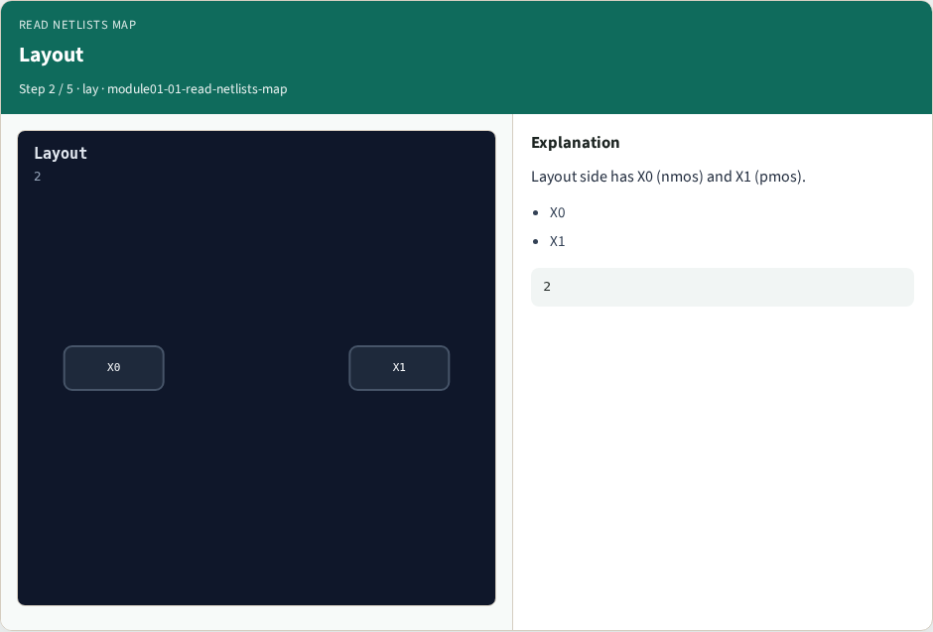
Layout
Layout
learn_netgen — 01 read netlists map
Notes:
Layout side has X0 (nmos) and X1 (pmos).

Slide 5

Four ports
Four ports
learn_netgen — 01 read netlists map
Notes:
Ports A, Y, VDD, VSS on both sides.

Slide 6

read command
read command
learn_netgen — 01 read netlists map
Notes:
Netgen read loads SPICE-like netlists.

Slide 7

Golden
Golden
learn_netgen — 01 read netlists map
Notes:
GOLDEN: sch_devices=2 lay_devices=2.

Slide 8
Browser lab track
Open read-netlists-map
Run the stage buttons and Check the goldens
learn_netgen — 01 read netlists map
Notes:
Open **read-netlists-map**. Run the stage buttons and Check the goldens.

Slide 9
Implement track
From common/, run solvers.py and confirm NETGEN_PARTA_OK
learn_netgen — 01 read netlists map
Notes:
From common/, run solvers.py and confirm NETGEN_PARTA_OK.

Slide 10
Pitfalls
Confusing schematic SPICE with layout extract
Forgetting permute on source/drain
learn_netgen — 01 read netlists map
Notes:
Confusing schematic SPICE with layout extract. Forgetting permute on source/drain.

Slide 11
Try these
From the common folder, run the Netgen map self-test
learn_netgen — 01 read netlists map
Notes:
From the common folder, run the Netgen map self-test.

Slide 12
Try these — try these
cd courses/learn_netgen/common
python3 solvers.py
learn_netgen — 01 read netlists map

Slide 13
Pseudocode
Here is the check in plain steps
learn_netgen — 01 read netlists map
Notes:
Here is the check in plain steps.

Slide 14
Pseudocode — try these
sch/lay devices=2.
ok if goldens match
learn_netgen — 01 read netlists map

Slide 15
Next
Complete the quiz for this part
Continue the Netgen Part A map, then the real CLI track
learn_netgen — 01 read netlists map
Notes:
Continue the Netgen Part A map, then the real CLI track.

