Slide 1
Why Compare
Match net names between schematic and layout
learn_netgen — 03 compare nets map
Notes:
Match net names between schematic and layout.

Slide 2
The idea
GOLDEN: matched_nets=4
learn_netgen — 03 compare nets map
Notes:
GOLDEN: matched_nets=4.

Slide 3
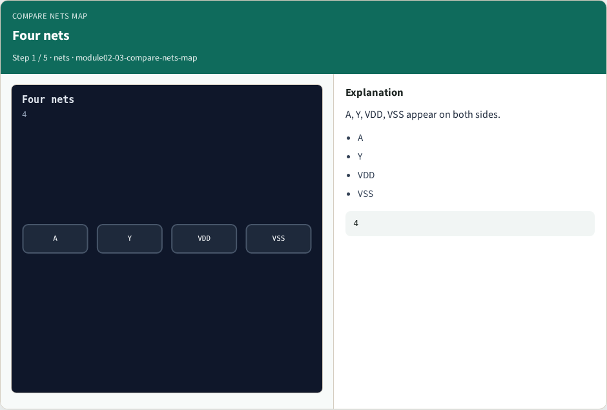
Four nets
Four nets
learn_netgen — 03 compare nets map
Notes:
A, Y, VDD, VSS appear on both sides.

Slide 4

All match
All match
learn_netgen — 03 compare nets map
Notes:
Set intersection gives four matched nets.

Slide 5
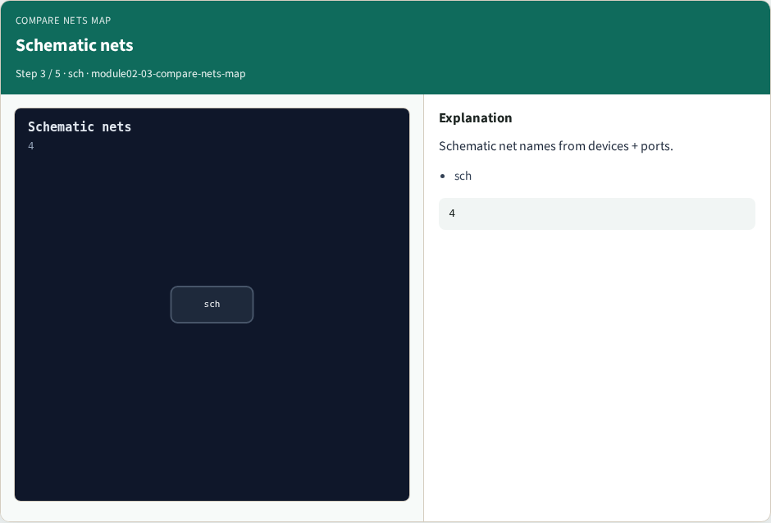
Schematic nets
Schematic nets
learn_netgen — 03 compare nets map
Notes:
Schematic net names from devices + ports.

Slide 6

Layout nets
Layout nets
learn_netgen — 03 compare nets map
Notes:
Layout net names from extract SPICE.

Slide 7

Golden
Golden
learn_netgen — 03 compare nets map
Notes:
GOLDEN: matched_nets=4.

Slide 8
Browser lab track
Open compare-nets-map
Run the stage buttons and Check the goldens
learn_netgen — 03 compare nets map
Notes:
Open **compare-nets-map**. Run the stage buttons and Check the goldens.

Slide 9
Implement track
From common/, run solvers.py and confirm NETGEN_PARTA_OK
learn_netgen — 03 compare nets map
Notes:
From common/, run solvers.py and confirm NETGEN_PARTA_OK.

Slide 10
Pitfalls
Confusing schematic SPICE with layout extract
Forgetting permute on source/drain
learn_netgen — 03 compare nets map
Notes:
Confusing schematic SPICE with layout extract. Forgetting permute on source/drain.

Slide 11
Try these
From the common folder, run the Netgen map self-test
learn_netgen — 03 compare nets map
Notes:
From the common folder, run the Netgen map self-test.

Slide 12
Try these — try these
cd courses/learn_netgen/common
python3 solvers.py
learn_netgen — 03 compare nets map

Slide 13
Pseudocode
Here is the check in plain steps
learn_netgen — 03 compare nets map
Notes:
Here is the check in plain steps.

Slide 14
Pseudocode — try these
matched_nets=4.
ok if goldens match
learn_netgen — 03 compare nets map

Slide 15
Next
Complete the quiz for this part
Continue the Netgen Part A map, then the real CLI track
learn_netgen — 03 compare nets map
Notes:
Continue the Netgen Part A map, then the real CLI track.

