Slide 1
Why LVS
LVS report: matched devices and mismatches
learn_netgen — 01 lvs report map
Notes:
LVS report: matched devices and mismatches.

Slide 2
The idea
GOLDEN: matched_devices=2; mismatch=0
learn_netgen — 01 lvs report map
Notes:
GOLDEN: matched_devices=2; mismatch=0.

Slide 3
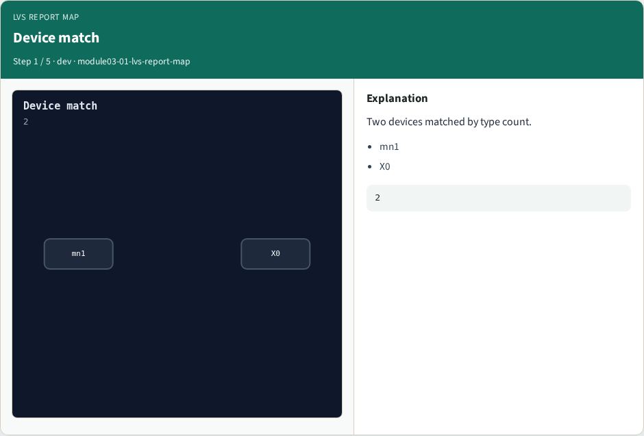
Device match
Device match
learn_netgen — 01 lvs report map
Notes:
Two devices matched by type count.

Slide 4

nmos/pmos
nmos/pmos
learn_netgen — 01 lvs report map
Notes:
One nmos + one pmos each side.

Slide 5
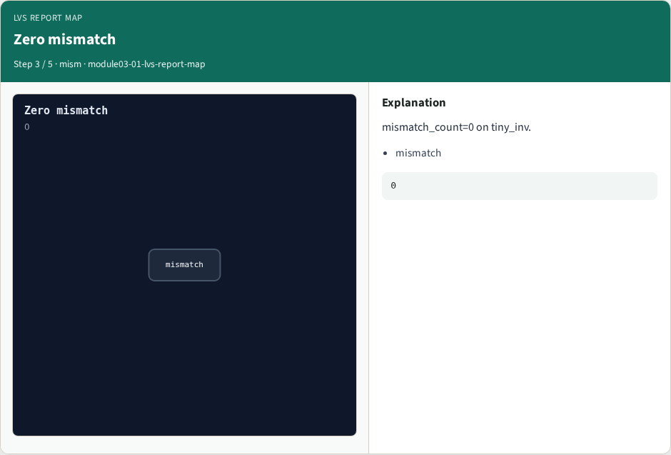
Zero mismatch
Zero mismatch
learn_netgen — 01 lvs report map
Notes:
mismatch_count=0 on tiny_inv.

Slide 6

LVS report
LVS report
learn_netgen — 01 lvs report map
Notes:
Netgen report summarizes compare.

Slide 7

Golden
Golden
learn_netgen — 01 lvs report map
Notes:
GOLDEN: matched_devices=2 mismatch=0.

Slide 8
Browser lab track
Open lvs-report-map
Run the stage buttons and Check the goldens
learn_netgen — 01 lvs report map
Notes:
Open **lvs-report-map**. Run the stage buttons and Check the goldens.

Slide 9
Implement track
From common/, run solvers.py and confirm NETGEN_PARTA_OK
learn_netgen — 01 lvs report map
Notes:
From common/, run solvers.py and confirm NETGEN_PARTA_OK.

Slide 10
Pitfalls
Confusing schematic SPICE with layout extract
Forgetting permute on source/drain
learn_netgen — 01 lvs report map
Notes:
Confusing schematic SPICE with layout extract. Forgetting permute on source/drain.

Slide 11
Try these
From the common folder, run the Netgen map self-test
learn_netgen — 01 lvs report map
Notes:
From the common folder, run the Netgen map self-test.

Slide 12
Try these — try these
cd courses/learn_netgen/common
python3 solvers.py
learn_netgen — 01 lvs report map

Slide 13
Pseudocode
Here is the check in plain steps
learn_netgen — 01 lvs report map
Notes:
Here is the check in plain steps.

Slide 14
Pseudocode — try these
matched_devices=2; mismatch=0.
ok if goldens match
learn_netgen — 01 lvs report map

Slide 15
Next
Complete the quiz for this part
Continue the Netgen Part A map, then the real CLI track
learn_netgen — 01 lvs report map
Notes:
Continue the Netgen Part A map, then the real CLI track.

