Slide 1
Why Netgen
Run the full Part A engine; ok when every golden matches
learn_netgen — 03 netgen engine
Notes:
Run the full Part A engine; ok when every golden matches.

Slide 2
The idea
GOLDEN: netgen_engine ok=True
learn_netgen — 03 netgen engine
Notes:
GOLDEN: netgen_engine ok=True.

Slide 3

Read ok
Read ok
learn_netgen — 03 netgen engine
Notes:
Read netlists stage passes.

Slide 4

Classes ok
Classes ok
learn_netgen — 03 netgen engine
Notes:
Device classes stage passes.

Slide 5

Permute ok
Permute ok
learn_netgen — 03 netgen engine
Notes:
Flatten permute stage passes.

Slide 6

Compare ok
Compare ok
learn_netgen — 03 netgen engine
Notes:
Compare nets stage passes.

Slide 7
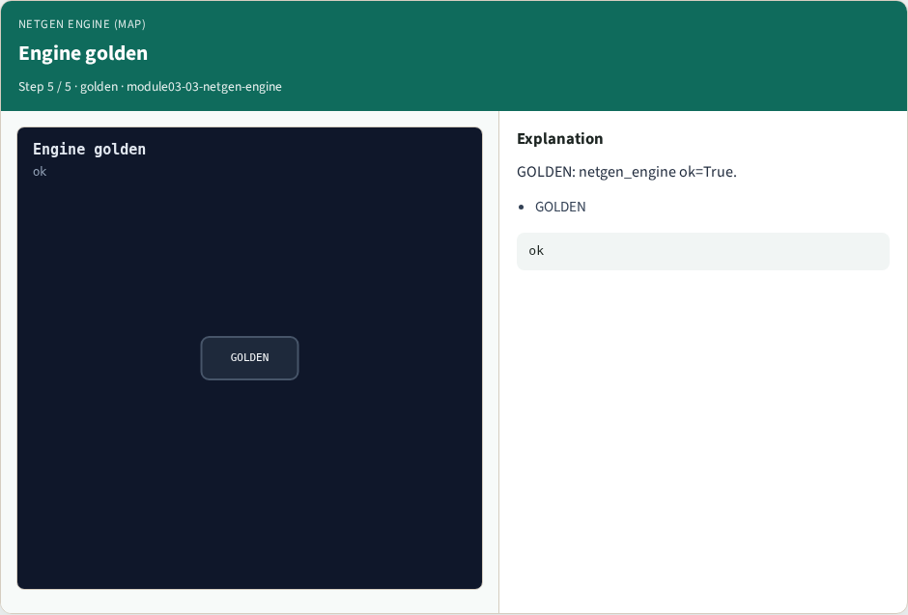
Engine golden
Engine golden
learn_netgen — 03 netgen engine
Notes:
GOLDEN: netgen_engine ok=True.

Slide 8
Browser lab track
Open netgen-engine
Run the stage buttons and Check the goldens
learn_netgen — 03 netgen engine
Notes:
Open **netgen-engine**. Run the stage buttons and Check the goldens.

Slide 9
Implement track
From common/, run solvers.py and confirm NETGEN_PARTA_OK
learn_netgen — 03 netgen engine
Notes:
From common/, run solvers.py and confirm NETGEN_PARTA_OK.

Slide 10
Pitfalls
Confusing schematic SPICE with layout extract
Forgetting permute on source/drain
learn_netgen — 03 netgen engine
Notes:
Confusing schematic SPICE with layout extract. Forgetting permute on source/drain.

Slide 11
Try these
From the common folder, run the Netgen map self-test
learn_netgen — 03 netgen engine
Notes:
From the common folder, run the Netgen map self-test.

Slide 12
Try these — try these
cd courses/learn_netgen/common
python3 solvers.py
learn_netgen — 03 netgen engine

Slide 13
Pseudocode
Here is the check in plain steps
learn_netgen — 03 netgen engine
Notes:
Here is the check in plain steps.

Slide 14
Pseudocode — try these
netgen_engine ok=True.
ok if goldens match
learn_netgen — 03 netgen engine

Slide 15
Next
Complete the quiz for this part
Continue the Netgen Part A map, then the real CLI track
learn_netgen — 03 netgen engine
Notes:
Continue the Netgen Part A map, then the real CLI track.

