Slide 1
Why real Netgen
Invoke netgen -batch script.tcl; recipe starts read_sch→read_lay
learn_netgen — 01 netgen cli
Notes:
Invoke netgen -batch script.tcl; recipe starts read_sch→read_lay.

Slide 2
The idea
GOLDEN: First two cmds: read_sch, read_lay
learn_netgen — 01 netgen cli
Notes:
GOLDEN: First two cmds: read_sch, read_lay.

Slide 3
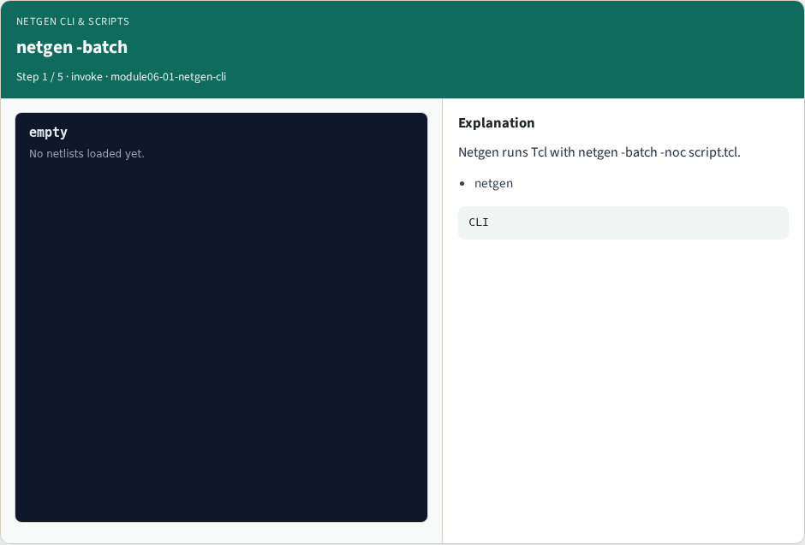
netgen -batch
netgen -batch
learn_netgen — 01 netgen cli
Notes:
Netgen runs Tcl with netgen -batch -noc script.tcl.

Slide 4

read sch
read sch
learn_netgen — 01 netgen cli
Notes:
First read schematic SPICE.

Slide 5

read lay
read lay
learn_netgen — 01 netgen cli
Notes:
Then read layout/extract SPICE.

Slide 6

compare
compare
learn_netgen — 01 netgen cli
Notes:
Compare nets and devices.

Slide 7

Golden
Golden
learn_netgen — 01 netgen cli
Notes:
GOLDEN: recipe prefix read_sch→read_lay.

Slide 8
Browser lab
Open netgen-cli
learn_netgen — 01 netgen cli
Notes:
Open **netgen-cli**.

Slide 9
Implement track
Run real_solvers.py , REAL_NETGEN_OK
learn_netgen — 01 netgen cli
Notes:
Run real_solvers.py — REAL_NETGEN_OK.

Slide 10
Pitfalls
Editing goldens without re-running scripts
learn_netgen — 01 netgen cli
Notes:
Editing goldens without re-running scripts.

Slide 11
Try these
From the common folder, run the real Netgen self-test
learn_netgen — 01 netgen cli
Notes:
From the common folder, run the real Netgen self-test.

Slide 12
Try these — try these
cd courses/learn_netgen/common
python3 real_solvers.py
learn_netgen — 01 netgen cli

Slide 13
Pseudocode
Here is the check in plain steps
learn_netgen — 01 netgen cli
Notes:
Here is the check in plain steps.

Slide 14
Pseudocode — try these
First two cmds: read_sch, read_lay.
ok if goldens match
learn_netgen — 01 netgen cli

Slide 15
Next
Complete the quiz for this part
Continue Part B evidence track
learn_netgen — 01 netgen cli
Notes:
Continue Part B evidence track.

