Slide 1
Why real Netgen
Read tiny_inv schematic and layout SPICE
learn_netgen — 01 real read spice
Notes:
Read tiny_inv schematic and layout SPICE.

Slide 2
The idea
GOLDEN: sch_devices=2; lay_devices=2; nets=4
learn_netgen — 01 real read spice
Notes:
GOLDEN: sch_devices=2; lay_devices=2; nets=4.

Slide 3
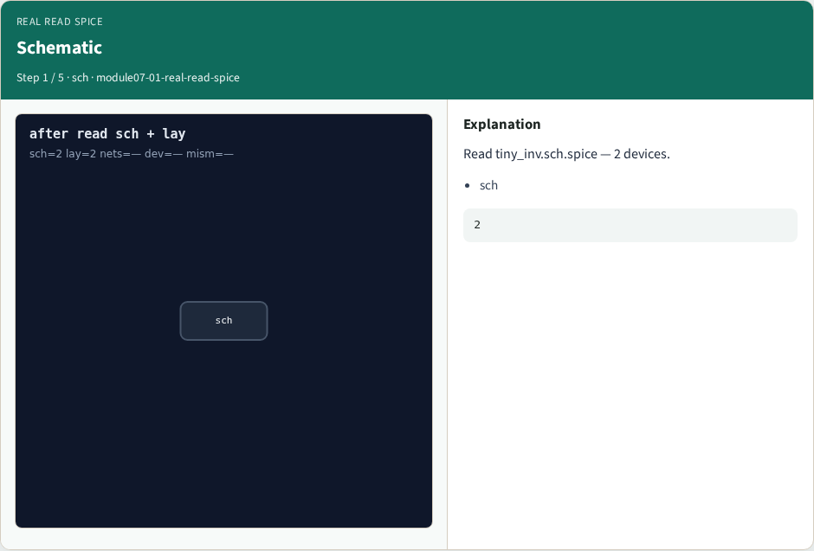
Schematic
Schematic
learn_netgen — 01 real read spice
Notes:
Read tiny_inv.sch.spice — 2 devices.

Slide 4

Layout
Layout
learn_netgen — 01 real read spice
Notes:
Read tiny_inv.lay.spice — 2 devices.

Slide 5

Four nets
Four nets
learn_netgen — 01 real read spice
Notes:
Four nets on each side.

Slide 6

tiny_inv
tiny_inv
learn_netgen — 01 real read spice
Notes:
Cell name tiny_inv.

Slide 7

Golden
Golden
learn_netgen — 01 real read spice
Notes:
GOLDEN: sch/lay devices=2 nets=4.

Slide 8
Browser lab
Open real-read-spice
learn_netgen — 01 real read spice
Notes:
Open **real-read-spice**.

Slide 9
Implement track
Run real_solvers.py , REAL_NETGEN_OK
learn_netgen — 01 real read spice
Notes:
Run real_solvers.py — REAL_NETGEN_OK.

Slide 10
Pitfalls
Editing goldens without re-running scripts
learn_netgen — 01 real read spice
Notes:
Editing goldens without re-running scripts.

Slide 11
Try these
From the common folder, run the real Netgen self-test
learn_netgen — 01 real read spice
Notes:
From the common folder, run the real Netgen self-test.

Slide 12
Try these — try these
cd courses/learn_netgen/common
python3 real_solvers.py
learn_netgen — 01 real read spice

Slide 13
Pseudocode
Here is the check in plain steps
learn_netgen — 01 real read spice
Notes:
Here is the check in plain steps.

Slide 14
Pseudocode — try these
sch_devices=2; lay_devices=2; nets=4.
ok if goldens match
learn_netgen — 01 real read spice

Slide 15
Next
Complete the quiz for this part
Continue Part B evidence track
learn_netgen — 01 real read spice
Notes:
Continue Part B evidence track.

