Slide 1
Why real Netgen
Compare nets and devices between sch and lay
learn_netgen — 03 real lvs compare
Notes:
Compare nets and devices between sch and lay.

Slide 2
The idea
GOLDEN: matched_nets=4; matched_devices=2; mismatch=0
learn_netgen — 03 real lvs compare
Notes:
GOLDEN: matched_nets=4; matched_devices=2; mismatch=0.

Slide 3

compare
compare
learn_netgen — 03 real lvs compare
Notes:
Netgen compare matches nets/devices.

Slide 4

Four nets
Four nets
learn_netgen — 03 real lvs compare
Notes:
Four nets matched.

Slide 5

Two devices
Two devices
learn_netgen — 03 real lvs compare
Notes:
Two devices matched.

Slide 6
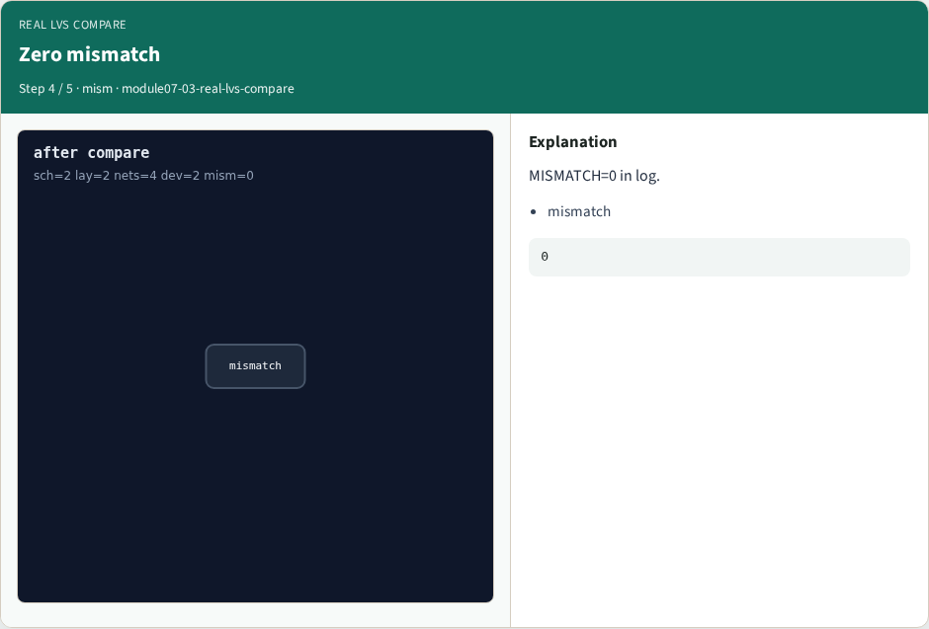
Zero mismatch
Zero mismatch
learn_netgen — 03 real lvs compare
Notes:
MISMATCH=0 in log.

Slide 7

Golden
Golden
learn_netgen — 03 real lvs compare
Notes:
GOLDEN: matched_nets=4 matched_devices=2.

Slide 8
Browser lab
Open real-lvs-compare
learn_netgen — 03 real lvs compare
Notes:
Open **real-lvs-compare**.

Slide 9
Implement track
Run real_solvers.py , REAL_NETGEN_OK
learn_netgen — 03 real lvs compare
Notes:
Run real_solvers.py — REAL_NETGEN_OK.

Slide 10
Pitfalls
Editing goldens without re-running scripts
learn_netgen — 03 real lvs compare
Notes:
Editing goldens without re-running scripts.

Slide 11
Try these
From the common folder, run the real Netgen self-test
learn_netgen — 03 real lvs compare
Notes:
From the common folder, run the real Netgen self-test.

Slide 12
Try these — try these
cd courses/learn_netgen/common
python3 real_solvers.py
learn_netgen — 03 real lvs compare

Slide 13
Pseudocode
Here is the check in plain steps
learn_netgen — 03 real lvs compare
Notes:
Here is the check in plain steps.

Slide 14
Pseudocode — try these
matched_nets=4; matched_devices=2; mismatch=0.
ok if goldens match
learn_netgen — 03 real lvs compare

Slide 15
Next
Complete the quiz for this part
Continue Part B evidence track
learn_netgen — 03 real lvs compare
Notes:
Continue Part B evidence track.

