Slide 1
Why real Netgen
Run the full real Netgen engine against goldens
learn_netgen — 03 netgen evidence
Notes:
Run the full real Netgen engine against goldens.

Slide 2
The idea
GOLDEN: real_netgen_engine ok=True
learn_netgen — 03 netgen evidence
Notes:
GOLDEN: real_netgen_engine ok=True.

Slide 3

Full recipe
Full recipe
learn_netgen — 03 netgen evidence
Notes:
Golden recipe has six Tcl stages.

Slide 4

Read golden
Read golden
learn_netgen — 03 netgen evidence
Notes:
Still 2 sch + 2 lay devices.

Slide 5
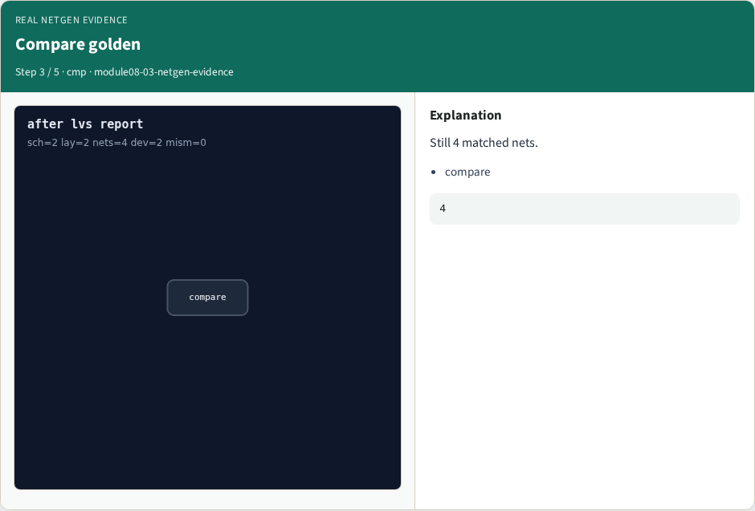
Compare golden
Compare golden
learn_netgen — 03 netgen evidence
Notes:
Still 4 matched nets.

Slide 6

Report golden
Report golden
learn_netgen — 03 netgen evidence
Notes:
Still mismatch=0.

Slide 7

Engine
Engine
learn_netgen — 03 netgen evidence
Notes:
GOLDEN: real_netgen_engine ok=True.

Slide 8
Browser lab
Open netgen-evidence
learn_netgen — 03 netgen evidence
Notes:
Open **netgen-evidence**.

Slide 9
Implement track
Run real_solvers.py , REAL_NETGEN_OK
learn_netgen — 03 netgen evidence
Notes:
Run real_solvers.py — REAL_NETGEN_OK.

Slide 10
Pitfalls
Editing goldens without re-running scripts
learn_netgen — 03 netgen evidence
Notes:
Editing goldens without re-running scripts.

Slide 11
Try these
From the common folder, run the real Netgen self-test
learn_netgen — 03 netgen evidence
Notes:
From the common folder, run the real Netgen self-test.

Slide 12
Try these — try these
cd courses/learn_netgen/common
python3 real_solvers.py
learn_netgen — 03 netgen evidence

Slide 13
Pseudocode
Here is the check in plain steps
learn_netgen — 03 netgen evidence
Notes:
Here is the check in plain steps.

Slide 14
Pseudocode — try these
real_netgen_engine ok=True.
ok if goldens match
learn_netgen — 03 netgen evidence

Slide 15
Next
Complete the quiz for this part
Continue Part B evidence track
learn_netgen — 03 netgen evidence
Notes:
Continue Part B evidence track.

