Slide 1
Why algorithms
Hash devices by nmos/pmos class for compare
learn_netgen — 01 hash devices algo
Notes:
Hash devices by nmos/pmos class for compare.

Slide 2
The idea
GOLDEN: hash_device_count=2
learn_netgen — 01 hash devices algo
Notes:
GOLDEN: hash_device_count=2.

Slide 3
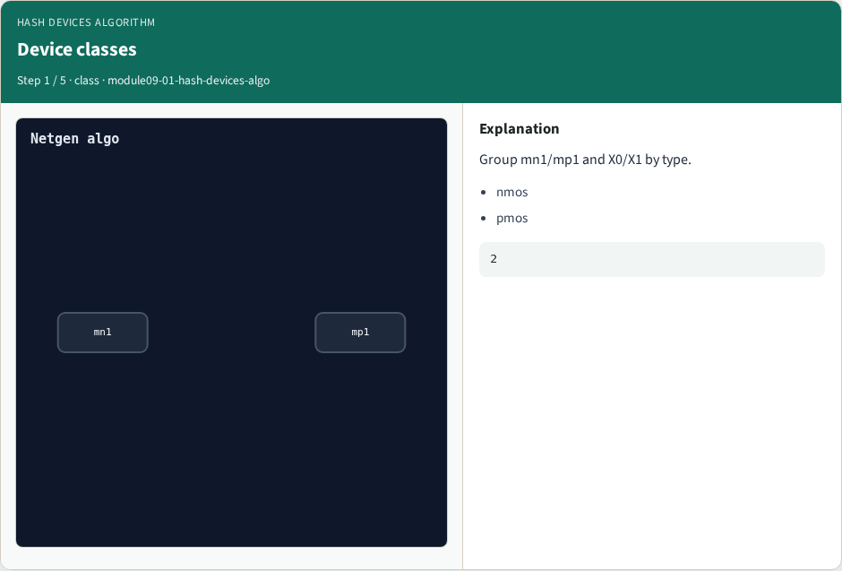
Device classes
Device classes
learn_netgen — 01 hash devices algo
Notes:
Group mn1/mp1 and X0/X1 by type.

Slide 4

Hash buckets
Hash buckets
learn_netgen — 01 hash devices algo
Notes:
Two class buckets for compare.

Slide 5

Schematic side
Schematic side
learn_netgen — 01 hash devices algo
Notes:
mn1 nmos, mp1 pmos.

Slide 6

Layout side
Layout side
learn_netgen — 01 hash devices algo
Notes:
X0 nmos, X1 pmos.

Slide 7
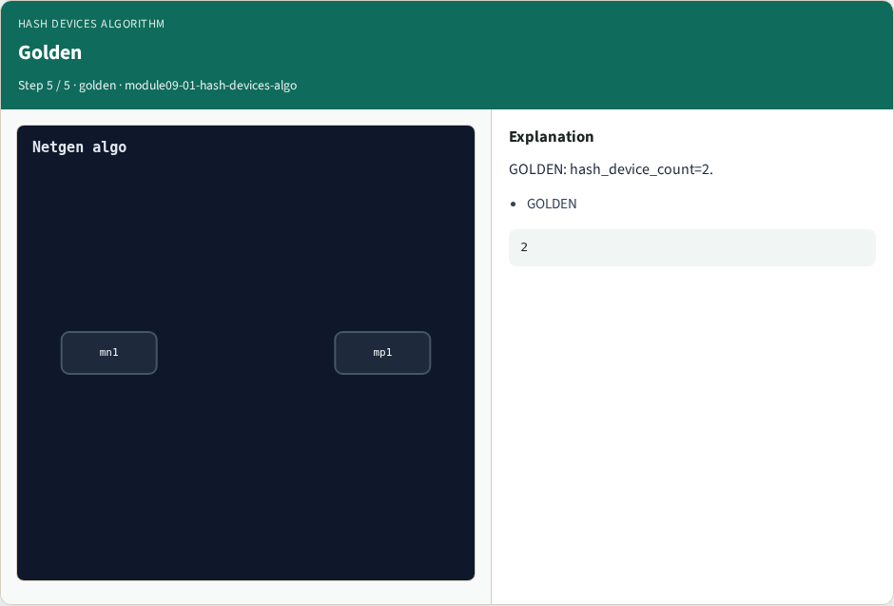
Golden
Golden
learn_netgen — 01 hash devices algo
Notes:
GOLDEN: hash_device_count=2.

Slide 8
Browser lab
Open hash-devices-algo
learn_netgen — 01 hash devices algo
Notes:
Open **hash-devices-algo**.

Slide 9
Implement track
Run algo_solvers.py and partc_bind.py
learn_netgen — 01 hash devices algo
Notes:
Run algo_solvers.py and partc_bind.py.

Slide 10
Pitfalls
Changing tiny_algo_netgen without updating Part B goldens
learn_netgen — 01 hash devices algo
Notes:
Changing tiny_algo_netgen without updating Part B goldens.

Slide 11
Try these
From the common folder, run the Part C self-tests
learn_netgen — 01 hash devices algo
Notes:
From the common folder, run the Part C self-tests.

Slide 12
Try these — try these
cd courses/learn_netgen/common
python3 algo_solvers.py
python3 partc_bind.py
learn_netgen — 01 hash devices algo

Slide 13
Pseudocode
Here is the check in plain steps
learn_netgen — 01 hash devices algo
Notes:
Here is the check in plain steps.

Slide 14
Pseudocode — try these
hash_device_count=2.
ok if goldens match and bind
learn_netgen — 01 hash devices algo

Slide 15
Next
Complete the quiz for this part
Continue Part C, then internals
learn_netgen — 01 hash devices algo
Notes:
Continue Part C, then internals.

