Slide 1
Why algorithms
Permute source/drain within MOSFET class
learn_netgen — 01 permute pins algo
Notes:
Permute source/drain within MOSFET class.

Slide 2
The idea
GOLDEN: permute_ok=True
learn_netgen — 01 permute pins algo
Notes:
GOLDEN: permute_ok=True.

Slide 3

D/S permute
D/S permute
learn_netgen — 01 permute pins algo
Notes:
Drain and source may swap.

Slide 4
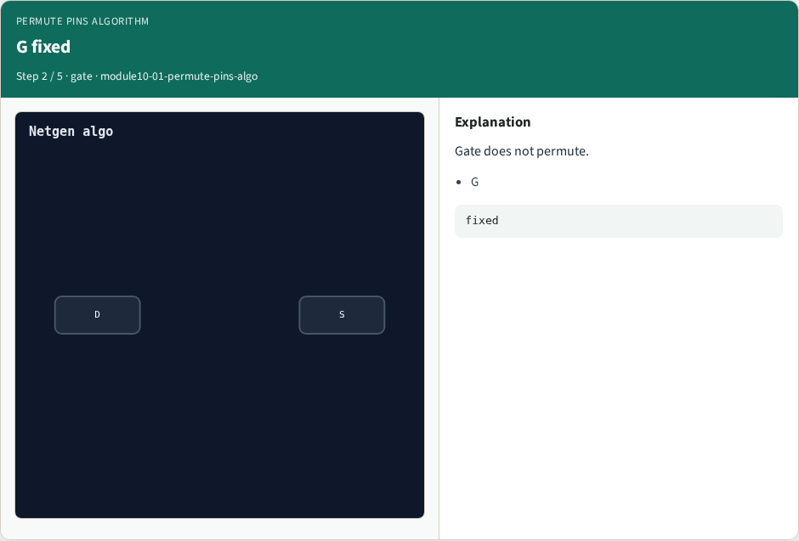
G fixed
G fixed
learn_netgen — 01 permute pins algo
Notes:
Gate does not permute.

Slide 5

nmos rule
nmos rule
learn_netgen — 01 permute pins algo
Notes:
nmos permute includes D,S.

Slide 6

pmos rule
pmos rule
learn_netgen — 01 permute pins algo
Notes:
pmos permute includes D,S.

Slide 7

Golden
Golden
learn_netgen — 01 permute pins algo
Notes:
GOLDEN: permute_ok=True.

Slide 8
Browser lab
Open permute-pins-algo
learn_netgen — 01 permute pins algo
Notes:
Open **permute-pins-algo**.

Slide 9
Implement track
Run algo_solvers.py and partc_bind.py
learn_netgen — 01 permute pins algo
Notes:
Run algo_solvers.py and partc_bind.py.

Slide 10
Pitfalls
Changing tiny_algo_netgen without updating Part B goldens
learn_netgen — 01 permute pins algo
Notes:
Changing tiny_algo_netgen without updating Part B goldens.

Slide 11
Try these
From the common folder, run the Part C self-tests
learn_netgen — 01 permute pins algo
Notes:
From the common folder, run the Part C self-tests.

Slide 12
Try these — try these
cd courses/learn_netgen/common
python3 algo_solvers.py
python3 partc_bind.py
learn_netgen — 01 permute pins algo

Slide 13
Pseudocode
Here is the check in plain steps
learn_netgen — 01 permute pins algo
Notes:
Here is the check in plain steps.

Slide 14
Pseudocode — try these
permute_ok=True.
ok if goldens match and bind
learn_netgen — 01 permute pins algo

Slide 15
Next
Complete the quiz for this part
Continue Part C, then internals
learn_netgen — 01 permute pins algo
Notes:
Continue Part C, then internals.

