Slide 1
Why Netgen internals
Read the compare flow bound to Part B goldens
learn_netgen — 03 read compare c
Notes:
Read the compare flow bound to Part B goldens.

Slide 2
The idea
GOLDEN: read_sch→read_lay→hash→match→emit (matched=2/4)
learn_netgen — 03 read compare c
Notes:
GOLDEN: read_sch→read_lay→hash→match→emit (matched=2/4).

Slide 3
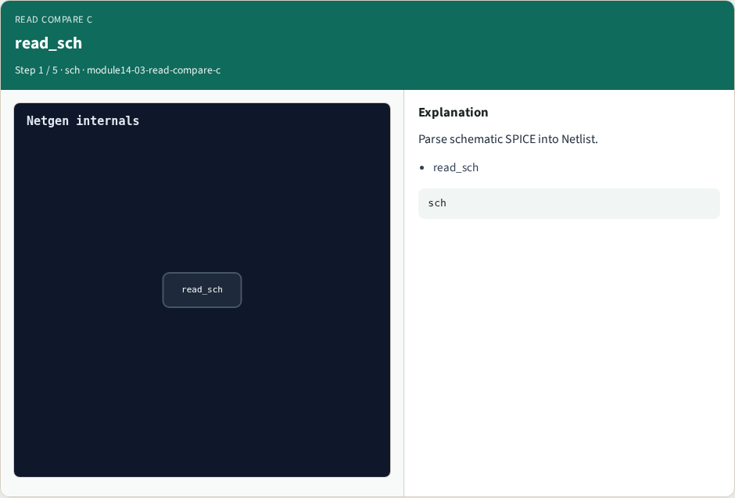
read_sch
read_sch
learn_netgen — 03 read compare c
Notes:
Parse schematic SPICE into Netlist.

Slide 4

read_lay
read_lay
learn_netgen — 03 read compare c
Notes:
Parse layout SPICE into Netlist.

Slide 5
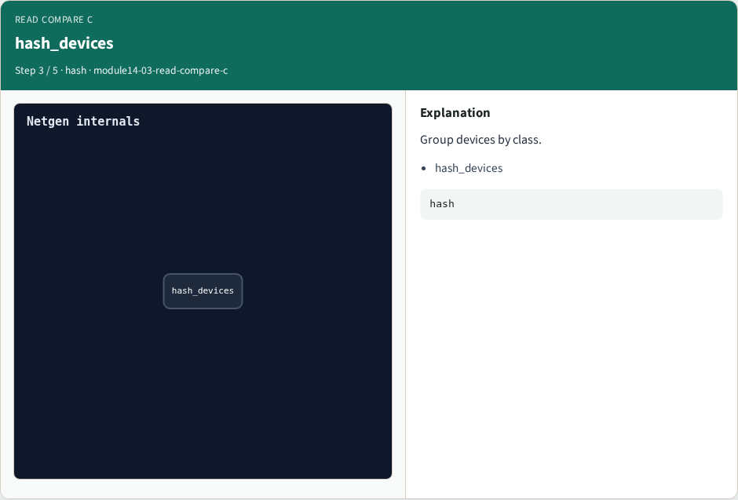
hash_devices
hash_devices
learn_netgen — 03 read compare c
Notes:
Group devices by class.

Slide 6

match_nets
match_nets
learn_netgen — 03 read compare c
Notes:
Compare net connectivity.

Slide 7

Golden
Golden
learn_netgen — 03 read compare c
Notes:
GOLDEN: matched=2/4 mismatch=0.

Slide 8
Browser lab
Open read-compare-c
learn_netgen — 03 read compare c
Notes:
Open **read-compare-c**.

Slide 9
Implement track
Call read_compare_c() in internals_solvers
learn_netgen — 03 read compare c
Notes:
Call read_compare_c() in internals_solvers.

Slide 10
Pitfalls
Treating browser JSON as the C API
learn_netgen — 03 read compare c
Notes:
Treating browser JSON as the C API.

Slide 11
Try these
From the common folder, run the internals self-test
learn_netgen — 03 read compare c
Notes:
From the common folder, run the internals self-test.

Slide 12
Try these — try these
cd courses/learn_netgen/common
python3 internals_solvers.py
learn_netgen — 03 read compare c

Slide 13
Pseudocode
Here is the checklist in plain steps
learn_netgen — 03 read compare c
Notes:
Here is the checklist in plain steps.

Slide 14
Pseudocode — try these
read_sch→read_lay→hash→match→emit (matched=2/4).
ok if goldens match INTERNALS_GOLDENS
learn_netgen — 03 read compare c

Slide 15
Next
Complete the quiz for this part
Wrap the Netgen path
learn_netgen — 03 read compare c
Notes:
Wrap the Netgen path.

