Slide 1
Why Netgen internals
Know where a new Tcl command lives and the minimal stub to build
learn_netgen — 03 contribute netgen
Notes:
Know where a new Tcl command lives and the minimal stub to build.

Slide 2
The idea
GOLDEN: tclcmd/cmd_lvs.c + register + Makefile + netgen help lvs
learn_netgen — 03 contribute netgen
Notes:
GOLDEN: tclcmd/cmd_lvs.c + register + Makefile + netgen help lvs.

Slide 3

Tree layout
Tree layout
learn_netgen — 03 contribute netgen
Notes:
netcomp/ and tclcmd/ hold compare and Tcl.

Slide 4

Stub file
Stub file
learn_netgen — 03 contribute netgen
Notes:
Minimal .c: Tcl command lvs registration.

Slide 5
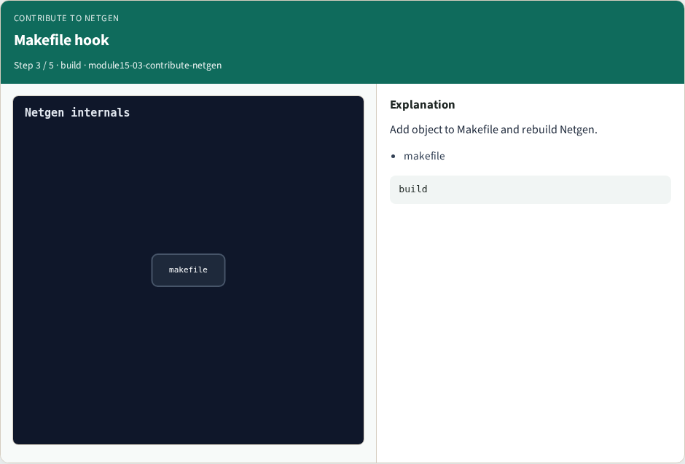
Makefile hook
Makefile hook
learn_netgen — 03 contribute netgen
Notes:
Add object to Makefile and rebuild Netgen.

Slide 6

Smoke
Smoke
learn_netgen — 03 contribute netgen
Notes:
netgen help lvs proves the command exists.

Slide 7

Golden
Golden
learn_netgen — 03 contribute netgen
Notes:
GOLDEN: path + tcl + makefile + rebuild + help.

Slide 8
Browser lab
Open contribute-netgen
learn_netgen — 03 contribute netgen
Notes:
Open **contribute-netgen**.

Slide 9
Implement track
Call contribute_netgen() in internals_solvers
learn_netgen — 03 contribute netgen
Notes:
Call contribute_netgen() in internals_solvers.

Slide 10
Pitfalls
Treating browser JSON as the C API
learn_netgen — 03 contribute netgen
Notes:
Treating browser JSON as the C API.

Slide 11
Try these
From the common folder, run the internals self-test
learn_netgen — 03 contribute netgen
Notes:
From the common folder, run the internals self-test.

Slide 12
Try these — try these
cd courses/learn_netgen/common
python3 internals_solvers.py
learn_netgen — 03 contribute netgen

Slide 13
Pseudocode
Here is the checklist in plain steps
learn_netgen — 03 contribute netgen
Notes:
Here is the checklist in plain steps.

Slide 14
Pseudocode — try these
tclcmd/cmd_lvs.c + register + Makefile + netgen help lvs.
ok if goldens match INTERNALS_GOLDENS
learn_netgen — 03 contribute netgen

Slide 15
Next
Complete the quiz for this part
Wrap the Netgen path
learn_netgen — 03 contribute netgen
Notes:
Wrap the Netgen path.

