Slide 1
Why algorithms
Levelize the graph and propagate arrivals/required
learn_opensta — 03 levelize propagate
Notes:
Levelize the graph and propagate arrivals/required.

Slide 2
The idea
GOLDEN: levels a/b=0…y=3; A(y)=2 R(y)=10
learn_opensta — 03 levelize propagate
Notes:
GOLDEN: levels a/b=0…y=3; A(y)=2 R(y)=10.

Slide 3
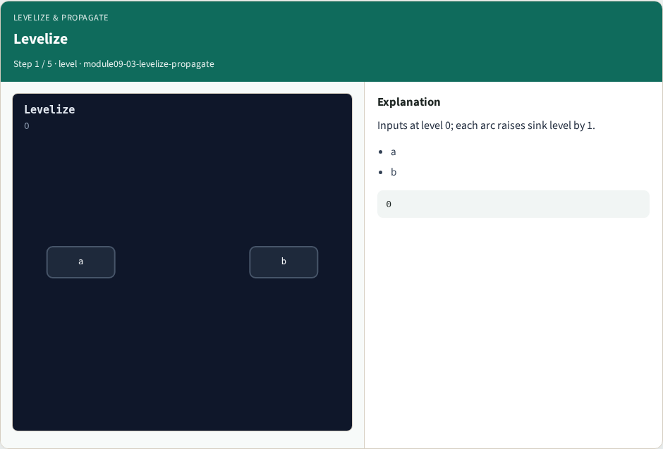
Levelize
Levelize
learn_opensta — 03 levelize propagate
Notes:
Inputs at level 0; each arc raises sink level by 1.

Slide 4
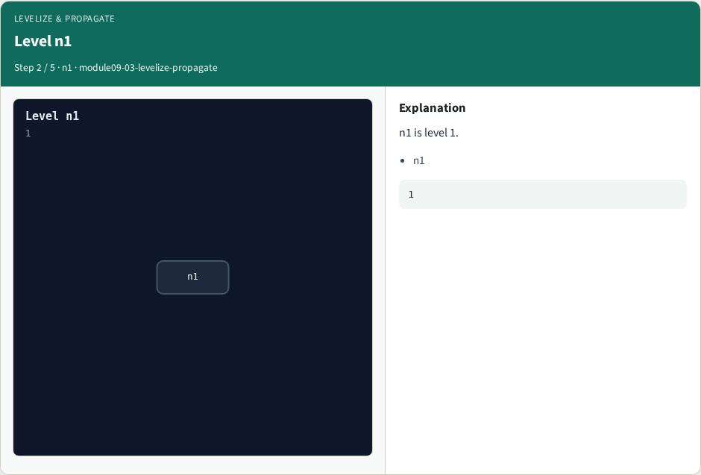
Level n1
Level n1
learn_opensta — 03 levelize propagate
Notes:
n1 is level 1.

Slide 5

Arrival y
Arrival y
learn_opensta — 03 levelize propagate
Notes:
Forward max arrival reaches y at 2.0.

Slide 6

Required y
Required y
learn_opensta — 03 levelize propagate
Notes:
Required at y equals period 10.

Slide 7
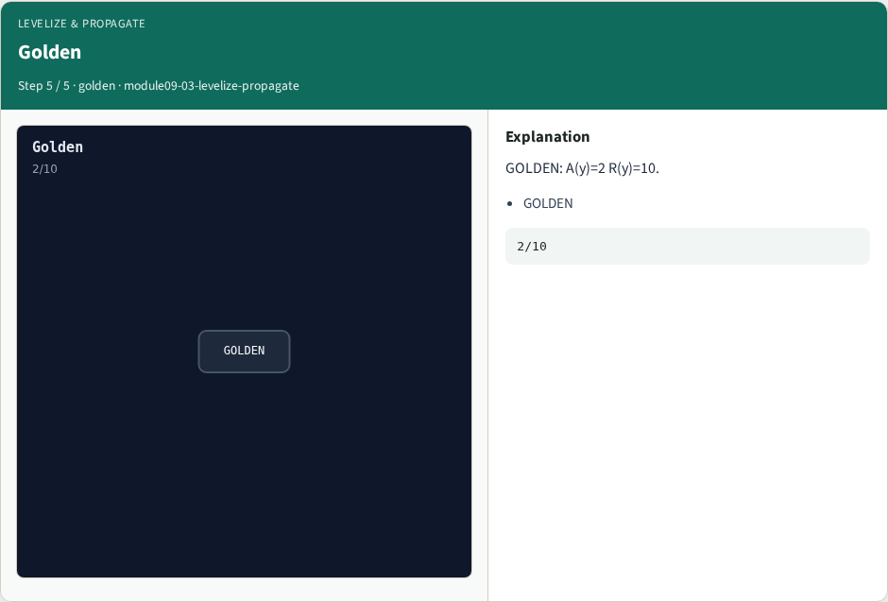
Golden
Golden
learn_opensta — 03 levelize propagate
Notes:
GOLDEN: A(y)=2 R(y)=10.

Slide 8
Browser lab track
Open levelize-propagate
Run Graph / Levelize / Propagate / Slack / Bind, then Check
learn_opensta — 03 levelize propagate
Notes:
Open **levelize-propagate**. Run Graph / Levelize / Propagate / Slack / Bind, then Check.

Slide 9
Implement track
From common/, run algo_solvers.py and partc_bind.py
learn_opensta — 03 levelize propagate
Notes:
From common/, run algo_solvers.py and partc_bind.py.

Slide 10
Pitfalls
Changing tiny_algo_sta without updating Part B liberty delays
Ignoring the bind side
learn_opensta — 03 levelize propagate
Notes:
Changing tiny_algo_sta without updating Part B liberty delays. Ignoring the bind side.

Slide 11
Try these
From the common folder, run the Part C self-tests
learn_opensta — 03 levelize propagate
Notes:
From the common folder, run the Part C self-tests.

Slide 12
Try these — try these
cd courses/learn_opensta/common
python3 algo_solvers.py
python3 partc_bind.py
learn_opensta — 03 levelize propagate

Slide 13
Pseudocode
Here is the check in plain steps
learn_opensta — 03 levelize propagate
Notes:
Here is the check in plain steps.

Slide 14
Pseudocode — try these
levels a/b=0…y=3; A(y)=2 R(y)=10.
ok if goldens match and bind
learn_opensta — 03 levelize propagate

Slide 15
Next
Complete the quiz for this part
Continue Part C, then wrap , internals literacy is next
learn_opensta — 03 levelize propagate
Notes:
Continue Part C, then wrap — internals literacy is next.

