Slide 1
Why algorithms
Compute slack and the critical path
learn_opensta — 01 slack algo
Notes:
Compute slack and the critical path.

Slide 2
The idea
GOLDEN: slack=8; path b→n1→n2→y
learn_opensta — 01 slack algo
Notes:
GOLDEN: slack=8; path b→n1→n2→y.

Slide 3

Slack
Slack
learn_opensta — 01 slack algo
Notes:
Slack equals required minus arrival.

Slide 4

Value 8
Value 8
learn_opensta — 01 slack algo
Notes:
With period 10 and arrival 2, slack is 8.

Slide 5

Critical path
Critical path
learn_opensta — 01 slack algo
Notes:
Backtrace picks b→n1→n2→y.

Slide 6
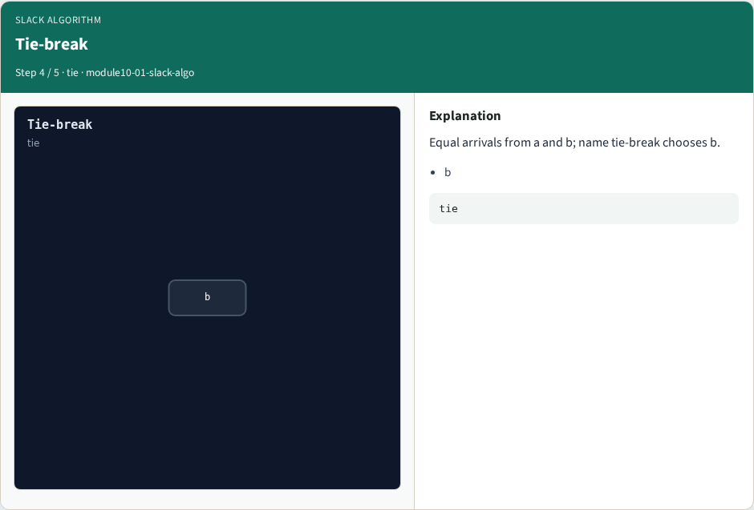
Tie-break
Tie-break
learn_opensta — 01 slack algo
Notes:
Equal arrivals from a and b; name tie-break chooses b.

Slide 7

Golden
Golden
learn_opensta — 01 slack algo
Notes:
GOLDEN: slack=8 path b→n1→n2→y.

Slide 8
Browser lab track
Open slack-algo
Run Graph / Levelize / Propagate / Slack / Bind, then Check
learn_opensta — 01 slack algo
Notes:
Open **slack-algo**. Run Graph / Levelize / Propagate / Slack / Bind, then Check.

Slide 9
Implement track
From common/, run algo_solvers.py and partc_bind.py
learn_opensta — 01 slack algo
Notes:
From common/, run algo_solvers.py and partc_bind.py.

Slide 10
Pitfalls
Changing tiny_algo_sta without updating Part B liberty delays
Ignoring the bind side
learn_opensta — 01 slack algo
Notes:
Changing tiny_algo_sta without updating Part B liberty delays. Ignoring the bind side.

Slide 11
Try these
From the common folder, run the Part C self-tests
learn_opensta — 01 slack algo
Notes:
From the common folder, run the Part C self-tests.

Slide 12
Try these — try these
cd courses/learn_opensta/common
python3 algo_solvers.py
python3 partc_bind.py
learn_opensta — 01 slack algo

Slide 13
Pseudocode
Here is the check in plain steps
learn_opensta — 01 slack algo
Notes:
Here is the check in plain steps.

Slide 14
Pseudocode — try these
slack=8; path b→n1→n2→y.
ok if goldens match and bind
learn_opensta — 01 slack algo

Slide 15
Next
Complete the quiz for this part
Continue Part C, then wrap , internals literacy is next
learn_opensta — 01 slack algo
Notes:
Continue Part C, then wrap — internals literacy is next.

