Slide 1
Why algorithms
Run the full Part C engine and bind to real report goldens
learn_opensta — 03 opensta algo engine
Notes:
Run the full Part C engine and bind to real report goldens.

Slide 2
The idea
GOLDEN: engine ok; bind slack 8↔8
learn_opensta — 03 opensta algo engine
Notes:
GOLDEN: engine ok; bind slack 8↔8.

Slide 3
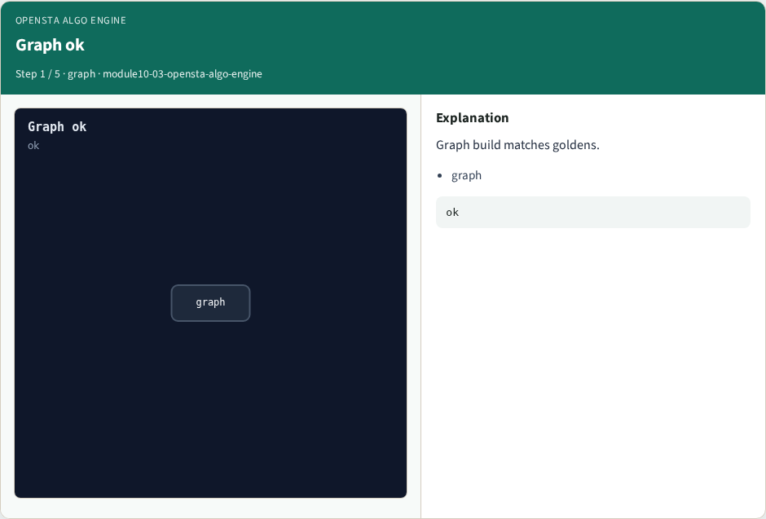
Graph ok
Graph ok
learn_opensta — 03 opensta algo engine
Notes:
Graph build matches goldens.

Slide 4

Propagate ok
Propagate ok
learn_opensta — 03 opensta algo engine
Notes:
Arrival and required match.

Slide 5

Slack ok
Slack ok
learn_opensta — 03 opensta algo engine
Notes:
Slack and path match.

Slide 6
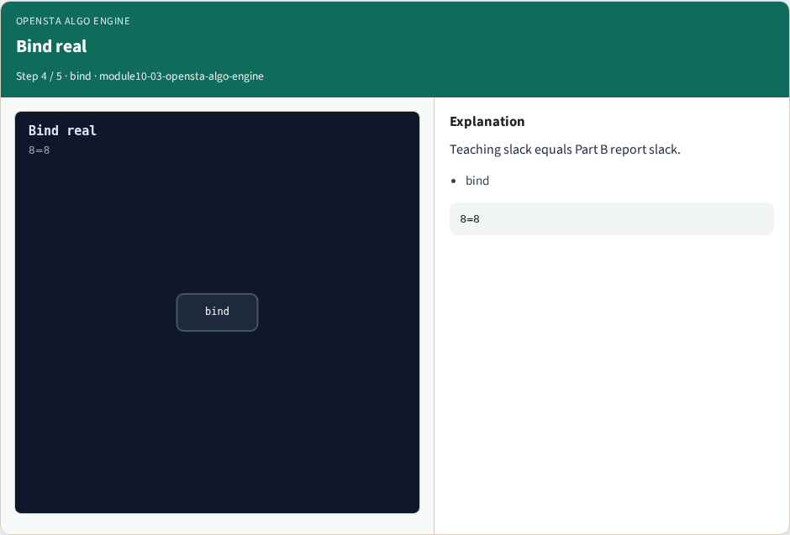
Bind real
Bind real
learn_opensta — 03 opensta algo engine
Notes:
Teaching slack equals Part B report slack.

Slide 7
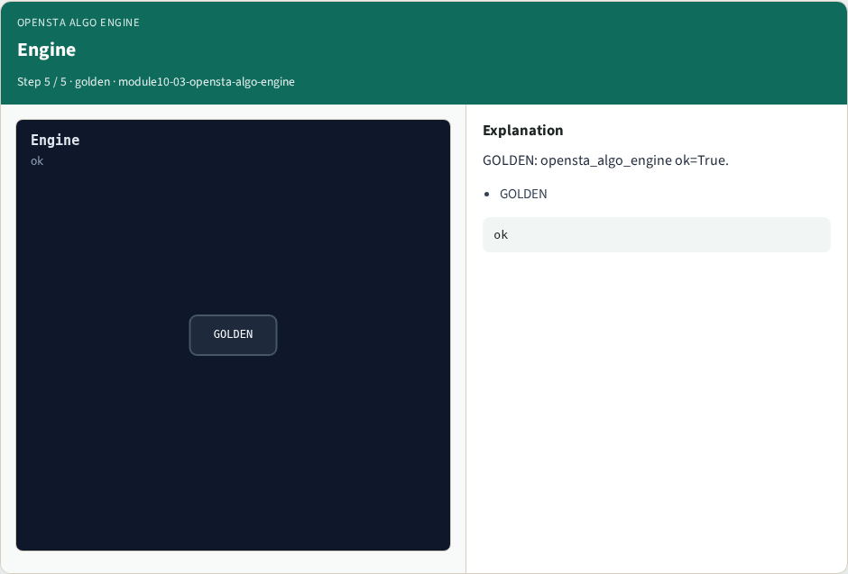
Engine
Engine
learn_opensta — 03 opensta algo engine
Notes:
GOLDEN: opensta_algo_engine ok=True.

Slide 8
Browser lab track
Open opensta-algo-engine
Run Graph / Levelize / Propagate / Slack / Bind, then Check
learn_opensta — 03 opensta algo engine
Notes:
Open **opensta-algo-engine**. Run Graph / Levelize / Propagate / Slack / Bind, then Check.

Slide 9
Implement track
From common/, run algo_solvers.py and partc_bind.py
learn_opensta — 03 opensta algo engine
Notes:
From common/, run algo_solvers.py and partc_bind.py.

Slide 10
Pitfalls
Changing tiny_algo_sta without updating Part B liberty delays
Ignoring the bind side
learn_opensta — 03 opensta algo engine
Notes:
Changing tiny_algo_sta without updating Part B liberty delays. Ignoring the bind side.

Slide 11
Try these
From the common folder, run the Part C self-tests
learn_opensta — 03 opensta algo engine
Notes:
From the common folder, run the Part C self-tests.

Slide 12
Try these — try these
cd courses/learn_opensta/common
python3 algo_solvers.py
python3 partc_bind.py
learn_opensta — 03 opensta algo engine

Slide 13
Pseudocode
Here is the check in plain steps
learn_opensta — 03 opensta algo engine
Notes:
Here is the check in plain steps.

Slide 14
Pseudocode — try these
engine ok; bind slack 8↔8.
ok if goldens match and bind
learn_opensta — 03 opensta algo engine

Slide 15
Next
Complete the quiz for this part
Continue Part C, then wrap , internals literacy is next
learn_opensta — 03 opensta algo engine
Notes:
Continue Part C, then wrap — internals literacy is next.

