Slide 1
Why STA C++
Browser IR and JSON are maps
learn_opensta — 01 sta cpp model
Notes:
Browser IR and JSON are maps. Real OpenSTA stores the same ideas as C++ objects.

Slide 2
The idea
GOLDEN: Network, Graph, Sdc, Search , Search drives arrivals and path reports
learn_opensta — 01 sta cpp model
Notes:
GOLDEN: Network, Graph, Sdc, Search — Search drives arrivals and path reports.

Slide 3

Network
Network
learn_opensta — 01 sta cpp model
Notes:
Network holds pins, nets, and instances.

Slide 4
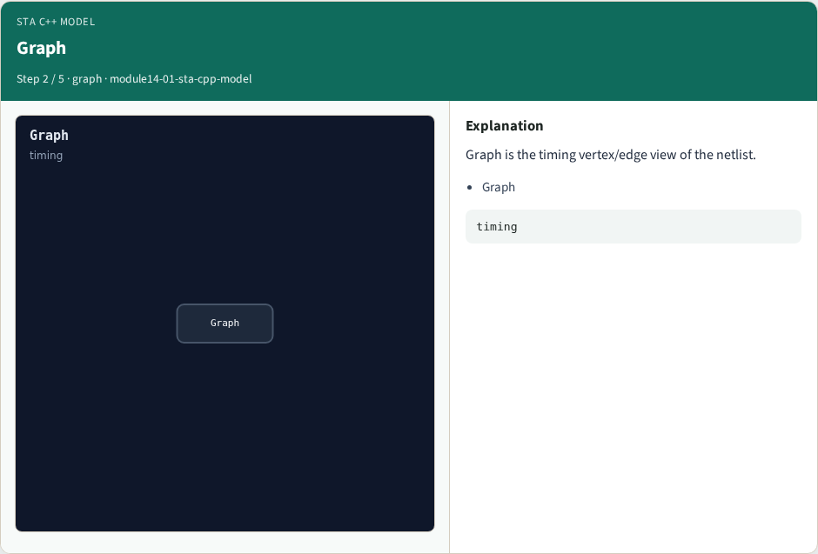
Graph
Graph
learn_opensta — 01 sta cpp model
Notes:
Graph is the timing vertex/edge view of the netlist.

Slide 5

Sdc
Sdc
learn_opensta — 01 sta cpp model
Notes:
Sdc stores clocks and timing constraints.

Slide 6
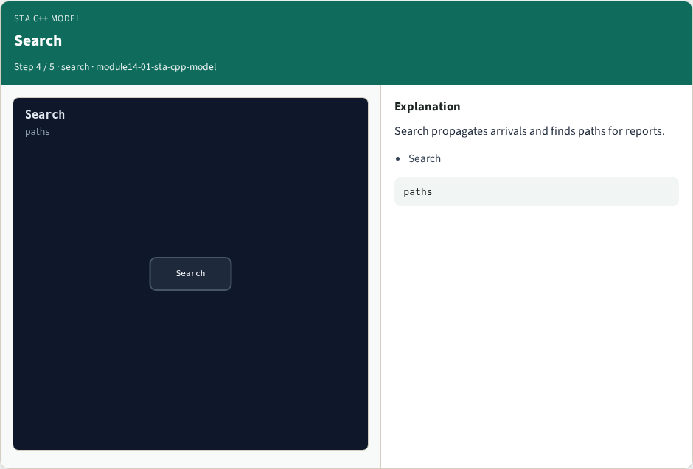
Search
Search
learn_opensta — 01 sta cpp model
Notes:
Search propagates arrivals and finds paths for reports.

Slide 7

Golden
Golden
learn_opensta — 01 sta cpp model
Notes:
GOLDEN: four pillars — Network, Graph, Sdc, Search.

Slide 8
Browser lab track
Open sta-cpp-model
Click through the four pillars and check the goldens
learn_opensta — 01 sta cpp model
Notes:
Open **sta-cpp-model**. Click through the four pillars and check the goldens.

Slide 9
Implement track
Call sta_cpp_model() in internals_solvers; assert pillar count and nesting
learn_opensta — 01 sta cpp model
Notes:
Call sta_cpp_model() in internals_solvers; assert pillar count and nesting.

Slide 10
Pitfalls
Treating JSON keys as the C++ API
Confusing Graph with physical Magick layout
learn_opensta — 01 sta cpp model
Notes:
Treating JSON keys as the C++ API. Confusing Graph with physical Magick layout.

Slide 11
Try these
From the common folder, run the internals solvers self-test
learn_opensta — 01 sta cpp model
Notes:
From the common folder, run the internals solvers self-test.

Slide 12
Try these — try these
cd courses/learn_opensta/common
python3 internals_solvers.py
learn_opensta — 01 sta cpp model

Slide 13
Pseudocode
Here is the OpenSTA nesting in plain steps
learn_opensta — 01 sta cpp model
Notes:
Here is the OpenSTA nesting in plain steps.

Slide 14
Pseudocode — try these
Network → pins/nets/instances
Graph → vertices/edges from Network
Sdc → clocks/constraints
Search → arrivals + FindPath for reports
learn_opensta — 01 sta cpp model

Slide 15
Next
Complete the quiz for this part
Next: read the FindPath to report_checks shape in the OpenSTA tree
learn_opensta — 01 sta cpp model
Notes:
Next: read the FindPath to report_checks shape in the OpenSTA tree.

