Slide 1
Why read FindPath
Part C algorithms match moves
learn_opensta — 03 read find path
Notes:
Part C algorithms match moves. Now map those moves onto the real C++ and Tcl report shape.

Slide 2
The idea
GOLDEN: tag endpoints
learn_opensta — 03 read find path
Notes:
GOLDEN: tag endpoints, walk back the worst path, emit pins, format report_checks — slack 8 like Part B.

Slide 3

Tag endpoints
Tag endpoints
learn_opensta — 03 read find path
Notes:
Search tags which pins are report endpoints.

Slide 4

Walk back
Walk back
learn_opensta — 03 read find path
Notes:
From the worst slack endpoint, walk previous arcs.

Slide 5

Emit path
Emit path
learn_opensta — 03 read find path
Notes:
Emit the ordered pin list for the critical path.

Slide 6

report_checks
report_checks
learn_opensta — 03 read find path
Notes:
report_checks formats delay 2 and slack 8 MET.

Slide 7
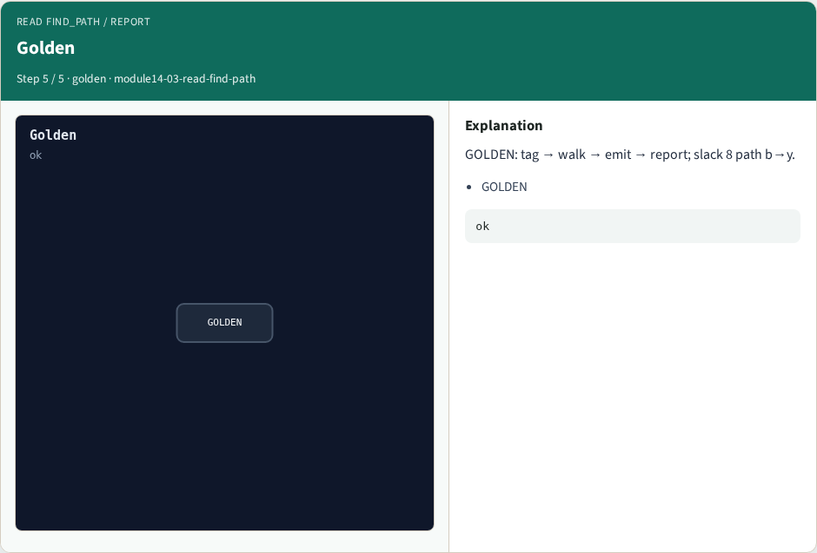
Golden
Golden
learn_opensta — 03 read find path
Notes:
GOLDEN: tag → walk → emit → report; slack 8 path b→y.

Slide 8
Browser lab track
Open read-find-path
Step the FindPath pipeline and check
learn_opensta — 03 read find path
Notes:
Open **read-find-path**. Step the FindPath pipeline and check.

Slide 9
Implement track
Call read_find_path(); assert stage order and Part B slack bind
learn_opensta — 03 read find path
Notes:
Call read_find_path(); assert stage order and Part B slack bind.

Slide 10
Pitfalls
Expecting FindPath to replace Liberty
Ignoring the Part B delay and slack goldens
learn_opensta — 03 read find path
Notes:
Expecting FindPath to replace Liberty. Ignoring the Part B delay and slack goldens.

Slide 11
Try these
From the common folder, call read_find_path and print the stages
learn_opensta — 03 read find path
Notes:
From the common folder, call read_find_path and print the stages.

Slide 12
Try these — try these
cd courses/learn_opensta/common
python3 -c "from internals_solvers import read_find_path;
print(read_find_path())"
learn_opensta — 03 read find path

Slide 13
Pseudocode
Here is the FindPath teaching flow in plain steps
learn_opensta — 03 read find path
Notes:
Here is the FindPath teaching flow in plain steps.

Slide 14
Pseudocode — try these
tag_endpoints
walk_back from worst slack
emit_path → [b, n1, n2, y]
report_checks → delay 2, slack 8 MET
learn_opensta — 03 read find path

Slide 15
Next
Complete the quiz for this part
Next: contribute a minimal Tcl command of your own
learn_opensta — 03 read find path
Notes:
Next: contribute a minimal Tcl command of your own.

