Slide 1
Why contribute
Reading is not enough
learn_opensta — 03 contribute opensta
Notes:
Reading is not enough. A contributor knows where a command lives and how it enters the build.

Slide 2
The idea
Add app/HelloCmd.cc, register the Tcl command, hook CMake, rebuild, sta -help hello_cmd
learn_opensta — 03 contribute opensta
Notes:
GOLDEN: add app/HelloCmd.cc, register the Tcl command, hook CMake, rebuild, sta -help hello_cmd.

Slide 3
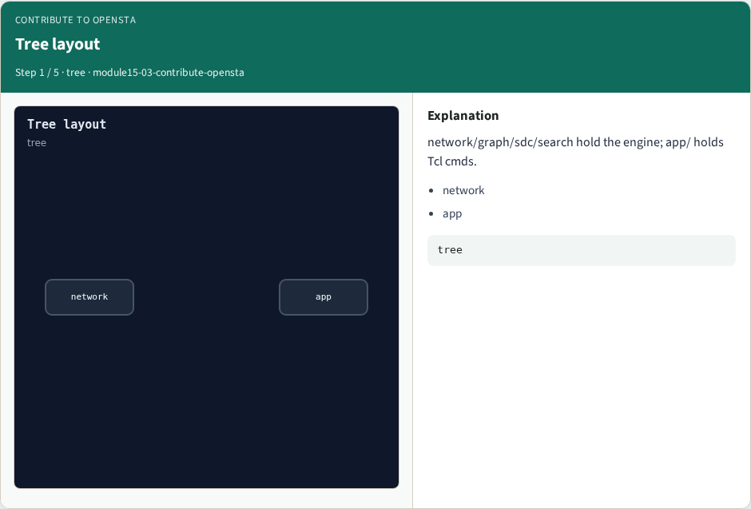
Tree layout
Tree layout
learn_opensta — 03 contribute opensta
Notes:
network/graph/sdc/search hold the engine; app/ holds Tcl cmds.

Slide 4
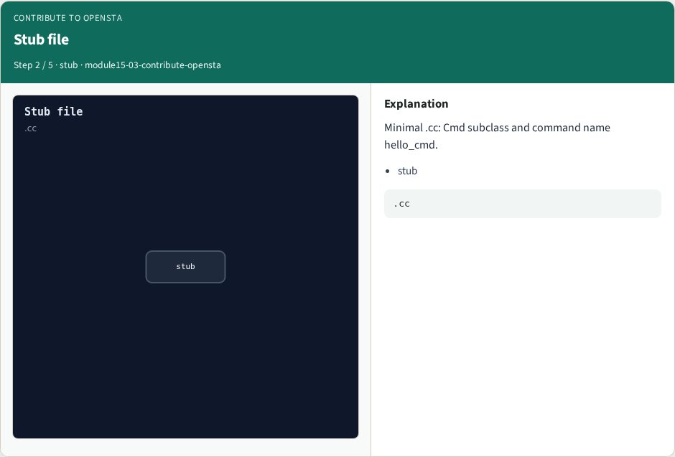
Stub file
Stub file
learn_opensta — 03 contribute opensta
Notes:
Minimal .cc: Cmd subclass and command name hello_cmd.

Slide 5

CMake hook
CMake hook
learn_opensta — 03 contribute opensta
Notes:
Add the object to CMakeLists and rebuild OpenSTA.

Slide 6
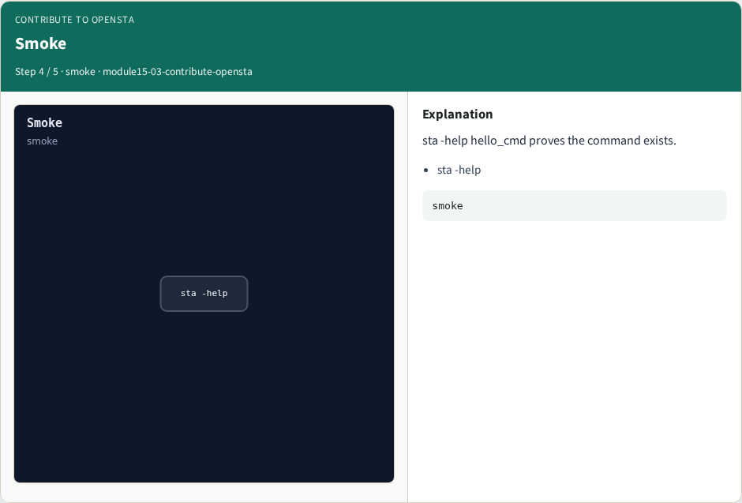
Smoke
Smoke
learn_opensta — 03 contribute opensta
Notes:
sta -help hello_cmd proves the command exists.

Slide 7
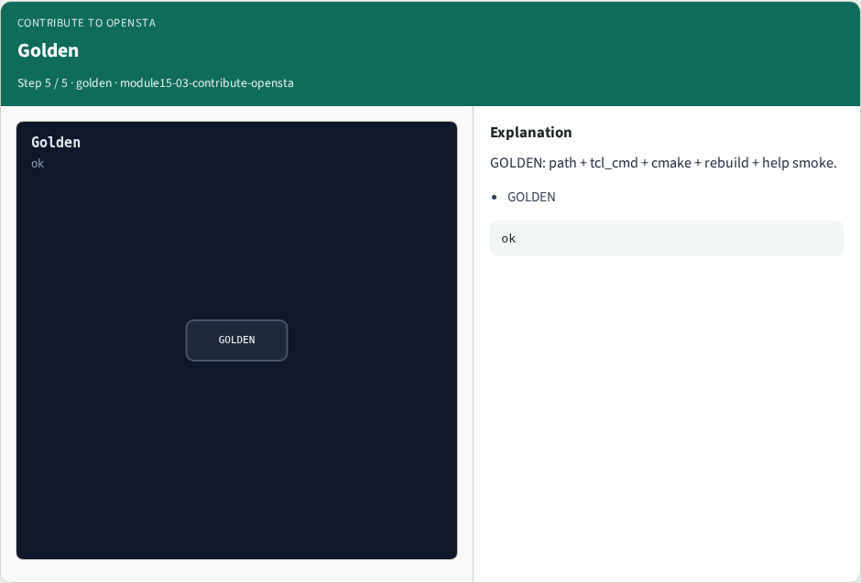
Golden
Golden
learn_opensta — 03 contribute opensta
Notes:
GOLDEN: path + tcl_cmd + cmake + rebuild + help smoke.

Slide 8
Browser lab track
Open contribute-opensta
Assemble the contribute checklist and check
learn_opensta — 03 contribute opensta
Notes:
Open **contribute-opensta**. Assemble the contribute checklist and check.

Slide 9
Implement track
Call contribute_opensta(); assert checklist length and smoke cmd
learn_opensta — 03 contribute opensta
Notes:
Call contribute_opensta(); assert checklist length and smoke cmd.

Slide 10
Pitfalls
Editing only docs
Forgetting the CMake entry
Skipping help smoke
learn_opensta — 03 contribute opensta
Notes:
Editing only docs. Forgetting the CMake entry. Skipping help smoke.

Slide 11
Try these
From the common folder, call contribute_opensta and print the checklist
learn_opensta — 03 contribute opensta
Notes:
From the common folder, call contribute_opensta and print the checklist.

Slide 12
Try these — try these
cd courses/learn_opensta/common
python3 -c "from internals_solvers import contribute_opensta;
print(contribute_opensta())"
learn_opensta — 03 contribute opensta

Slide 13
Pseudocode
Here is the contribute checklist in plain steps
learn_opensta — 03 contribute opensta
Notes:
Here is the contribute checklist in plain steps.

Slide 14
Pseudocode — try these
path ← app/HelloCmd.cc
register Tcl cmd hello_cmd
add to CMake; rebuild
smoke ← sta -help hello_cmd
learn_opensta — 03 contribute opensta

Slide 15
Next
Complete the quiz for this part
Wrap the OpenSTA path , you can use OpenSTA and open the C++ tree with intent
learn_opensta — 03 contribute opensta
Notes:
Wrap the OpenSTA path — you can use OpenSTA and open the C++ tree with intent.

