Slide 1
Geometry load
PEX starts from annotated layout segments , layers, nets, and segment ids
learn_pex — 01 geometry load
Notes:
PEX starts from annotated layout segments — layers, nets, and segment ids.

Slide 2
The idea
GOLDEN: 4 segments, 3 layers
learn_pex — 01 geometry load
Notes:
GOLDEN: 4 segments, 3 layers.

Slide 3

Segments
Segments
learn_pex — 01 geometry load
Notes:
Four wire/via segments on net n1: s1, s2, v1, s3.

Slide 4

Layers
Layers
learn_pex — 01 geometry load
Notes:
Three layers: M1, VIA, M2.

Slide 5

Nets
Nets
learn_pex — 01 geometry load
Notes:
Single net n1 with ports in and out.

Slide 6
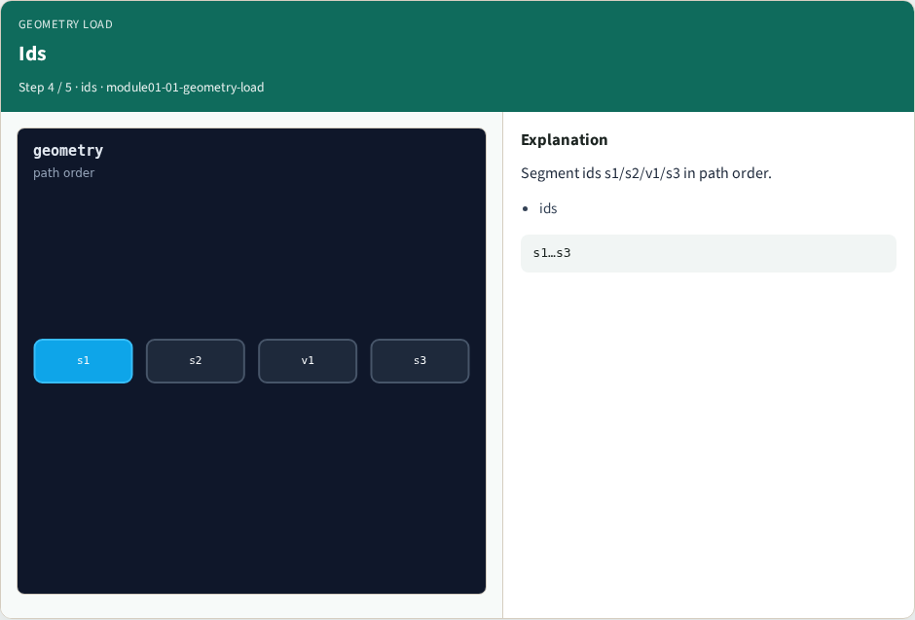
Ids
Ids
learn_pex — 01 geometry load
Notes:
Segment ids s1/s2/v1/s3 in path order.

Slide 7

Golden
Golden
learn_pex — 01 geometry load
Notes:
GOLDEN: segment_count=4, layer_count=3.

Slide 8
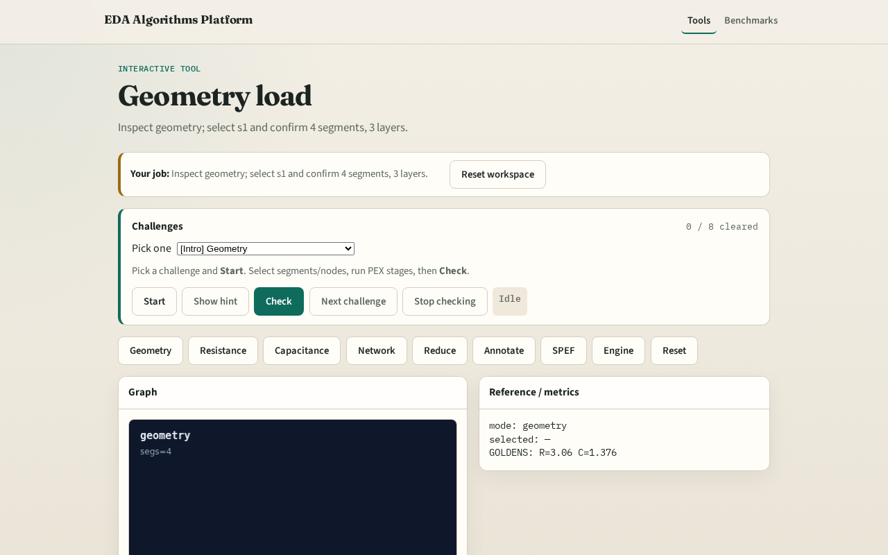
Browser lab track
Browser lab starter
learn_pex — 01 geometry load
Notes:
Open **geometry-load**. Inspect tiny_pex; confirm 4 segments, 3 layers.

Slide 9
Implement track
Call load_geometry(); assert segment_count==4 and layer_count==3
learn_pex — 01 geometry load
Notes:
Call load_geometry(); assert segment_count==4 and layer_count==3.

Slide 10
Pitfalls
Counting ports as segments
Ignoring VIA layer in layer_count
learn_pex — 01 geometry load
Notes:
Counting ports as segments. Ignoring VIA layer in layer_count.

Slide 11
Your turn
Next: resistance extract
learn_pex — 01 geometry load
Notes:
Next: resistance extract.

