Slide 1
Resistance
Resistance extract computes R = rho*L/W for metals; VIA uses lump rho
learn_pex — 03 resistance extract
Notes:
Resistance extract computes R = rho*L/W for metals; VIA uses lump rho.

Slide 2
The idea
GOLDEN: R_total=3.06; s1=0.5
learn_pex — 03 resistance extract
Notes:
GOLDEN: R_total=3.06; s1=0.5.

Slide 3

Formula
Formula
learn_pex — 03 resistance extract
Notes:
Metal R = rho*L/W; VIA uses lump rho.

Slide 4
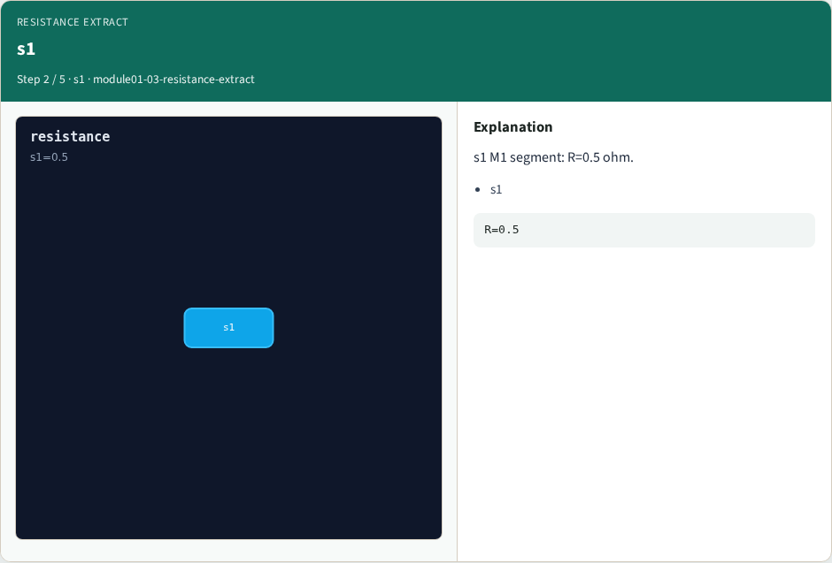
s1
s1
learn_pex — 03 resistance extract
Notes:
s1 M1 segment: R=0.5 ohm.

Slide 5

s2
s2
learn_pex — 03 resistance extract
Notes:
s2 M1 segment: R=0.4 ohm.

Slide 6

v1
v1
learn_pex — 03 resistance extract
Notes:
v1 VIA lump: R=2.0 ohm.

Slide 7

Golden
Golden
learn_pex — 03 resistance extract
Notes:
GOLDEN: R_total=3.06; s1=0.5.

Slide 8

Browser lab track
Browser lab starter
learn_pex — 03 resistance extract
Notes:
Open **resistance-extract**. Select s1; confirm R_total=3.06.

Slide 9
Implement track
Call extract_resistance(); assert r_total==3.06 and resistors['s1']==0.5
learn_pex — 03 resistance extract
Notes:
Call extract_resistance(); assert r_total==3.06 and resistors['s1']==0.5.

Slide 10
Pitfalls
Using max edge as width
Forgetting VIA lump resistance
learn_pex — 03 resistance extract
Notes:
Using max edge as width. Forgetting VIA lump resistance.

Slide 11
Your turn
Next: capacitance extract
learn_pex — 03 resistance extract
Notes:
Next: capacitance extract.

