Slide 1
Capacitance
Capacitance extract uses c_area*area + c_perim*perimeter on metals; skip VIA
learn_pex — 05 capacitance extract
Notes:
Capacitance extract uses c_area*area + c_perim*perimeter on metals; skip VIA.

Slide 2
The idea
GOLDEN: C_total=1.376; 3 caps
learn_pex — 05 capacitance extract
Notes:
GOLDEN: C_total=1.376; 3 caps.

Slide 3
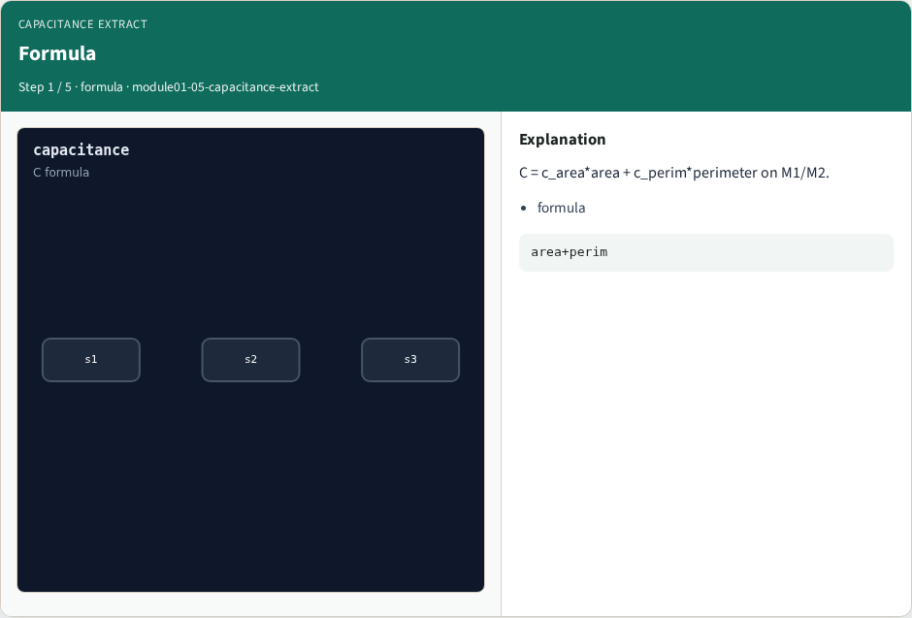
Formula
Formula
learn_pex — 05 capacitance extract
Notes:
C = c_area*area + c_perim*perimeter on M1/M2.

Slide 4
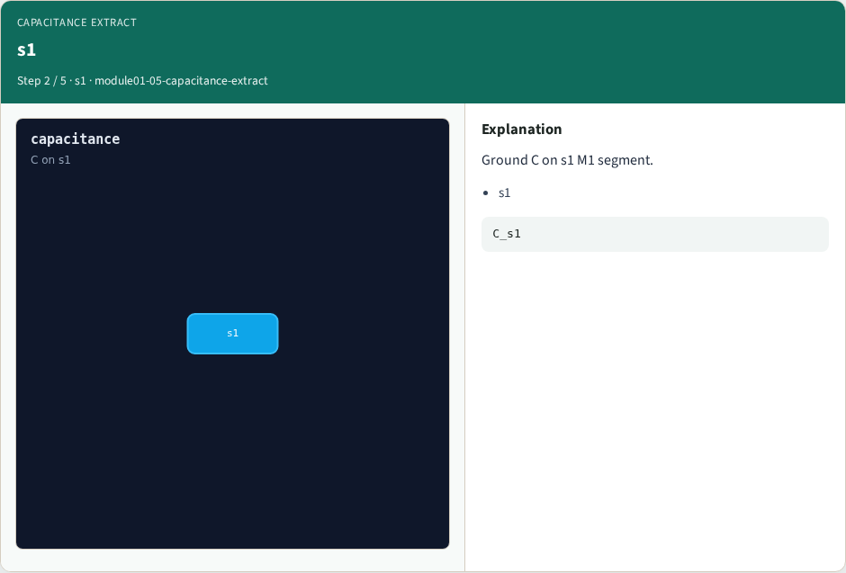
s1
s1
learn_pex — 05 capacitance extract
Notes:
Ground C on s1 M1 segment.

Slide 5

s2
s2
learn_pex — 05 capacitance extract
Notes:
Ground C on s2 M1 segment.

Slide 6

s3
s3
learn_pex — 05 capacitance extract
Notes:
Ground C on s3 M2 segment.

Slide 7

Golden
Golden
learn_pex — 05 capacitance extract
Notes:
GOLDEN: C_total=1.376; 3 caps.

Slide 8
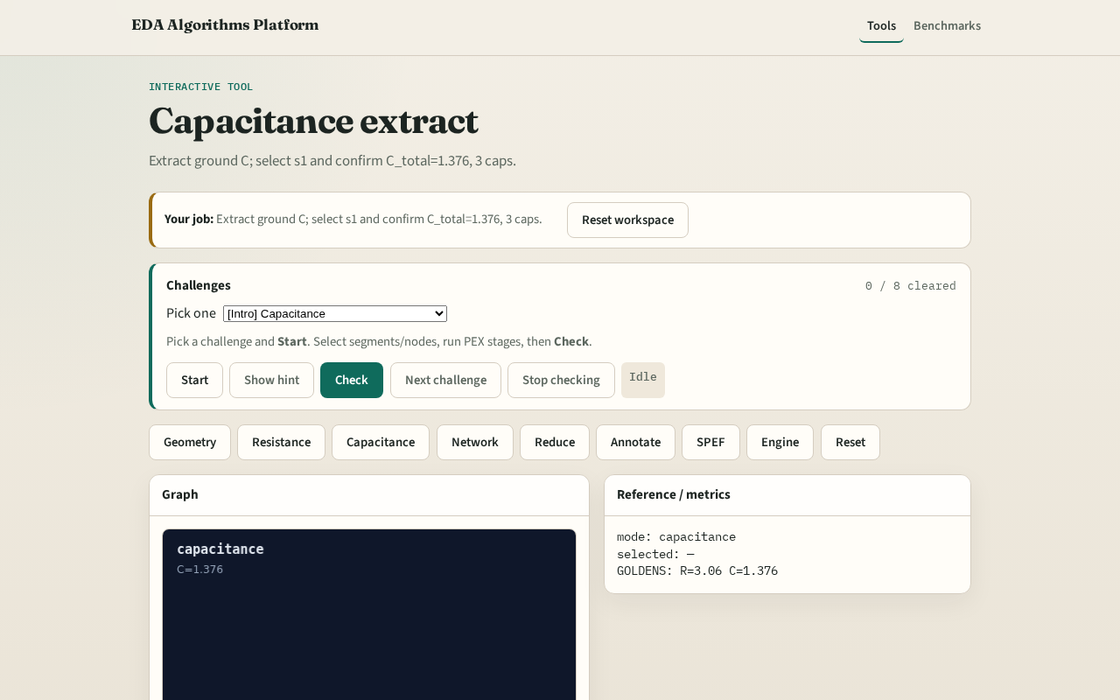
Browser lab track
Browser lab starter
learn_pex — 05 capacitance extract
Notes:
Open **capacitance-extract**. Select s1; confirm C_total=1.376 and 3 caps.

Slide 9
Implement track
Call extract_capacitance(); assert c_total==1.376 and count==3
learn_pex — 05 capacitance extract
Notes:
Call extract_capacitance(); assert c_total==1.376 and count==3.

Slide 10
Pitfalls
Adding VIA capacitance
Using length instead of area for C
learn_pex — 05 capacitance extract
Notes:
Adding VIA capacitance. Using length instead of area for C.

Slide 11
Your turn
Next: RC network build
learn_pex — 05 capacitance extract
Notes:
Next: RC network build.

