Slide 1
RC network
RC network chains segment resistors in series; attach ground C at metal nodes
learn_pex — 01 rc network
Notes:
RC network chains segment resistors in series; attach ground C at metal nodes.

Slide 2
The idea
GOLDEN: series chain; nodes include in/out
learn_pex — 01 rc network
Notes:
GOLDEN: series chain; nodes include in/out.

Slide 3

Order
Order
learn_pex — 01 rc network
Notes:
Series path: s1 → s2 → v1 → s3.

Slide 4

Resistors
Resistors
learn_pex — 01 rc network
Notes:
Four R edges in series from in to out.

Slide 5
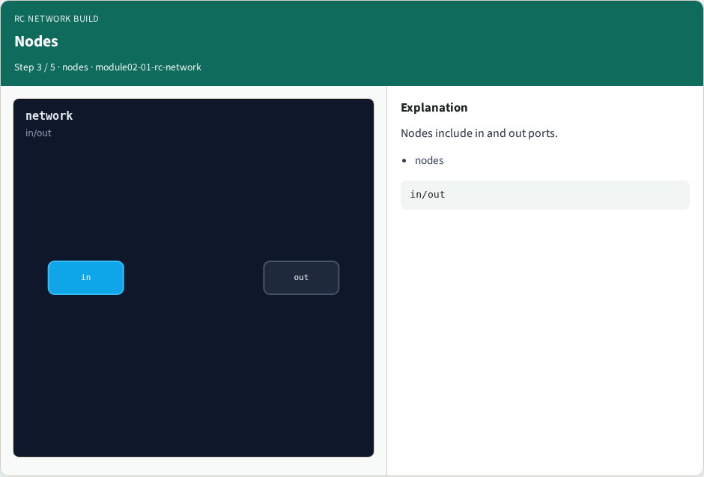
Nodes
Nodes
learn_pex — 01 rc network
Notes:
Nodes include in and out ports.

Slide 6

Caps
Caps
learn_pex — 01 rc network
Notes:
Three C branches to gnd on metal nodes.

Slide 7

Golden
Golden
learn_pex — 01 rc network
Notes:
GOLDEN: series chain; nodes include in/out.

Slide 8
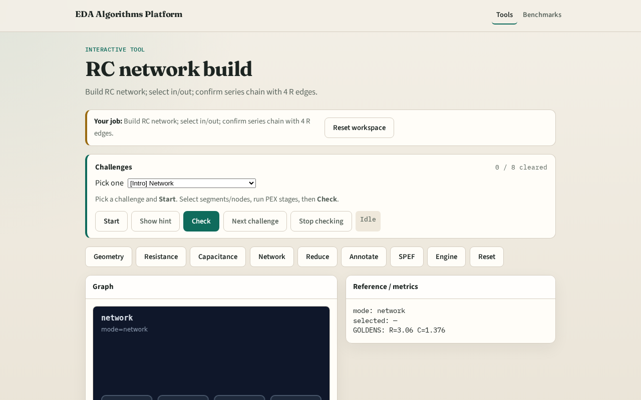
Browser lab track
Browser lab starter
learn_pex — 01 rc network
Notes:
Open **rc-network**. Select in and out; confirm series chain.

Slide 9
Implement track
Call build_rc_network(); assert nodes include 'in' and 'out' and r_count==4
learn_pex — 01 rc network
Notes:
Call build_rc_network(); assert nodes include 'in' and 'out' and r_count==4.

Slide 10
Pitfalls
Parallel instead of series R
Attaching C on VIA node
learn_pex — 01 rc network
Notes:
Parallel instead of series R. Attaching C on VIA node.

Slide 11
Your turn
Next: network reduction
learn_pex — 01 rc network
Notes:
Next: network reduction.

