Slide 1
Reduce
Network reduction collapses the chain to in–out R_eq and lumped C_eq
learn_pex — 03 network reduce
Notes:
Network reduction collapses the chain to in–out R_eq and lumped C_eq.

Slide 2
The idea
GOLDEN: after_nodes=2; R_eq=3.06 C_eq=1.376
learn_pex — 03 network reduce
Notes:
GOLDEN: after_nodes=2; R_eq=3.06 C_eq=1.376.

Slide 3

Before
Before
learn_pex — 03 network reduce
Notes:
Full chain has 5 nodes before reduce.

Slide 4
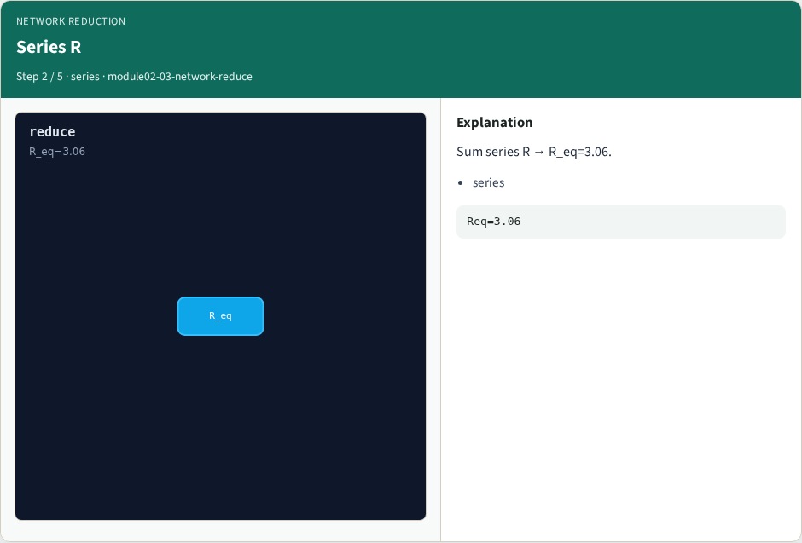
Series R
Series R
learn_pex — 03 network reduce
Notes:
Sum series R → R_eq=3.06.

Slide 5
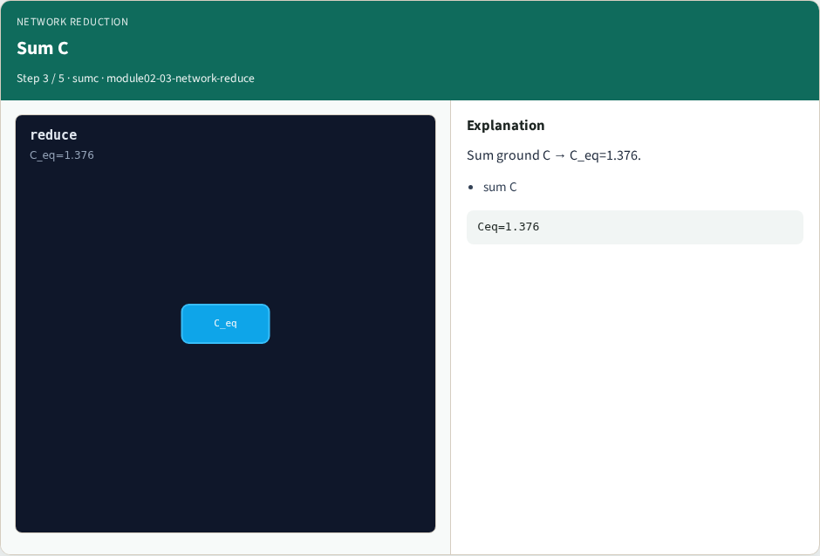
Sum C
Sum C
learn_pex — 03 network reduce
Notes:
Sum ground C → C_eq=1.376.

Slide 6

After
After
learn_pex — 03 network reduce
Notes:
Reduced to 2 signal ports (in/out).

Slide 7

Golden
Golden
learn_pex — 03 network reduce
Notes:
GOLDEN: after_nodes=2; R_eq=3.06 C_eq=1.376.

Slide 8

Browser lab track
Browser lab starter
learn_pex — 03 network reduce
Notes:
Open **network-reduce**. Select R_eq; confirm after_nodes=2.

Slide 9
Implement track
Call reduce_network(); assert after_nodes==2 and r_eq==3.06 and c_eq==1.376
learn_pex — 03 network reduce
Notes:
Call reduce_network(); assert after_nodes==2 and r_eq==3.06 and c_eq==1.376.

Slide 10
Pitfalls
Reducing C before R
Keeping internal nodes after reduce
learn_pex — 03 network reduce
Notes:
Reducing C before R. Keeping internal nodes after reduce.

Slide 11
Your turn
Next: back-annotate nets
learn_pex — 03 network reduce
Notes:
Next: back-annotate nets.

