Slide 1
Annotate
Back-annotate writes r_total and c_total onto net n1 with port list
learn_pex — 01 back annotate
Notes:
Back-annotate writes r_total and c_total onto net n1 with port list.

Slide 2
The idea
GOLDEN: net n1 annotated
learn_pex — 01 back annotate
Notes:
GOLDEN: net n1 annotated.

Slide 3
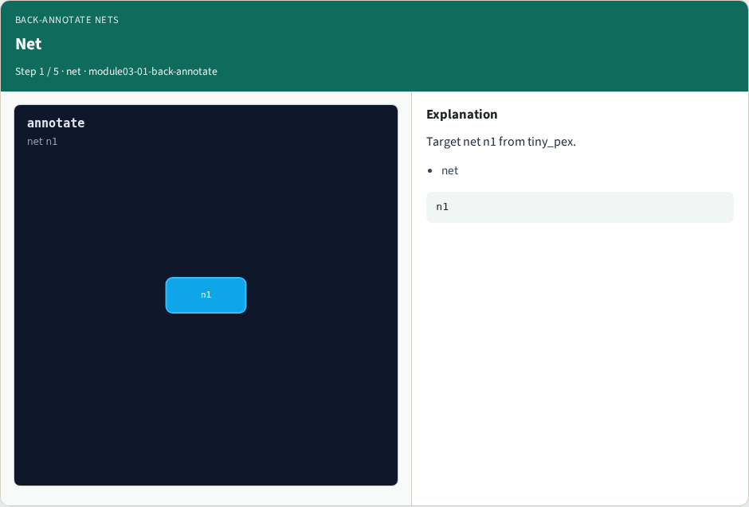
Net
Net
learn_pex — 01 back annotate
Notes:
Target net n1 from tiny_pex.

Slide 4

R total
R total
learn_pex — 01 back annotate
Notes:
r_total=3.06 from reduced network.

Slide 5

C total
C total
learn_pex — 01 back annotate
Notes:
c_total=1.376 from reduced network.

Slide 6

Ports
Ports
learn_pex — 01 back annotate
Notes:
Ports in and out on n1.

Slide 7

Golden
Golden
learn_pex — 01 back annotate
Notes:
GOLDEN: net n1 annotated.

Slide 8
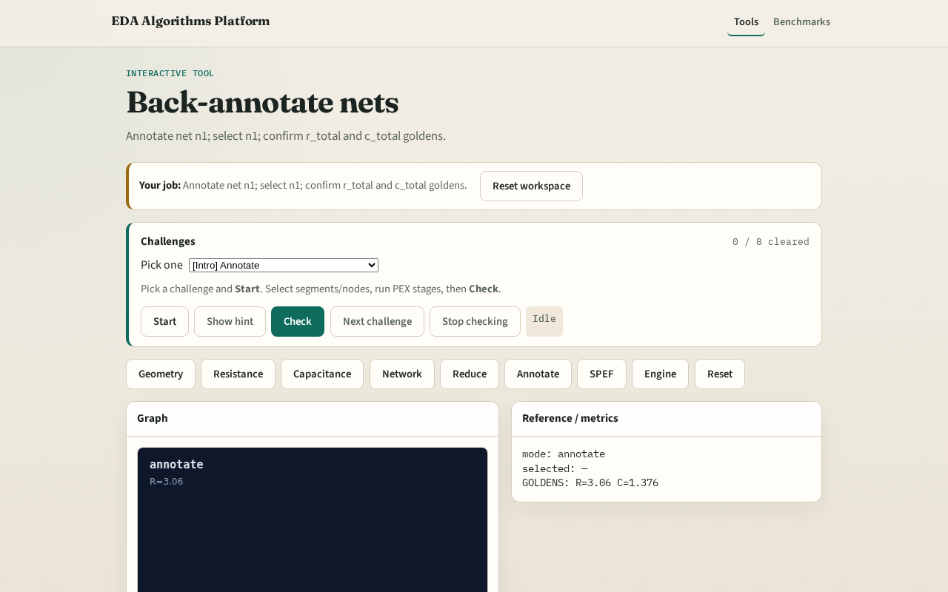
Browser lab track
Browser lab starter
learn_pex — 01 back annotate
Notes:
Open **back-annotate**. Select n1; confirm annotation count=1.

Slide 9
Implement track
Call back_annotate(); assert net=='n1' and count==1
learn_pex — 01 back annotate
Notes:
Call back_annotate(); assert net=='n1' and count==1.

Slide 10
Pitfalls
Annotating wrong net
Missing port list on annotation
learn_pex — 01 back annotate
Notes:
Annotating wrong net. Missing port list on annotation.

Slide 11
Your turn
Next: SPEF-lite emit
learn_pex — 01 back annotate
Notes:
Next: SPEF-lite emit.

