Slide 1
SPEF-lite
SPEF-lite records one *RES and one *CAP from the reduced network
learn_pex — 03 spef lite
Notes:
SPEF-lite records one *RES and one *CAP from the reduced network.

Slide 2
The idea
GOLDEN: 1 RES + 1 CAP
learn_pex — 03 spef lite
Notes:
GOLDEN: 1 RES + 1 CAP.

Slide 3
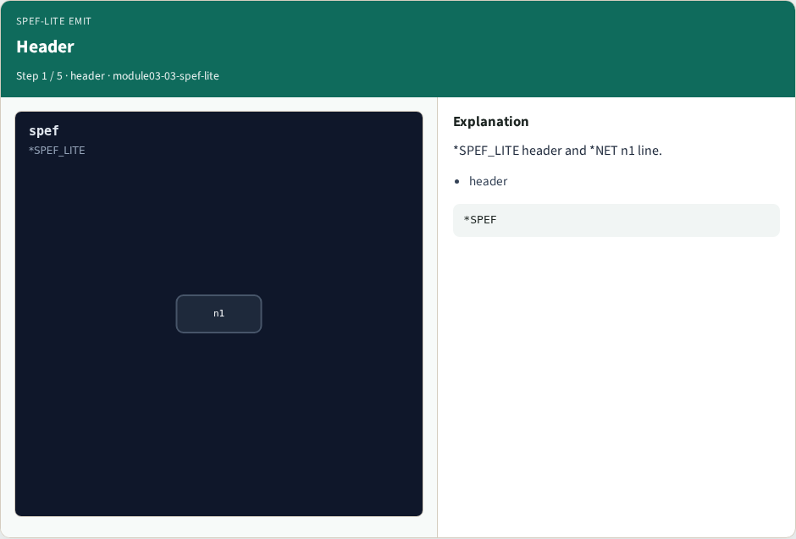
Header
Header
learn_pex — 03 spef lite
Notes:
*SPEF_LITE header and *NET n1 line.

Slide 4

RES
RES
learn_pex — 03 spef lite
Notes:
One *RES in out 3.06 line.

Slide 5

CAP
CAP
learn_pex — 03 spef lite
Notes:
One *CAP out 1.376 line.

Slide 6

Counts
Counts
learn_pex — 03 spef lite
Notes:
res_count=1, cap_count=1.

Slide 7

Golden
Golden
learn_pex — 03 spef lite
Notes:
GOLDEN: 1 RES + 1 CAP.

Slide 8
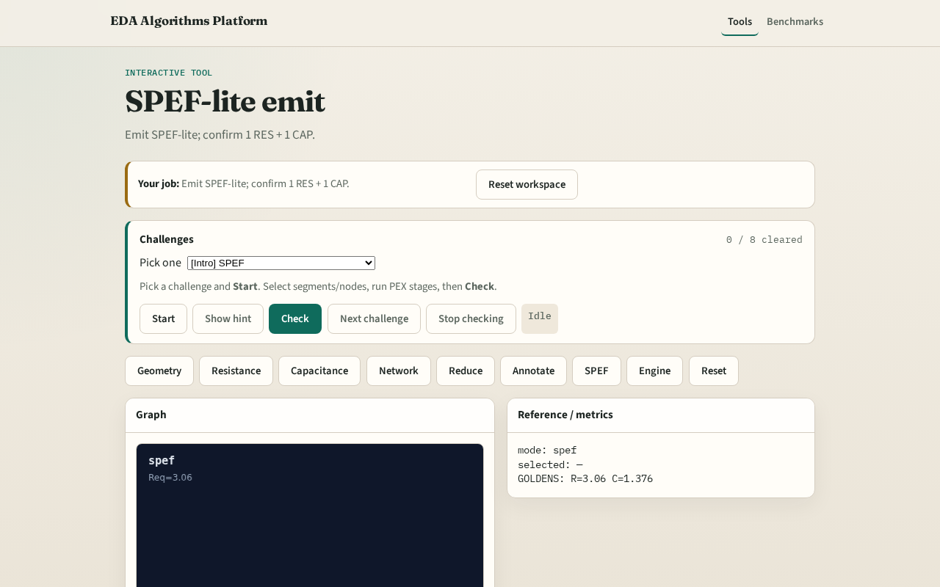
Browser lab track
Browser lab starter
learn_pex — 03 spef lite
Notes:
Open **spef-lite**. Run SPEF; confirm 1 RES + 1 CAP.

Slide 9
Implement track
Call emit_spef_lite(); assert res_count==1 and cap_count==1
learn_pex — 03 spef lite
Notes:
Call emit_spef_lite(); assert res_count==1 and cap_count==1.

Slide 10
Pitfalls
Emitting per-segment instead of reduced
Missing *NET line
learn_pex — 03 spef lite
Notes:
Emitting per-segment instead of reduced. Missing *NET line.

Slide 11
Your turn
Next: PEX engine integration
learn_pex — 03 spef lite
Notes:
Next: PEX engine integration.

